Slide 1
I hope that you are all well! We are missing you all and can’t wait to see you back at school!
This week we will be focusing on play script writing.
Day one – We will look at the features of play scripts and you will be asked to identify the features.
Day two – We will be editing and improving play scripts based on what we have learnt about the features.
Day three – We will be creating our own play scripts using a checklist to guide our writing.
Day four – We will be editing our play scripts. We will focus on the key features of a play script as well as punctuation, grammar and spelling.
Day five – We will be completing a SPAG activity focusing on adverbs.

Slide 2
W.B. 11.5.20 Day one
Miss Tidman’s Literacy group

Slide 4
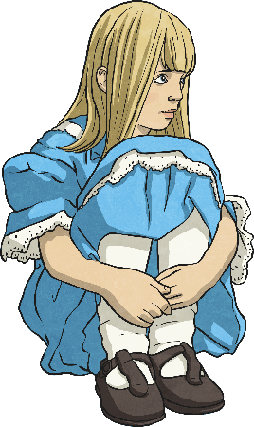
Features of a Play Script: Character List
Characters Alice In Wonderland
Alice
The main character – A young girl who is lost in Wonderland. Has a great imagination.
The Mad Hatter
As the name suggests, he is ‘crazy’. He gives out riddles, dresses fashionably and likes tea.
Hare
A friend of the Mad Hatter, thinks it is always time for afternoon tea, is also mad.
Dormouse
Incredibly sleepy friend of the Mad Hatter.
At the beginning of a play script, you’ll find a list of all the characters that are in the play.
Sometimes they will have a short description with them.
How might this help someone who wanted to perform the play?
This tells people what the characters are like before reading the play.
Why do you think this is?
This helps anyone who wants to perform the play know how many actors they need.

Slide 5
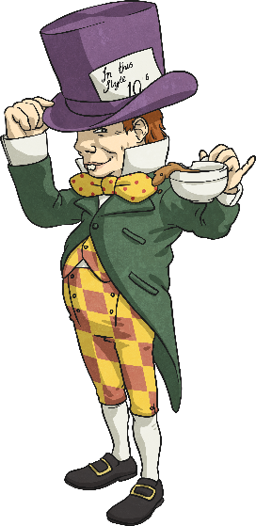
Features of a Play Script: Scene Number, Title and Setting Description
A bit like chapters in a book, the sections of a script are broken down into ‘scenes’. A new scene usually means a new setting.
Scene 7 – A Mad Tea Party
The Mad Hatter, Dormouse and Hare are sitting at a table having afternoon tea.
Just after the scene number and title is a short description of the setting. This tells you what the stage looks like.

Slide 6
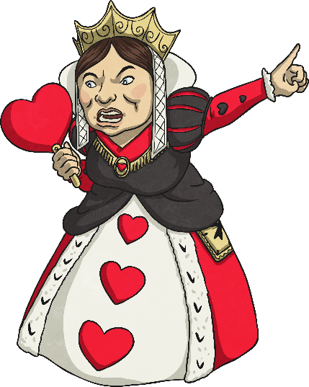
Features of a Play Script: Speaker Name, Colon and Dialogue
A colon always comes after the name.
Queen of Hearts:
Guards! Get her! Off with her head! Off with her head!
In a script, the name of the character who is speaking goes on the left.
After the colon is the dialogue (the words the character says).
How is this different to writing speech in a story?
No inverted commas!

Slide 7
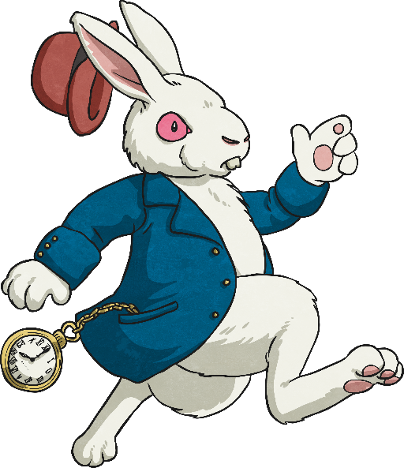
Features of a Play Script: Stage Directions
Words in brackets are stage directions. These are instructions to the actors so they know what their character should be doing.
White Rabbit:
Alice:
(anxiously, whilst rushing across the stage) I’m late! I’m late!
(confused) A talking rabbit? It can’t be…
Sometimes they tell the actor how to say their words.
The actors don’t say the stage directions.

Slide 8
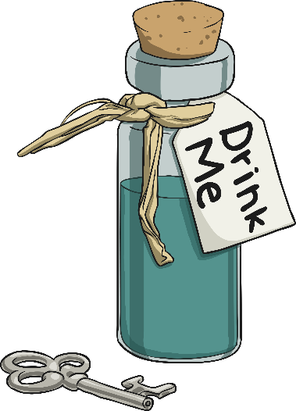
Features of a Play Script: Stage Directions and Narrators
Some plays have a narrator to help set the scene for the audience, but lots of plays don’t.
Narrator:
Alice found herself in a strange room, inside was a small table. On top of it, sat a small, peculiar-looking bottle with a label on.
(Alice looks around, confused, then goes over to the table and studies the bottle.)
Stage directions can be given to any character, not just the ones speaking. They are always written in present tense.

Slide 9
Can you find the play script features in the text here?
Scene number and title
Scene 7 – A Mad Tea Party
The Mad Hatter, Dormouse and Hare are sitting at a table having afternoon tea.
Lost and lonely, Alice continued towards the sound. She didn’t know what to expect when she reached a clearing…
(Alice enters the scene, stage left)
(starts for a moment, pauses and a broad grin appears across his face. He gets up out of his chair and walks across the table towards Alice)
(exasperated)
(gasps and throws his hands against his head)
You’re absolutely Alice, I’d know you anywhere.
(to the rest of the characters at the table)
I’d know him anywhere!
(Dormouse and Hare laugh manically)
Well, as you can see we’re still having tea.
You’re terribly late you know… naughty.
I’m incredibly intrigued.
Narrator:
Mad Hatter:
Dormouse:
Hare:
Mad hatter:
Alice:
Setting description
Speaker’s name, followed by a colon (:)
It’s you.
No it’s not! Hare brought us the wrong Alice!
It’s the wrong Alice!
Stage directions in brackets
Speech – without inverted commas!
click the different features to show the answers
Present tense

Slide 10
Now you know the features…
Your task is to read through the play script and identify as many features as you possibly can.
You could print the play script off and highlight different features or just get an adult to check you have spotted them all online.
The play script is saved as a separate file.

Slide 11
W.B. 11.5.20 Day two
Miss Tidman’s Literacy group

Slide 12
Editing a play script
Look back at the features that you identified from Day one.
Use the following checklist to help you.
Can you identify any features that are missing?
You need to add these into the play script to ensure it is amazing!

Slide 13
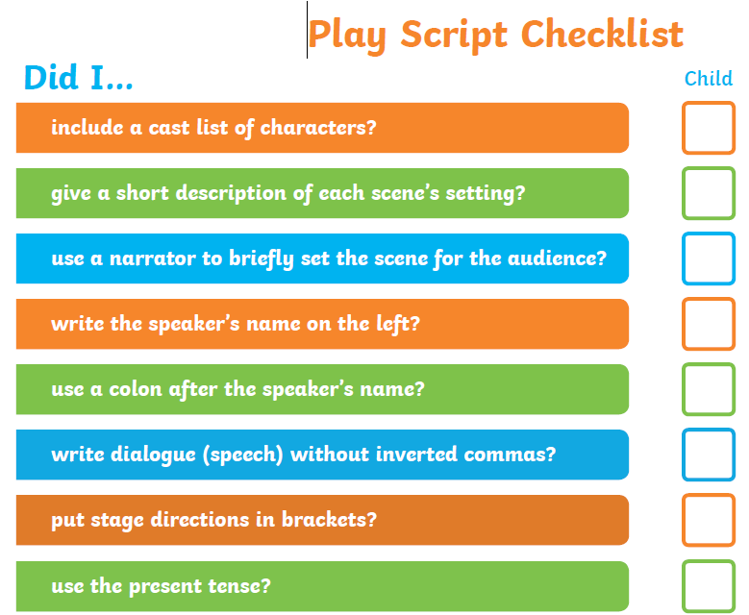

Slide 14
Challenges
Use the checklist to identify the features that are missing from the play script and add them in.
Can you create your own checklist of features for a play script? Use what you learnt from day one to identify the missing features from the play script and add them in.
Re-write the play script adding in the missing features and up-levelling the vocabulary choices. Use the checklist to support you

Slide 15
W.B. 11.5.20 Day three
Miss Tidman’s Literacy group

Slide 16
Writing a play script
Now that we have had two days to look at the features of a play script – you should be super star play script writers!
We are going to read through a story together. Then look at how we can begin to use our checklist from day two to re-write the story as a play script.

Slide 17
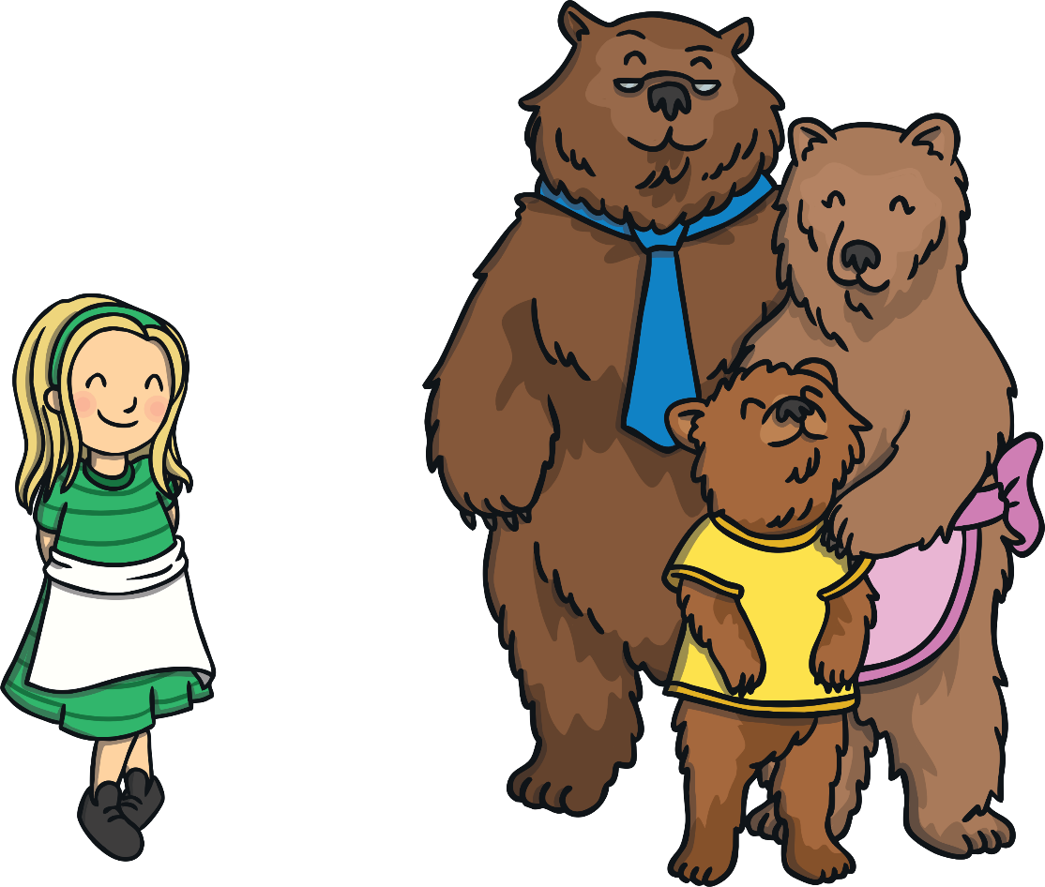
Once upon a time lived Goldilocks and The Three Bears.

Slide 18
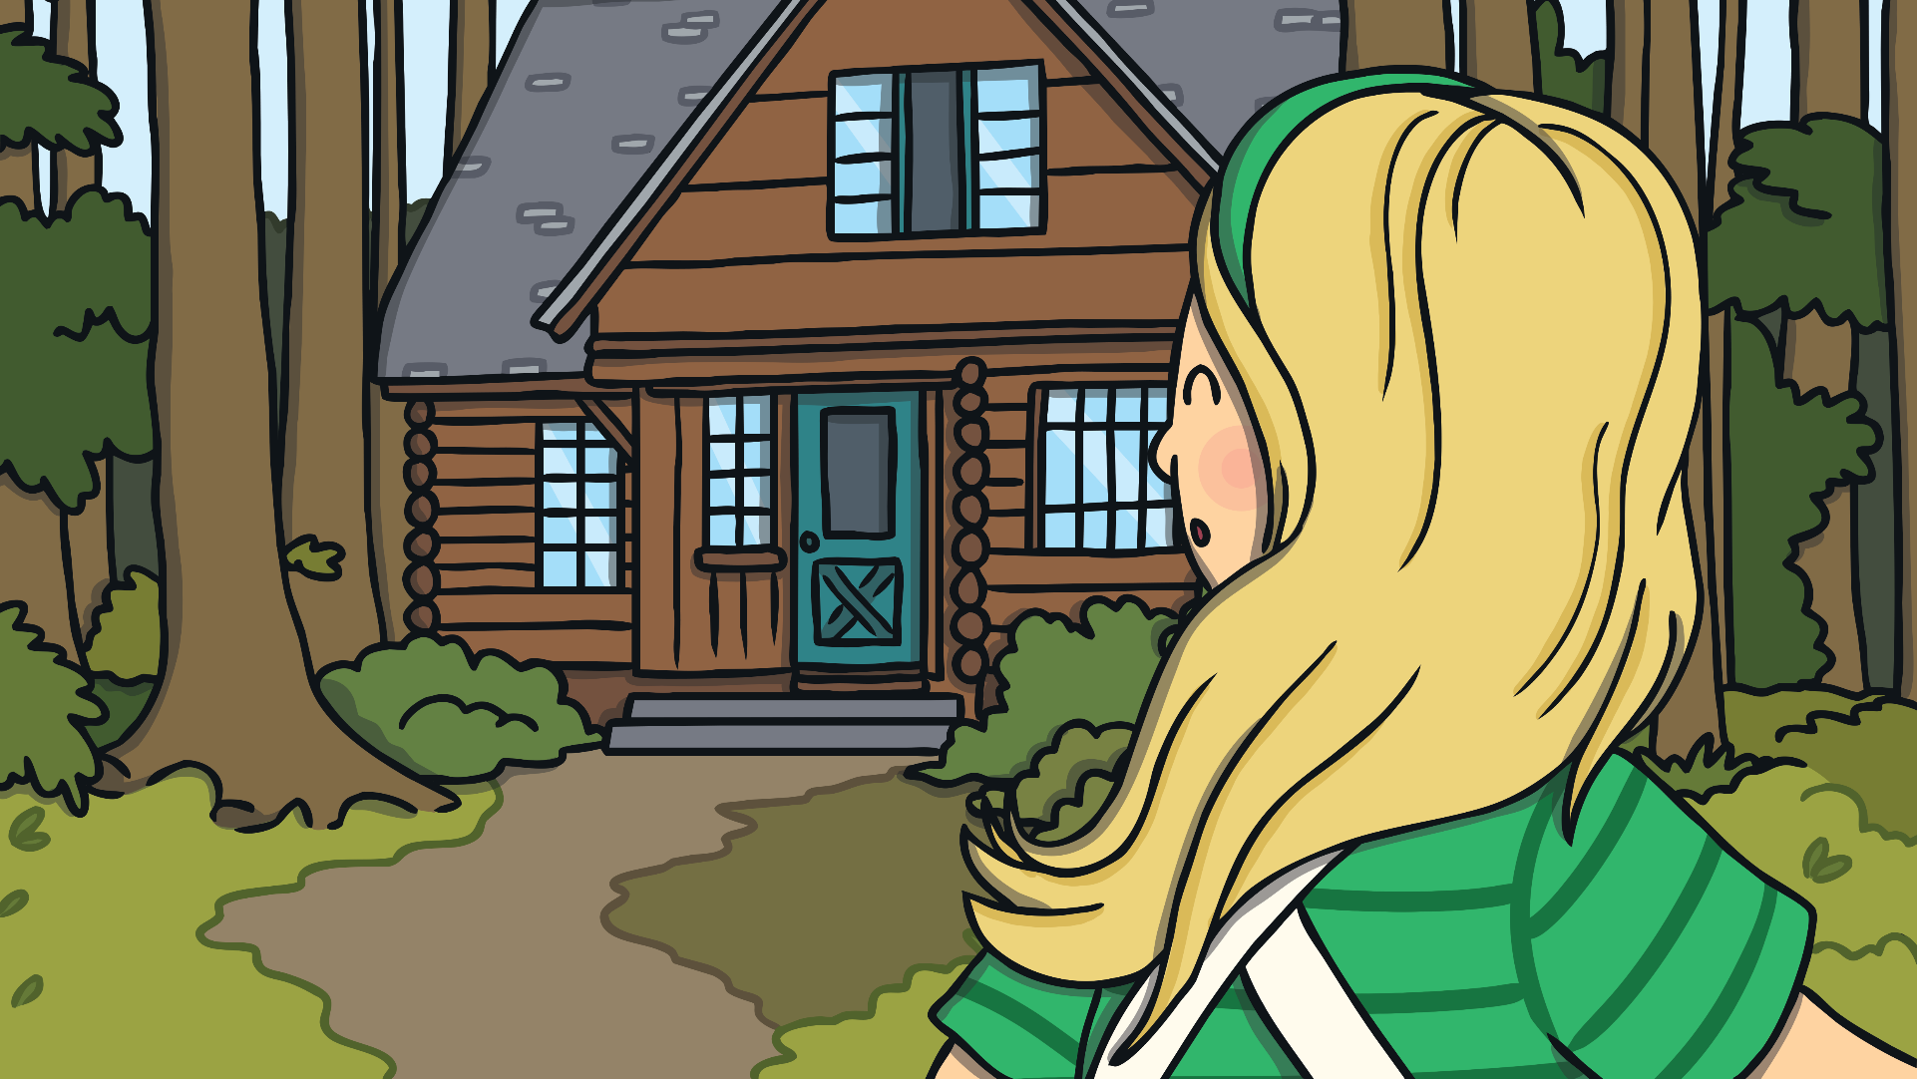
One day, Goldilocks went for a walk in the forest and found a house. She knocked, and when nobody answered, she decided to go inside.

Slide 19
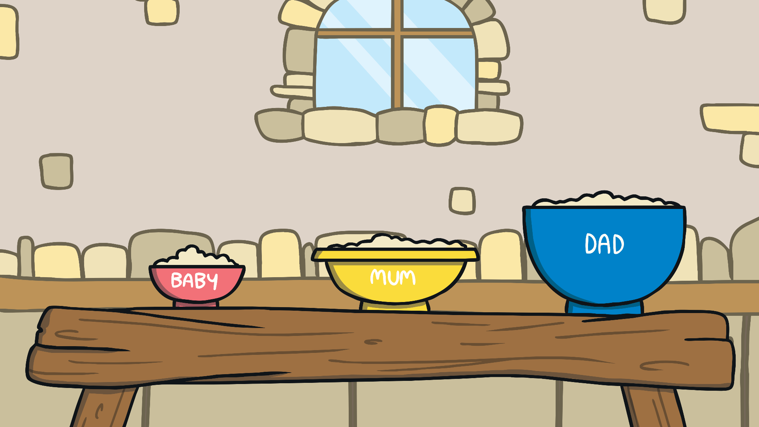
At the table, there were three bowls of porridge. Goldilocks was hungry.

Slide 20
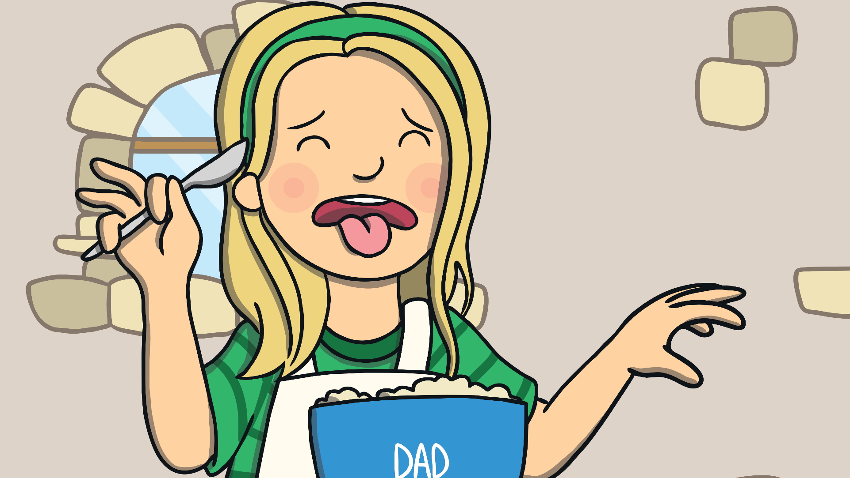
She tasted the porridge from the large bowl. “This porridge is too salty!” she said.

Slide 21
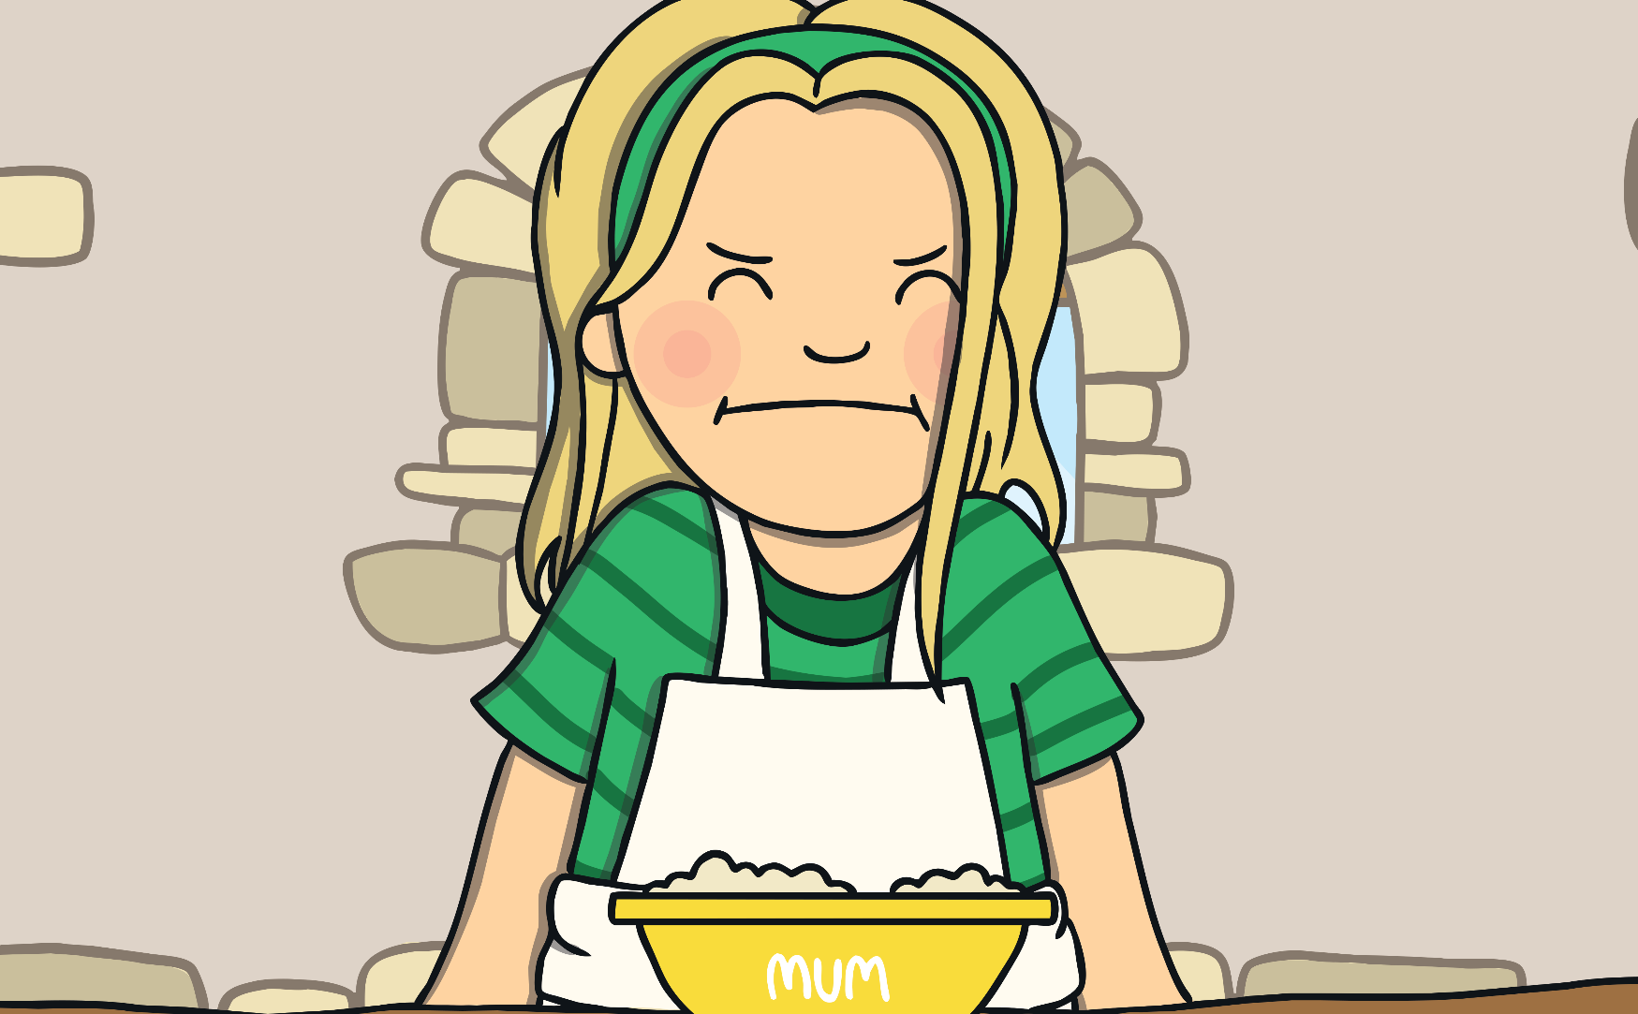
She tasted the porridge from the medium sized bowl. “This porridge is too sweet!” she said.

Slide 22
She tasted the porridge from the small bowl. “This porridge is just right,” she said and she ate it all up.

Slide 23
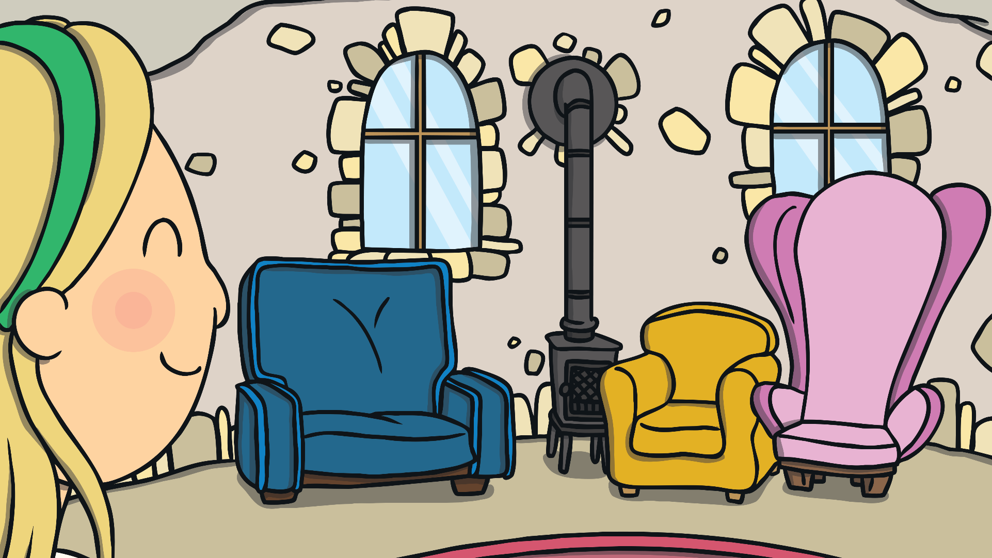
Goldilocks felt tired, so she walked into the living room and saw three chairs.

Slide 24
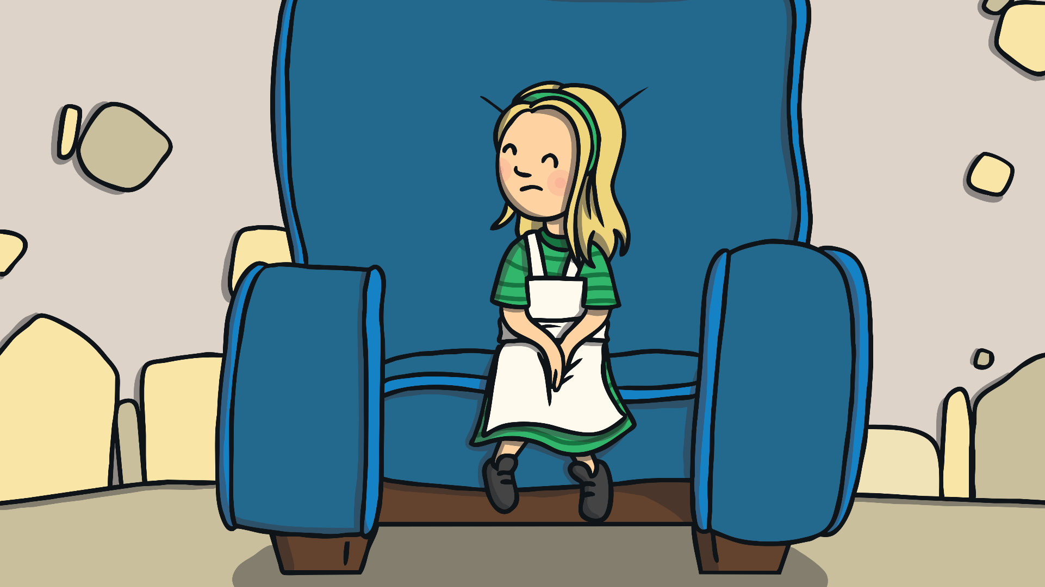
She sat in the large chair to rest her feet. “This chair is too big!” she said.

Slide 25
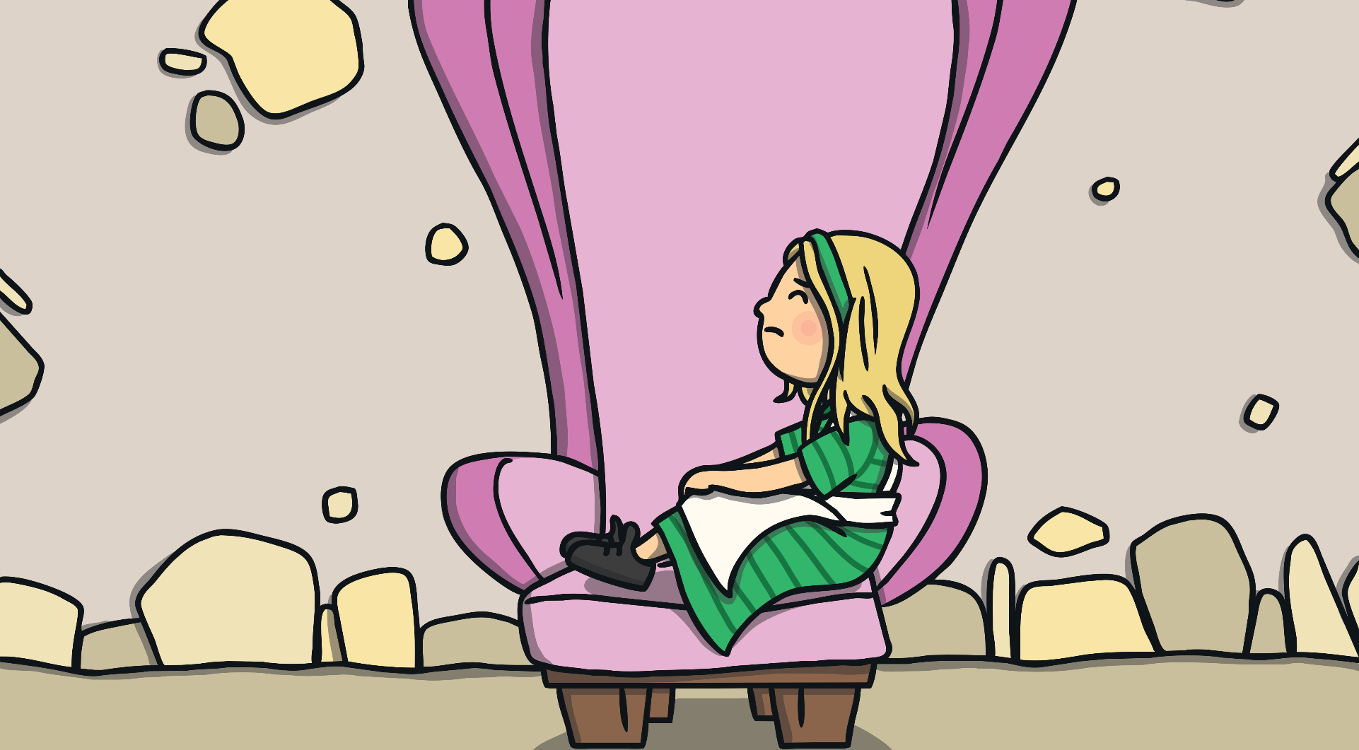
She sat in the medium sized chair. “This chair is too big, too!” she said.

Slide 26
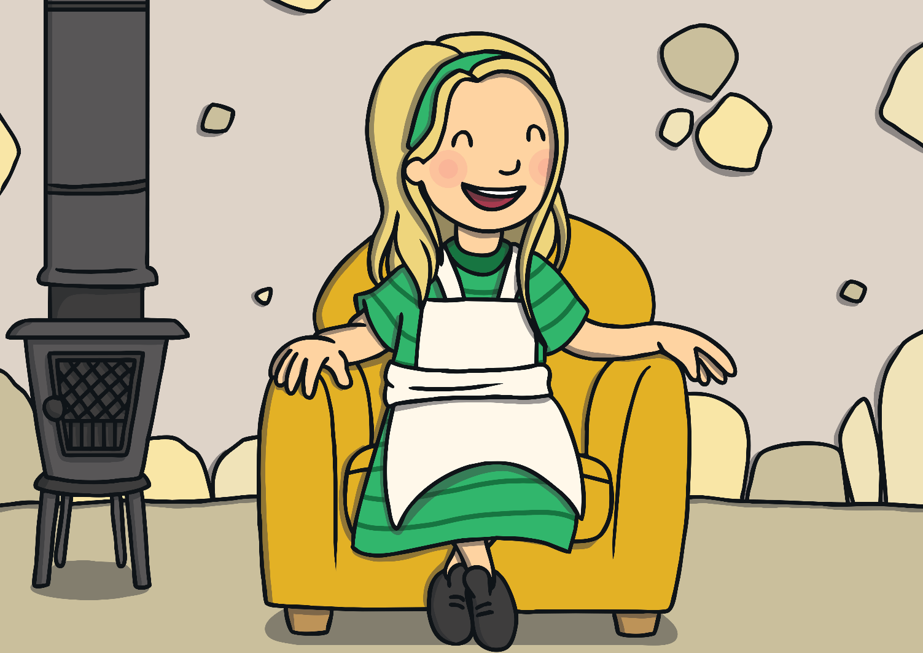
She sat in the small chair. “This chair is just right,” she sighed.

Slide 27
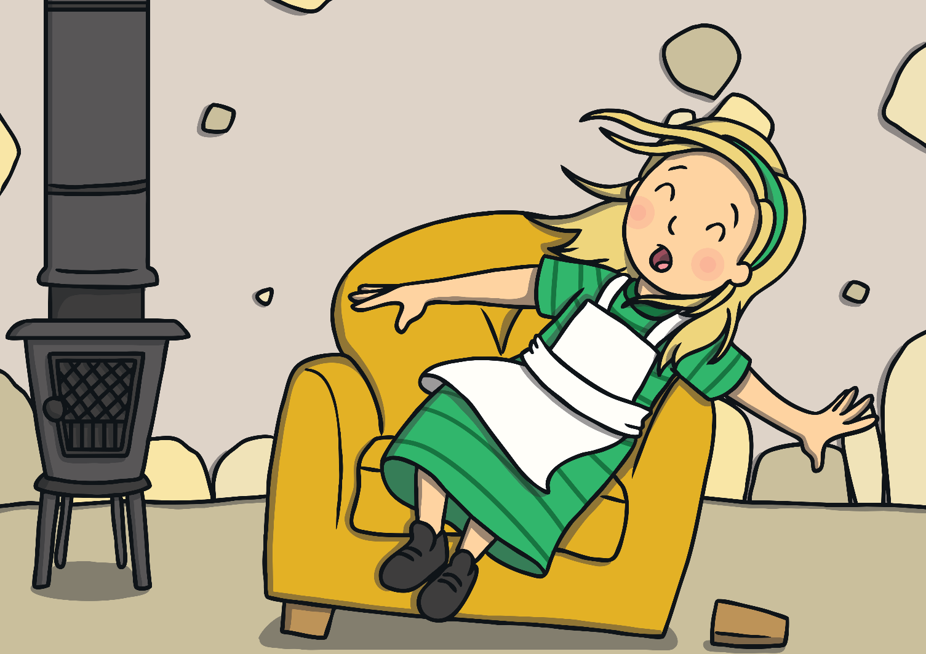
Just as Goldilocks settled down into the chair to rest, it broke into pieces!

Slide 28
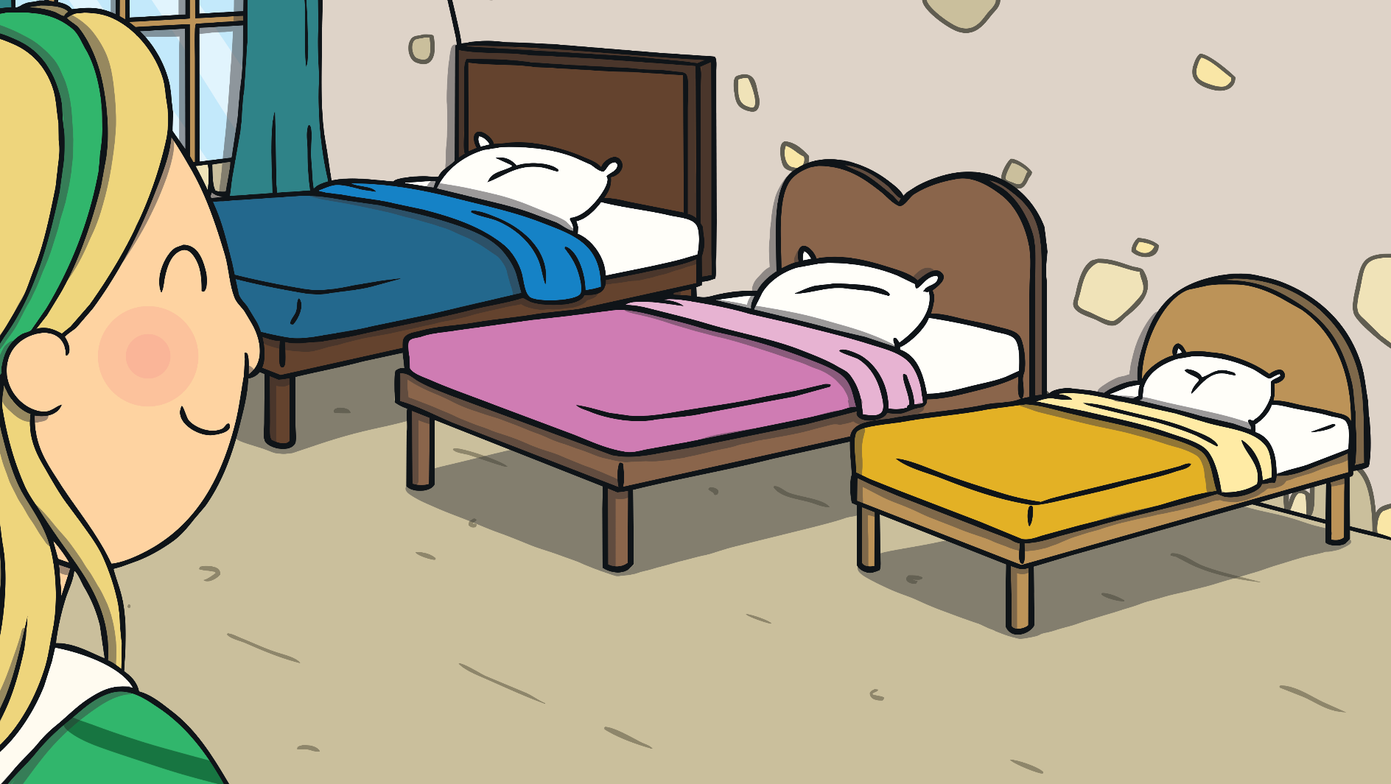
By now, Goldilocks was very tired, so she went upstairs to the bedroom.

Slide 29
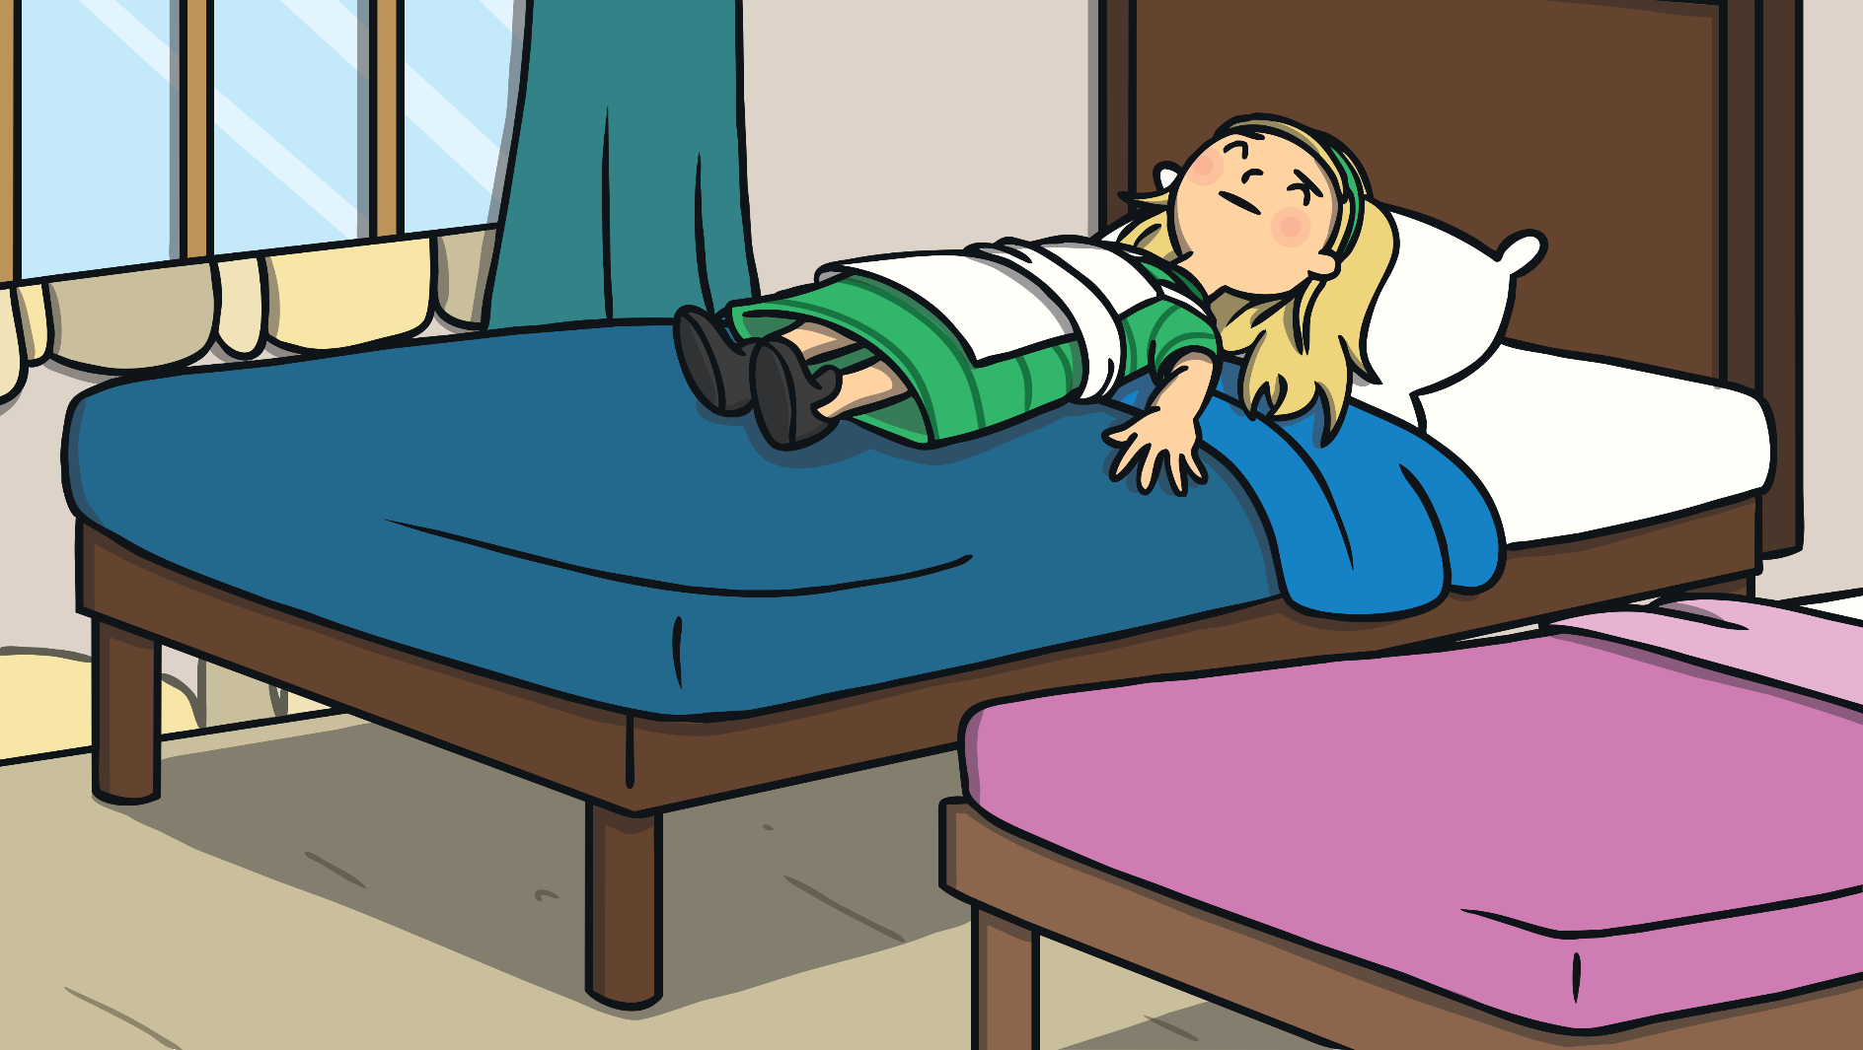
She lay down on the large bed. “This bed is too hard!” she said.

Slide 30
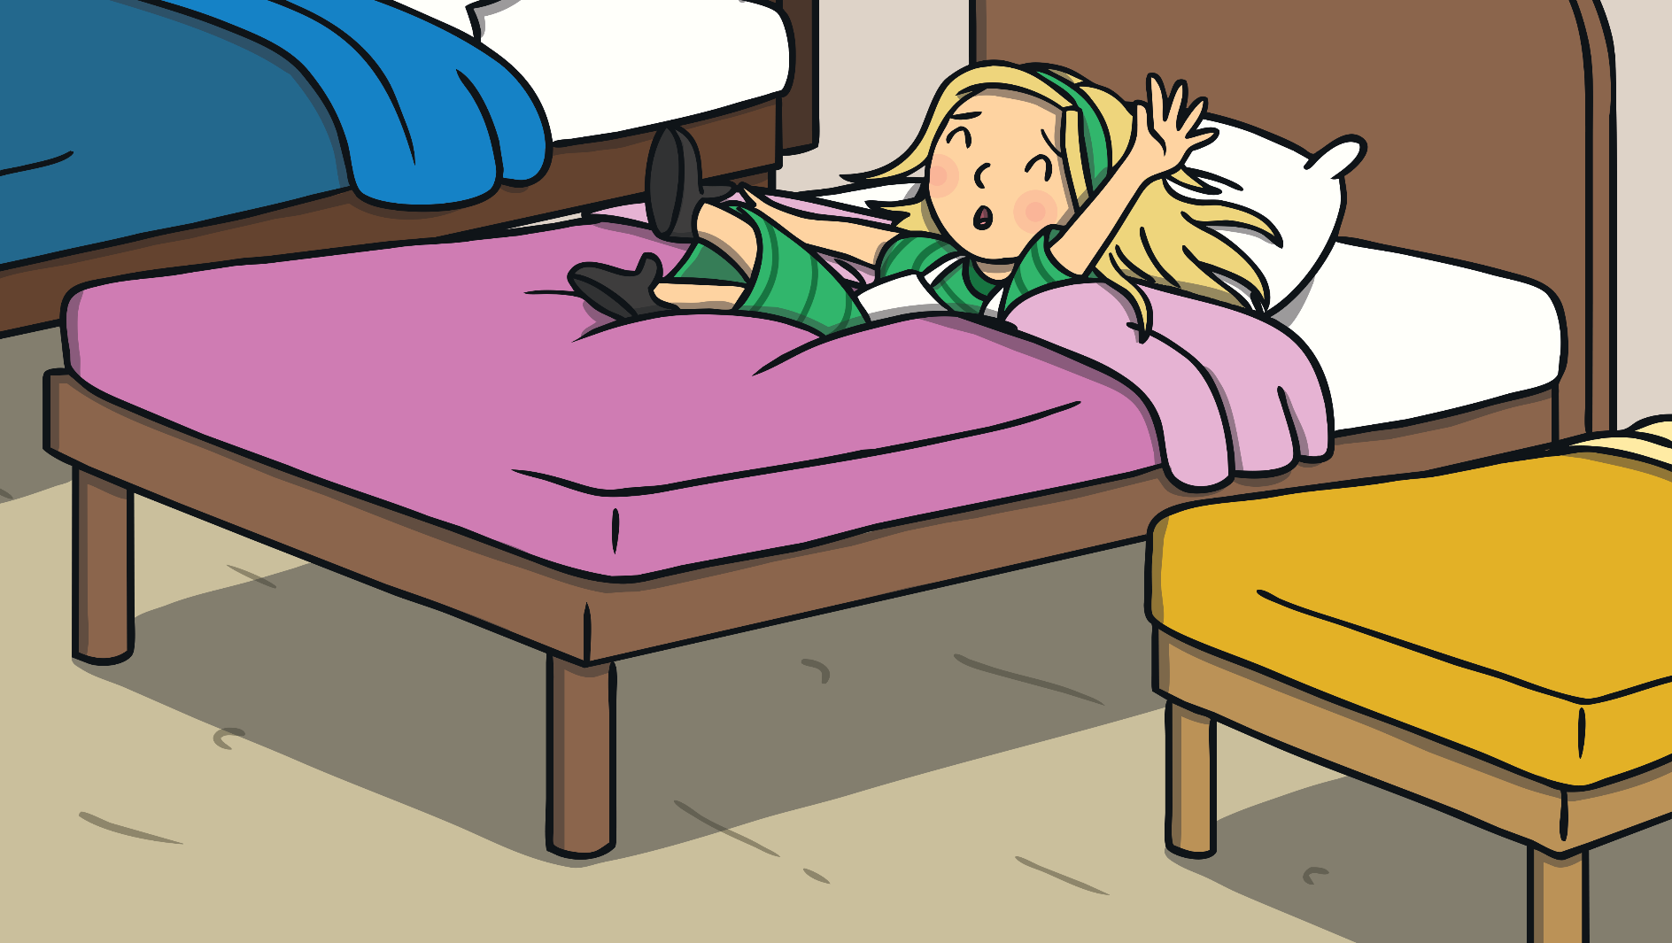
She lay down on the medium sized bed. "This bed is too soft!" she said.

Slide 31
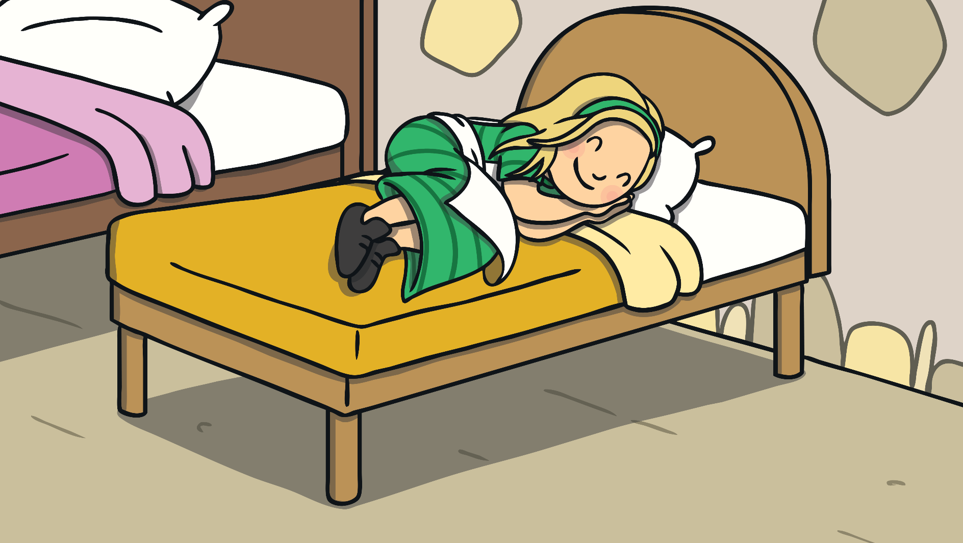
She lay down on the small bed. "This bed is just right," she sighed. She curled up and fell asleep.

Slide 32
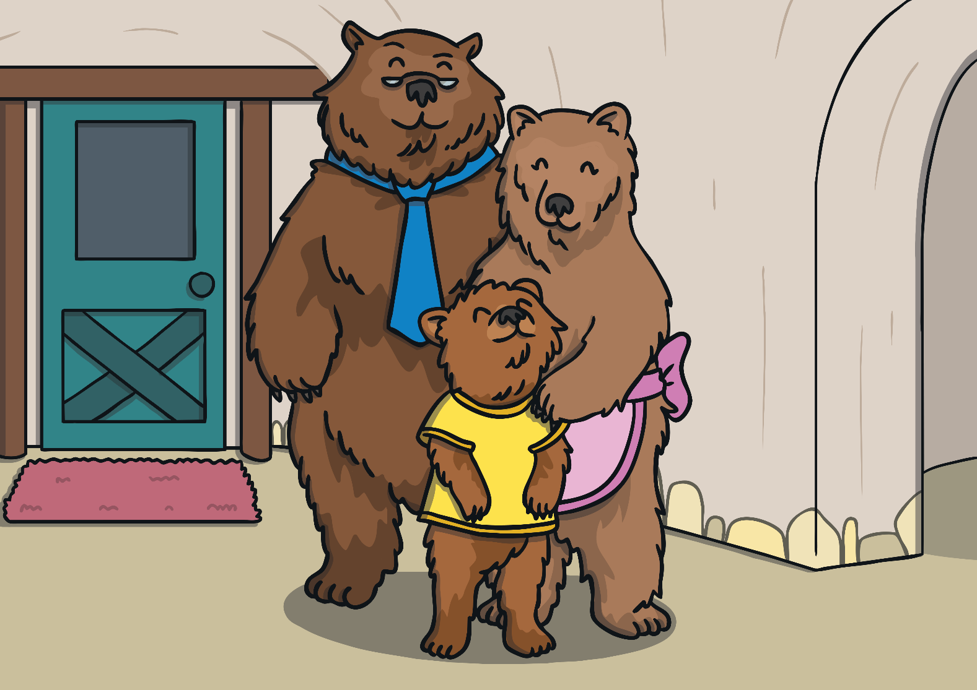
As she was sleeping, The Three Bears came home.

Slide 33
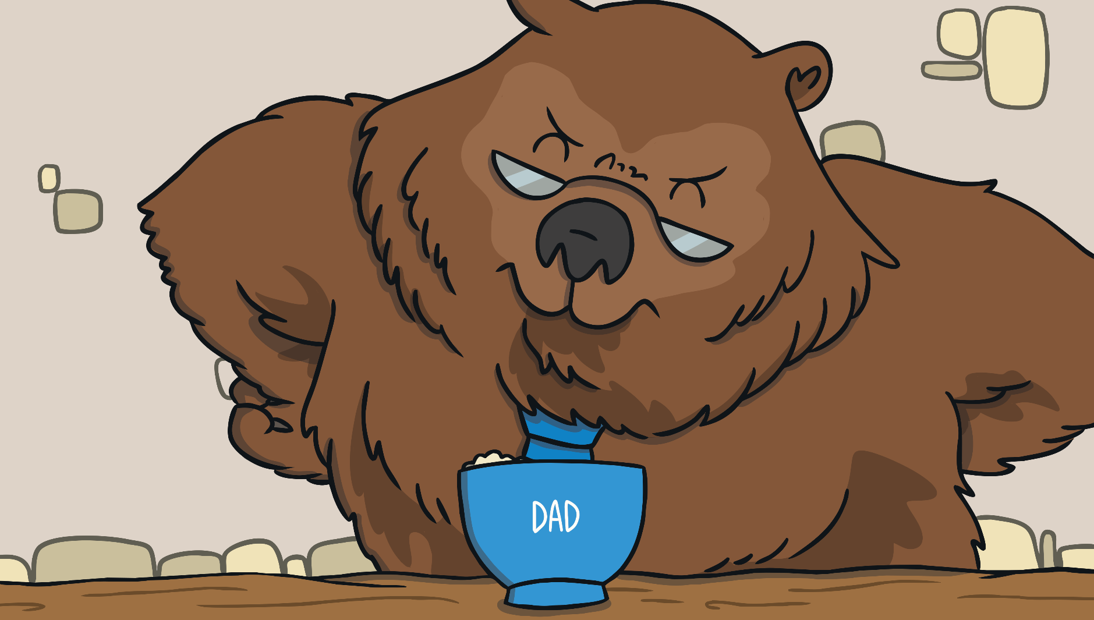
“Someone’s been eating my porridge,” growled Daddy Bear.

Slide 34
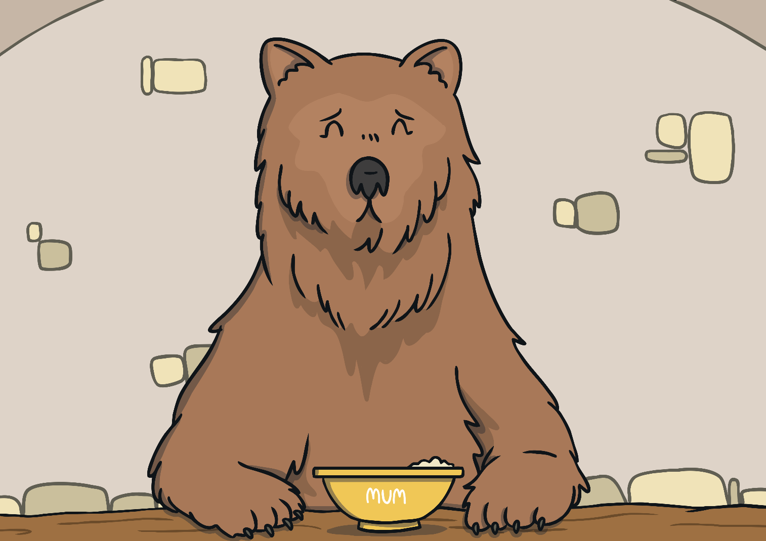
“Someone’s been eating my porridge,” said Mummy Bear.

Slide 35
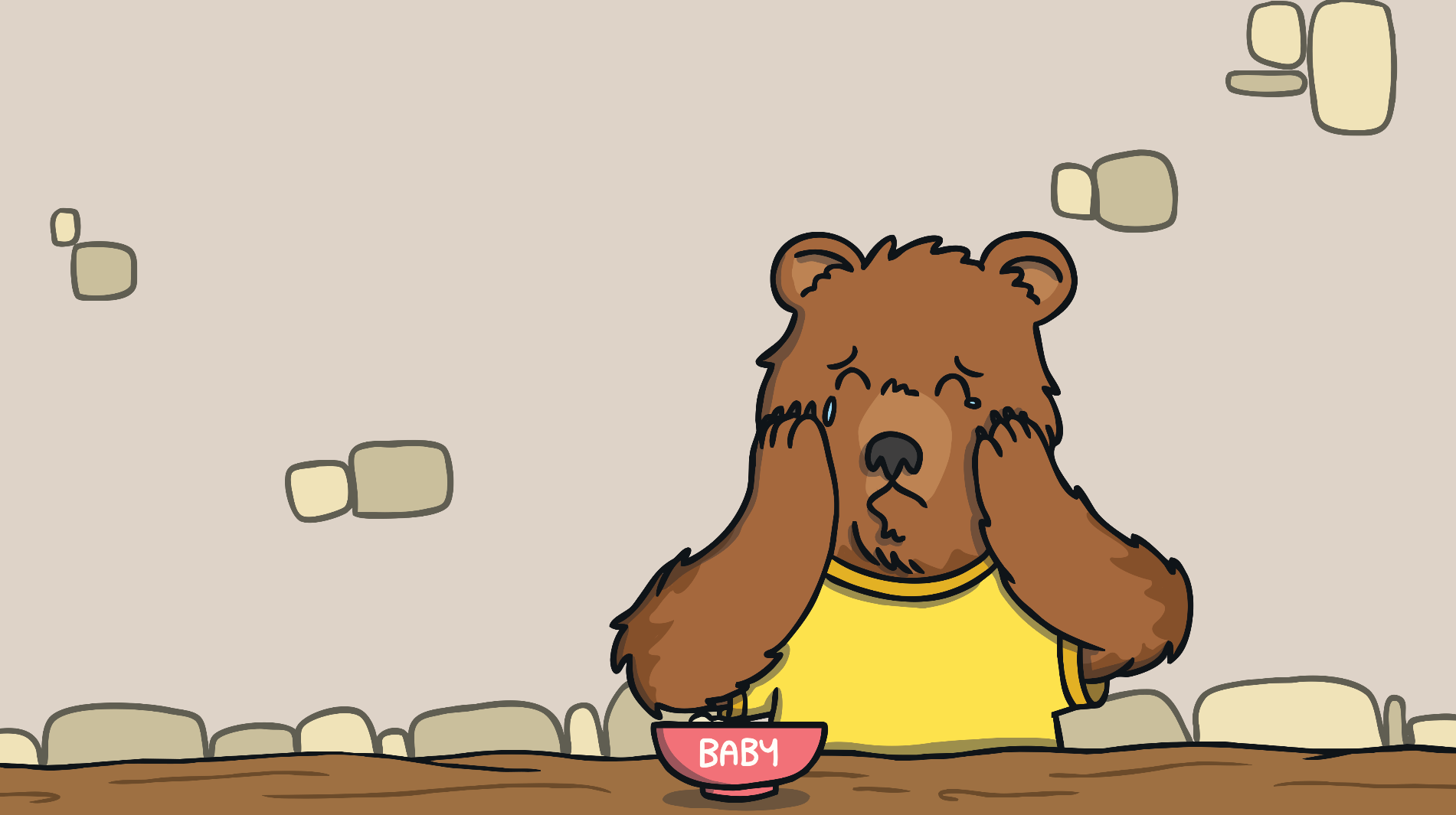
“Someone’s been eating my porridge and it’s all gone!” cried Baby Bear.

Slide 36
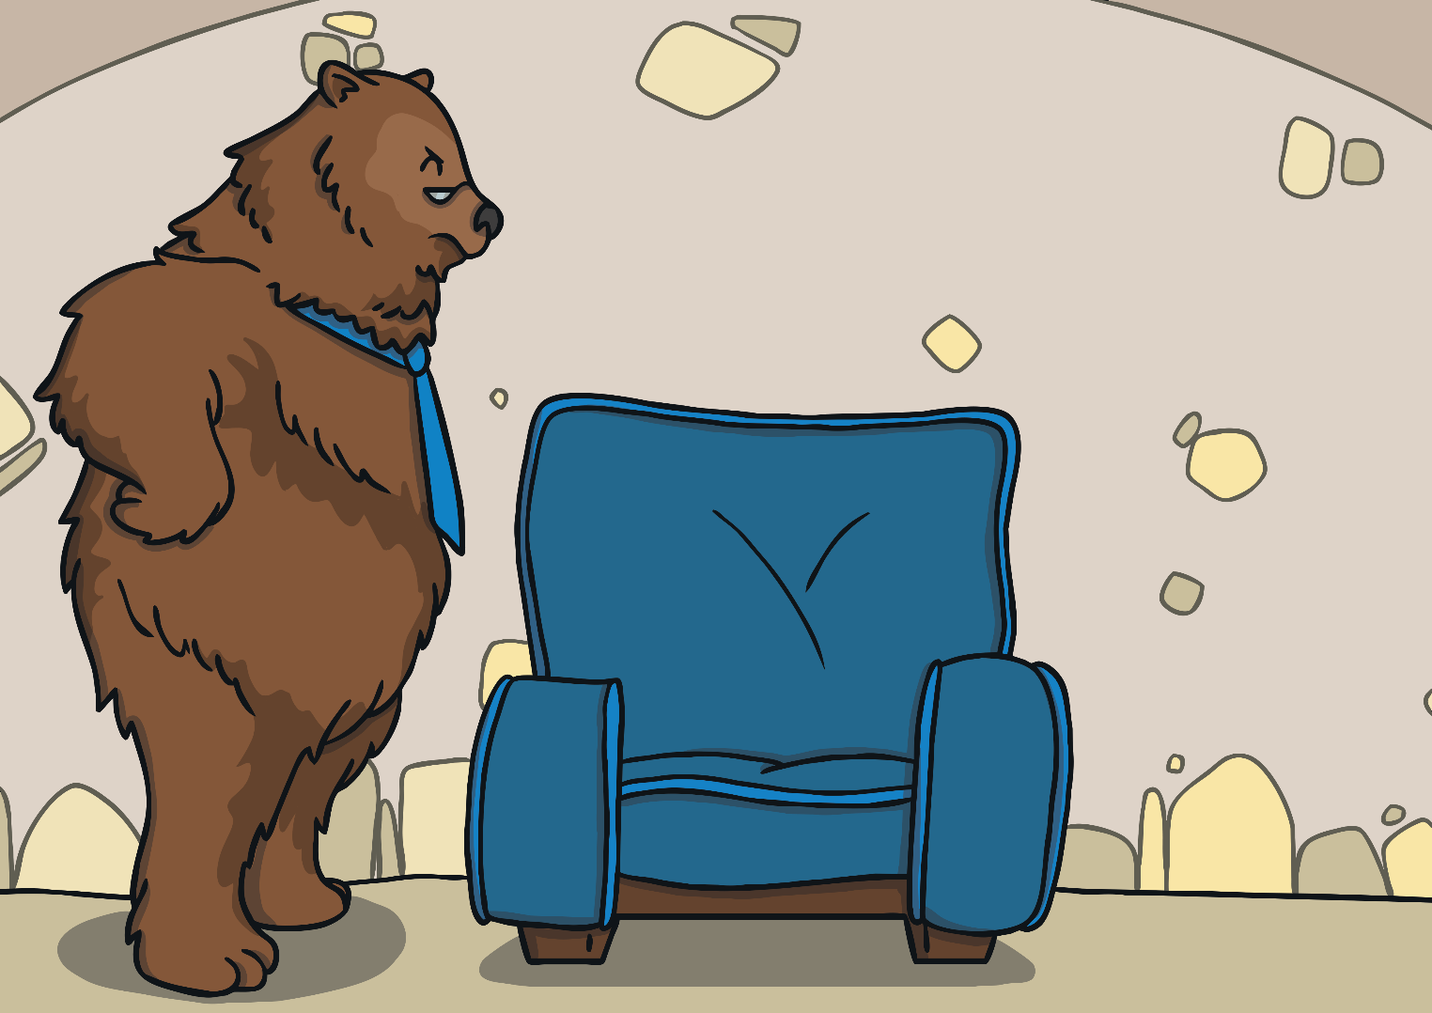
“Someone’s been sitting in my chair!” growled Daddy Bear.

Slide 37
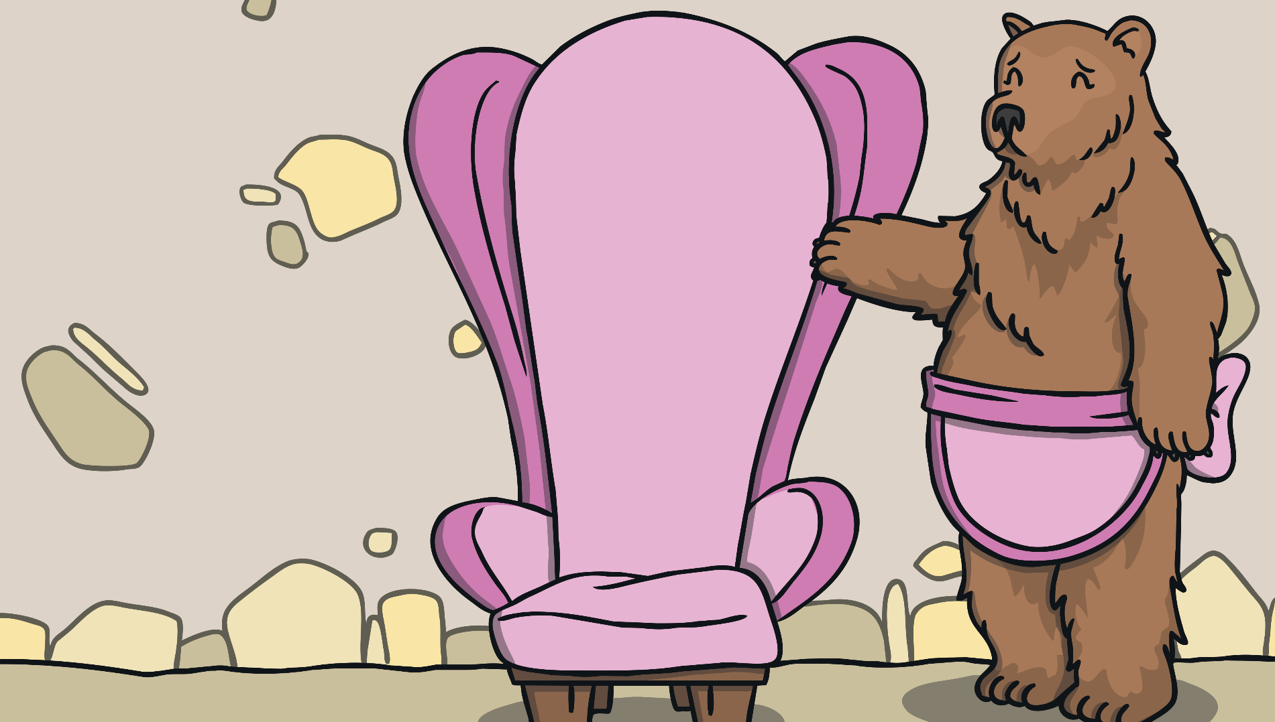
“Someone’s been sitting in my chair!” said Mummy Bear.

Slide 38
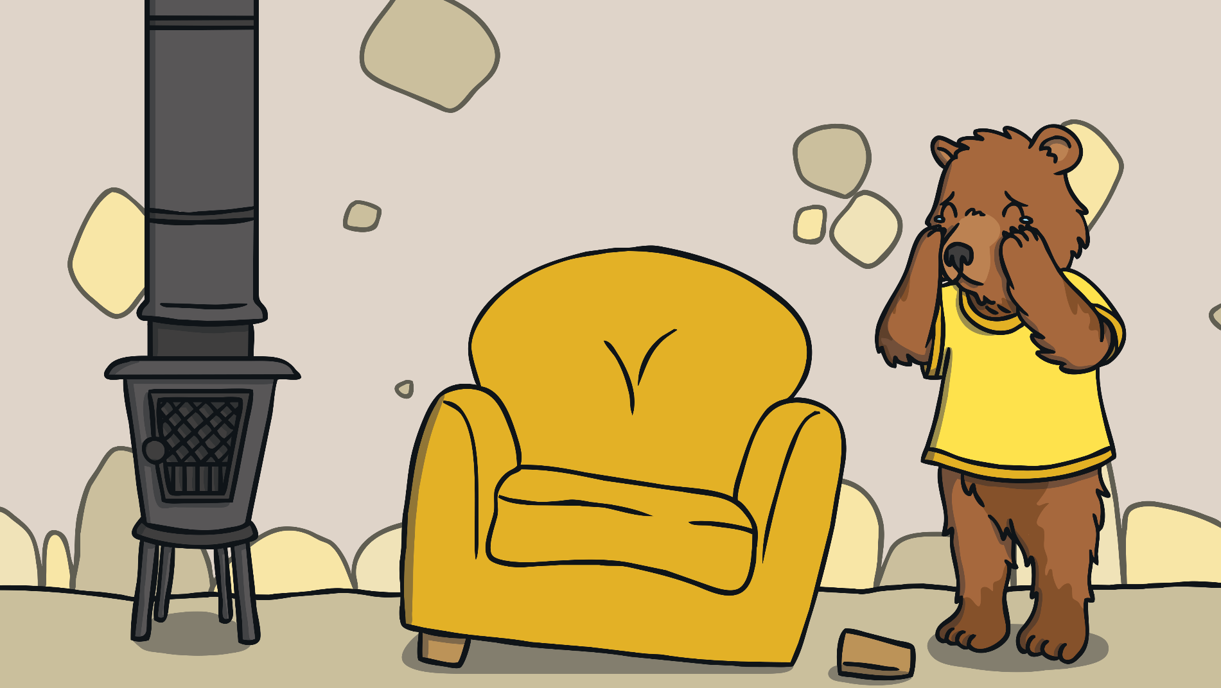
“Someone’s been sitting in my chair and it’s broken!” cried Baby Bear.

Slide 39
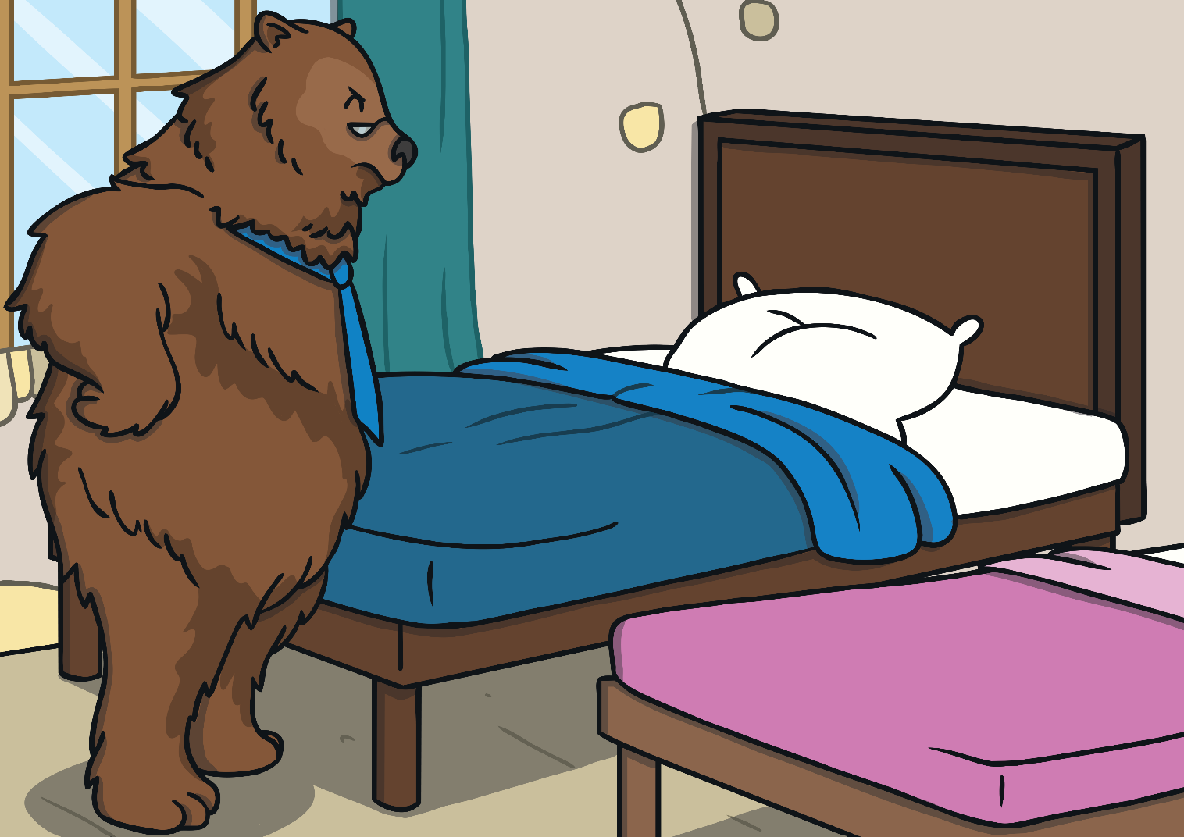
When they got upstairs to the bedroom, Daddy Bear growled, “Someone’s been sleeping on my bed.”

Slide 40
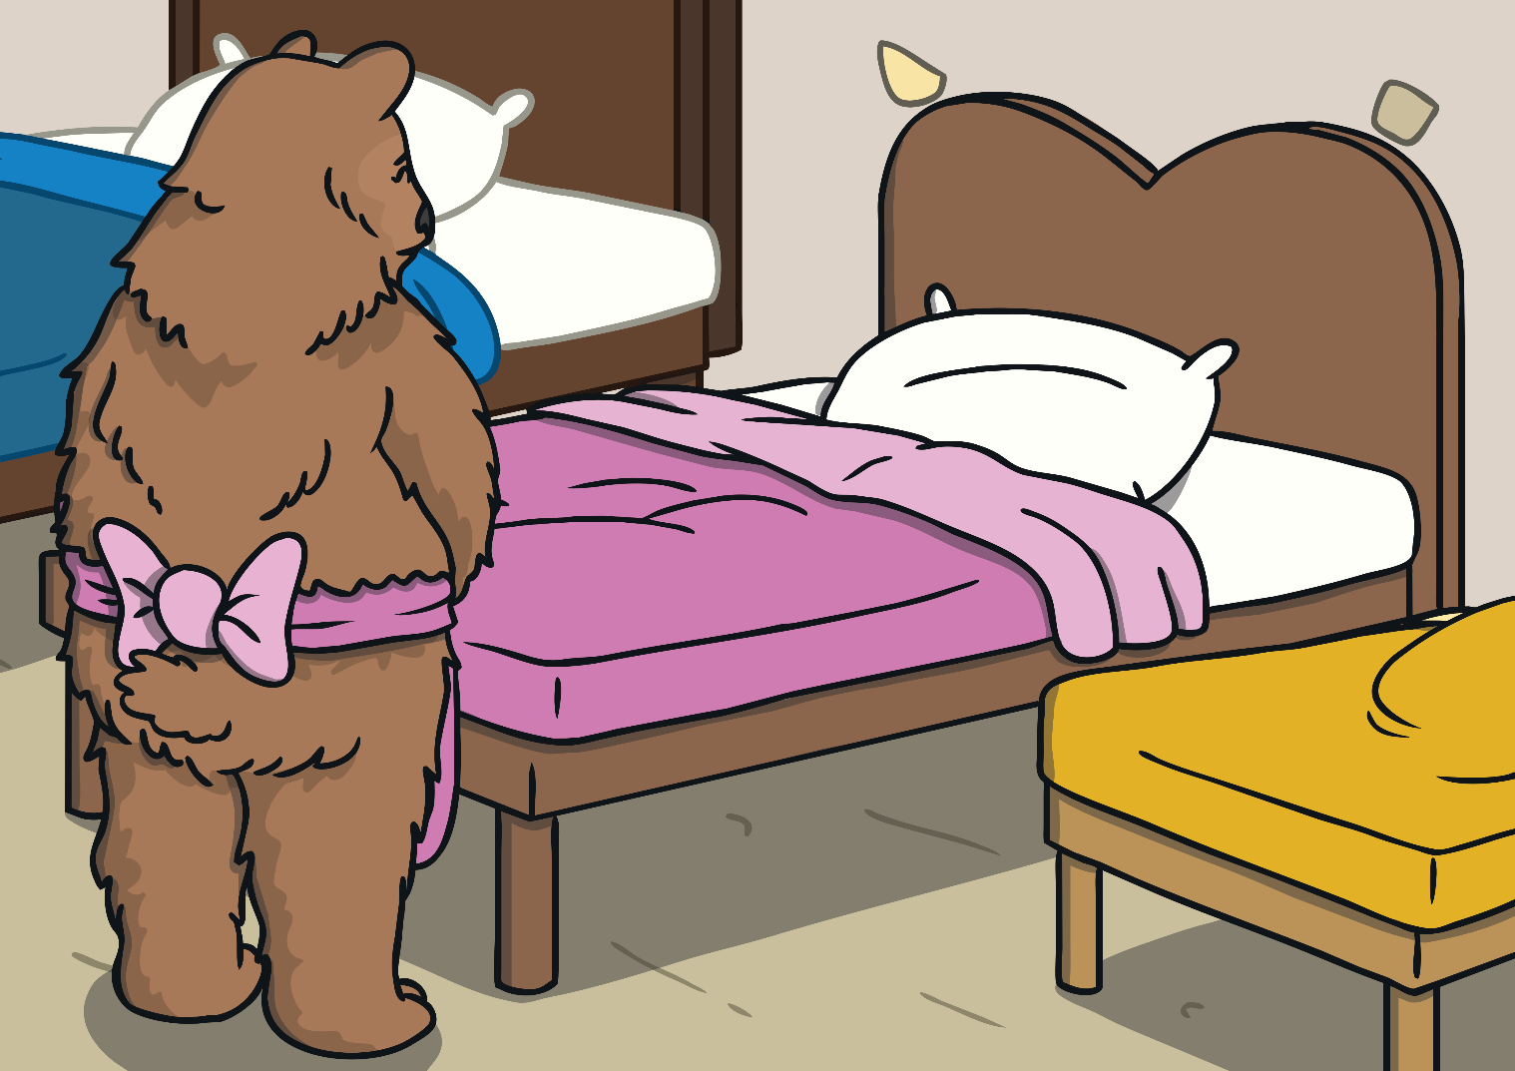
“Someone’s been sleeping on my bed too,” said the Mummy Bear

Slide 41
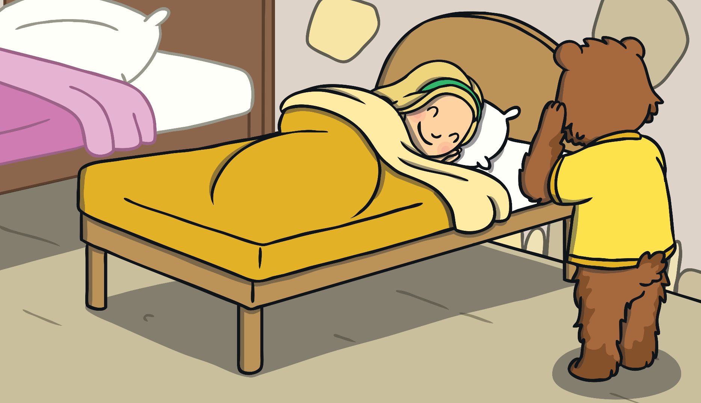
“Someone’s been sleeping in my bed, and she’s still there!” cried Baby Bear.

Slide 42
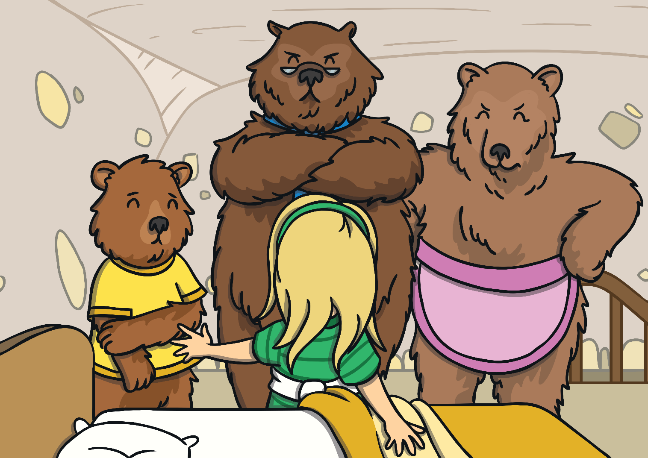
Just then Goldilocks woke up and saw The Three Bears. “Help!” she screamed.

Slide 43
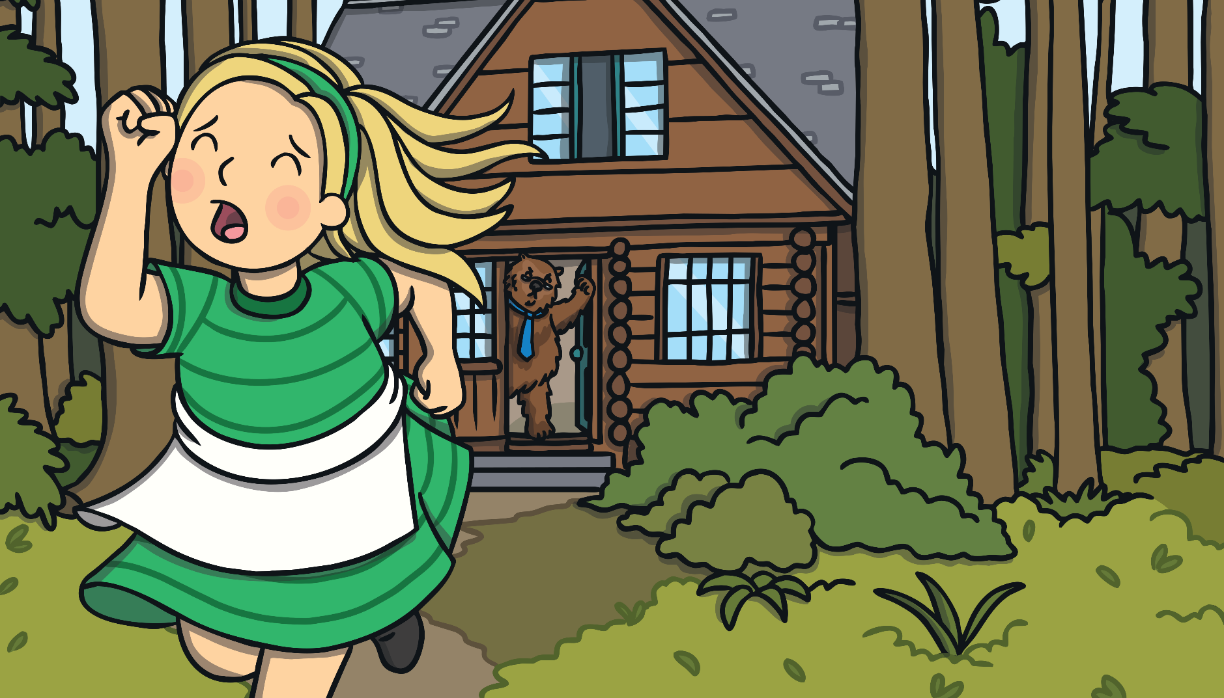
Goldilocks ran down the stairs and into the forest. And she never went back into the woods again.

Slide 44
Now you need to turn this story of Goldilocks and the three bears into a play script. Use your checklists to help you. Challenges
Can you include the characters name on the left, use a colon (: ) after the name and speech without inverted commas? Don’t forget anything the character doesn’t say should be in brackets. You do not need to write ‘said Goldilocks.’
Same as one star.
Can you include stage directions in brackets where appropriate?
Same as one star and two star.
Can you include a brief description of how your character says their line. E.g. – calmly, angrily, shouting.

Slide 45
W.B. 11.5.20 Day four
Miss Tidman’s Literacy group

Slide 46
You need to have your play script from yesterday ready.
Today you need to edit and improve your ‘Goldilocks and the three bears’ play script.
Sometimes when we are writing we forget to go back and read what we have written. We need to do this to ensure quite a few things…
What we have written makes sense.
The features of that text type have been included.
Our writing is punctuated accurately and our spelling is correct.
To ensure we have made the best vocabulary choices.

Slide 47
Use the checklist to help edit your work…

Slide 48
Once you have edited your work to check that you have included all of the features of a play script, you also need to check your punctuation and spelling.
Remember you can look up words that you are unsure of the spelling for.
I am expecting to see a variety of the following punctuation in your play script…
Full stops
Capital letters
Colons
Brackets
Commas
Exclamation marks
Question marks

Slide 49
W.B. 11.5.20 Day five
Miss Tidman’s Literacy group

Slide 50
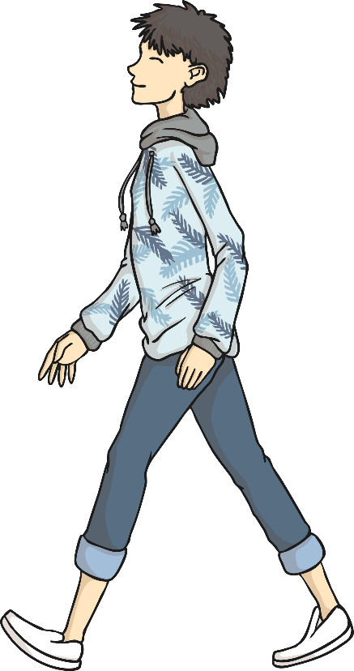
Verbs and Adverbs
An adverb is used to describe how, what, when, where and why a verb happens.
James walked quickly to the shops.
verb
adverb
This explains how James walked.
Who can mime (silently act) what James was doing?

Slide 51
Verbs and Adverbs
An adverb is used to describe how, what, when, where and why a verb happens.
Claire sipped her tea gently.
verb
adverb
This explains how Claire sipped.
Who can mime (silently act) what Claire did?

Slide 52
Verbs and Adverbs
An adverb is used to describe how, what, when, where and why a verb happens.
Gavin always rides his bike.
adverb
verb
This explains when Gavin rides.
Who can mime (silently act) what Gavin is doing?

Slide 53
Verbs and Adverbs
What are adverbs?
They are added to the verb to answer questions like…
How?
When?
Where?
Why?
They describe the way something happens.
They often end in –ly but not always!
Watch the clip to help you by clicking on the play button.

Slide 54
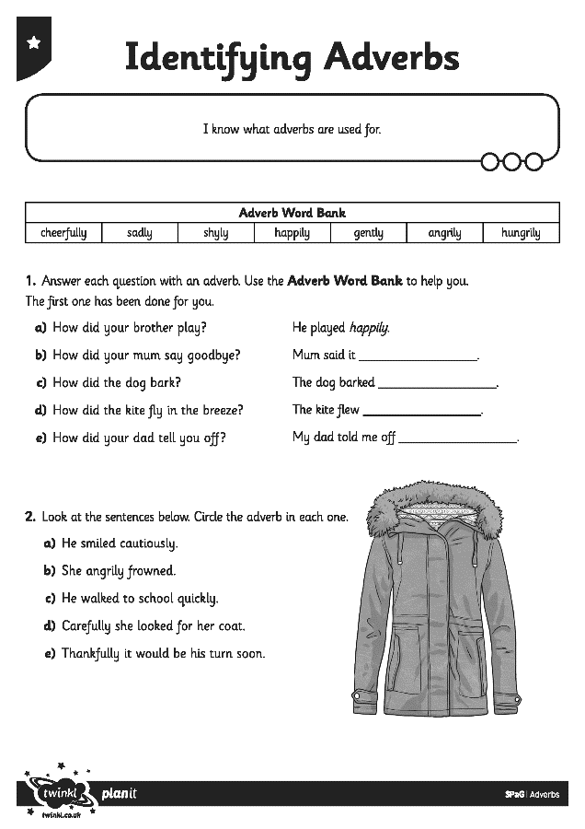
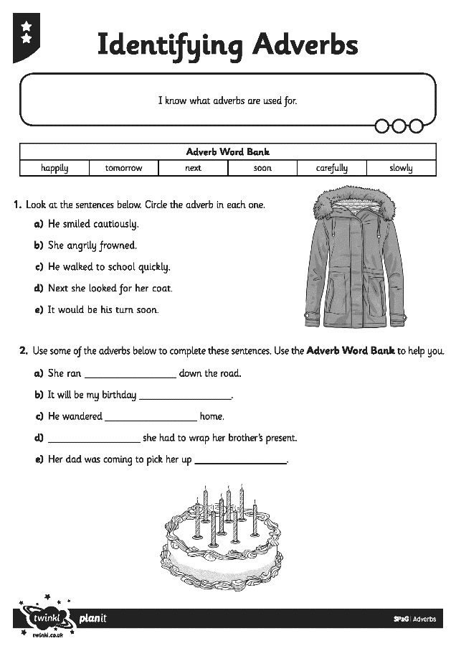
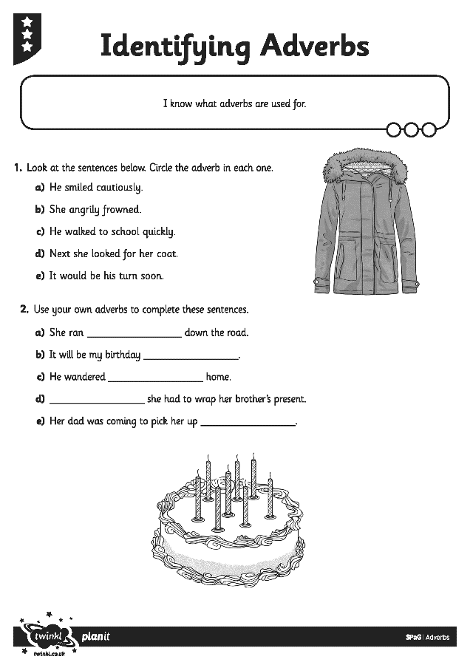
Identifying and Adding Adverbs
Work on your own to complete Identifying and Adding Adverbs Activity Sheet. Then have a go at the mini test.

