Slide 3
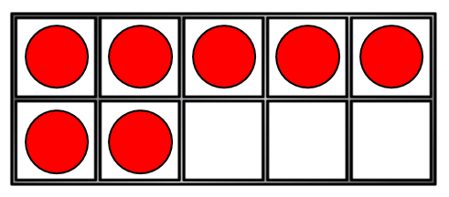
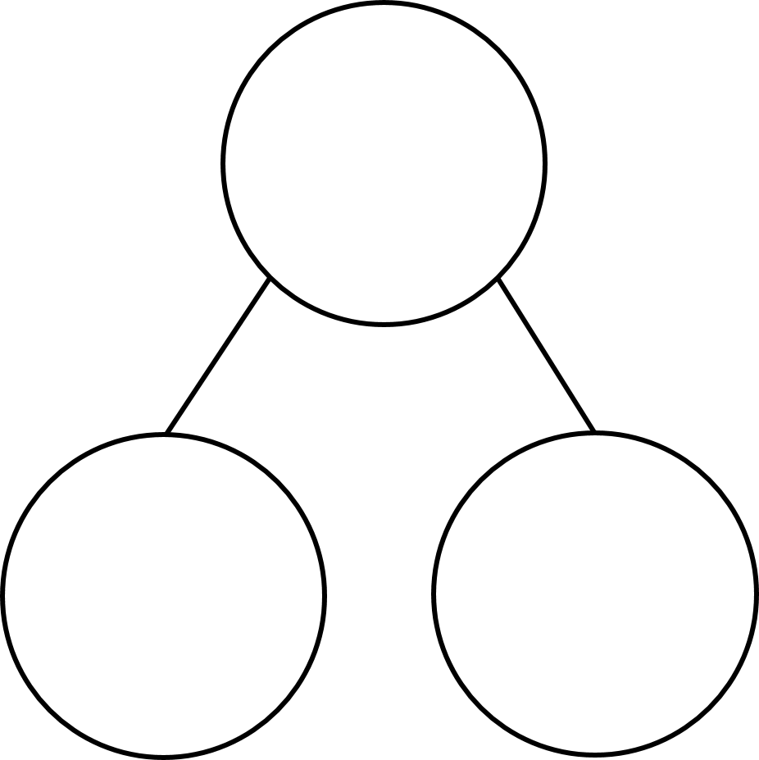
1) Count backwards from 4 to 0
2) What symbol is missing? 10 5 $=$ 5
3) This shows 7 $−$ 4 =
4) What number is missing?
?
4
5
?

Slide 4
1) Count backwards from 4 to 0
2) What symbol is missing? 10 5 $=$ 5
3) This shows 7 $−$ 4 =
4) What number is missing?
4, 3, 2, 1, 0
$$−$$
?
3
4
5
9
?

Slide 6
How many leaves altogether?
8
8
5
3
5
There are red leaves.
How many leaves are green?
8
$$−$$
5
$$=$$
3

Slide 7
Have a go at question 1 on the worksheet

Slide 8
How many buttons are there?
There are 9 buttons.
How can we sort them into 2 groups?

Slide 9
How many are blue?
9
$$−$$
3
$$=$$
?
6
9
3
6

Slide 10
How many are red?
9
$$−$$
6
$$=$$
?
3
9
3
6

Slide 11
There are 9 buttons.
9
2
7
$$−$$
$$=$$
?
9
2
7
2 buttons are hearts.
How many are NOT hearts?
7

Slide 12
What group is missing?
9
$$−$$
5
$$=$$
?
4
Have a think

Slide 13
Have a go at question 2 on the worksheet

Slide 14
8
5
6
4
4
1
$$−$$
$$=$$
$$−$$
?
$$=$$
4
?
6
5
?
8
4
1

Slide 15

Have a think
6
2
8
8
$$−$$
2
$$=$$
6

Slide 16
Have a go at finishing the worksheet

