Slide 1
LIFE/work balance
We have started a #LIFEworkbalance campaign and we need your help to complete our LIFE/work balance survey.
We hope to publish the results soon, so please give 15 minutes of your time to help us get a true picture of school life.
Want to be a part of this campaign? Take the survey on our website and share it with your colleagues!
© Classroom Secrets Limited 2018

Slide 2
Year 5 – Summer Block 5 – Volume – What is Volume?
About This Resource:
This PowerPoint has been designed to support your teaching of this small step. It includes a starter activity and an example of each question from the Varied Fluency and Reasoning and Problem Solving resources also provided in this pack. You can choose to work through all examples provided or a selection of them depending on the needs of your class.
National Curriculum Objectives:
Mathematics Year 5: (5M8) Estimate volume [for example, using 1 cm3 blocks to build cuboids (including cubes)] and capacity [for example, using water]
More Year 5 Volume resources.
Did you like this resource? Don’t forget to review it on our website.
© Classroom Secrets Limited 2018

Slide 3
Year 5 – Summer Block 5 – Volume
Step 1: What is Volume?
© Classroom Secrets Limited 2018

Slide 4
Introduction
What information do you need to find the volume of a shape?
How many different shapes can you make using 1cm cubes that have a volume of 10cm³?
© Classroom Secrets Limited 2018

Slide 5
Introduction
What information do you need to find the volume of a shape?
The length, width, and height of a shape.
How many different shapes can you make using 1cm cubes that have a volume of 10cm³? Various answers, including:

Slide 6
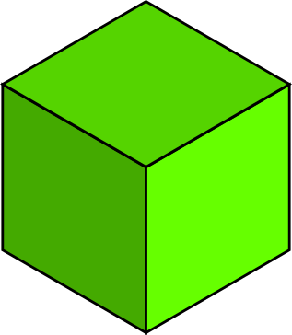
Varied Fluency 1
Complete the stem sentences to show the volume of this cuboid.
The cuboid is made up of __________ 1cm cubes.
The volume of the cuboid is __________ cm³.
© Classroom Secrets Limited 2018

Slide 7
Varied Fluency 1
Complete the stem sentences to show the volume of this cuboid.
The cuboid is made up of 20 1cm cubes.
The volume of the cuboid is 20cm³.
© Classroom Secrets Limited 2018

Slide 8
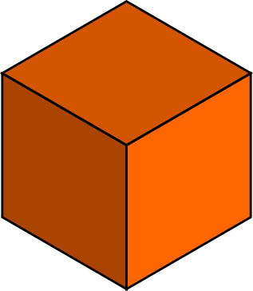
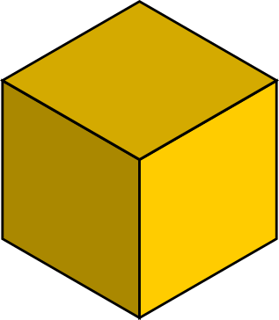
Varied Fluency 2
Count the cm cubes to work out the volume of the cuboids.
A.
B.
A = cm³
B = cm³
© Classroom Secrets Limited 2018

Slide 9
Varied Fluency 2
Count the cm cubes to work out the volume of the cuboids.
A.
B.
A = 16 cm³
B = 24cm³
© Classroom Secrets Limited 2018

Slide 10
Varied Fluency 3
Match the liquid in each container to the correct volume.
A. | B. | C.
100ml
#
1000ml
60ml
40ml
20ml
600cm³
50cm³
400cm³
© Classroom Secrets Limited 2018

Slide 11
Varied Fluency 3
Match the liquid in each container to the correct volume.
A. | B. | C.
100ml
#
1000ml
60ml
40ml
20ml
B = 600cm³
C = 50cm³
A = 400cm³
© Classroom Secrets Limited 2018

Slide 12
Varied Fluency 4
. True or false? The volume of this cuboid is 20cm³.
© Classroom Secrets Limited 2018

Slide 13
Varied Fluency 4
. True or false? The volume of this cuboid is 20cm³.
False. It is 16cm³
© Classroom Secrets Limited 2018

Slide 14
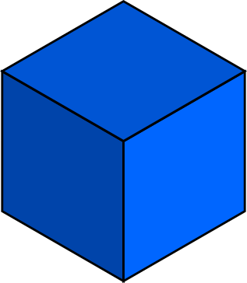
Reasoning 1
Circle the cuboids that total the volume of the liquid inside the container.
A.
B.
C.
D.
80ml
© Classroom Secrets Limited 2018

Slide 15
Reasoning 1
Circle the cuboids that total the volume of liquid inside the container.
A + B + C. A has 6 cubes, B has 14 cubes and C has 20 cubes.
6 + 14 + 20 = 40.
A.
B.
C.
D.
80ml
© Classroom Secrets Limited 2018

Slide 16
Problem Solving 1
. Find the odd one out by matching the shape to the correct volume.
Explain your reasoning.
18cm³
16cm³
14cm³
16cm³
A.
B.
C.
© Classroom Secrets Limited 2018

Slide 17
Problem Solving 1
. Find the odd one out by matching the shape to the correct volume.
Explain your reasoning.
14cm³ is the odd one out because there is no cuboid that has this number of cubes.
18cm³
16cm³
14cm³
16cm³
A.
B.
C.
© Classroom Secrets Limited 2018

Slide 18
Reasoning 2
Grace is calculating the volume of her shape..
Is Grace correct? Explain your answer.
My cuboid’s length is 3 cubes and it’s height is 2 cubes. I multiply these together to find the volume so the volume of my cuboid is 6cm^{3.}
© Classroom Secrets Limited 2018

Slide 19
Reasoning 2
Grace is calculating the volume of her shape..
Is Grace correct? Explain your answer.
No, she is not correct because…
My cuboid’s length is 3 cubes and it’s height is 2 cubes. I multiply these together to find the volume so the volume of my cuboid is 6cm^{3.}
© Classroom Secrets Limited 2018

Slide 20
Reasoning 2
Grace is calculating the volume of her shape..
Is Grace correct? Explain your answer.
No, she is not correct because to find the volume you have to multiply by the width as well. The width is 3 cubes so 3 x 3 x 2 = 18cm³
My cuboid’s length is 3 cubes and it’s height is 2 cubes. I multiply these together to find the volume so the volume of my cuboid is 6cm^{3.}
© Classroom Secrets Limited 2018

