Slide 1
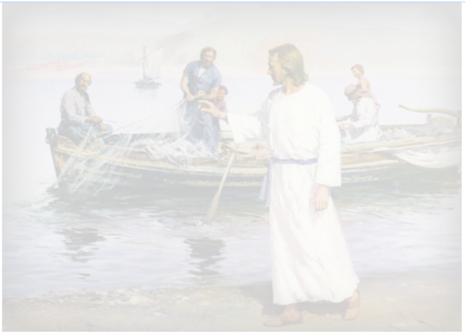
To explore what it is like to be a disciple of Jesus

Slide 2
What is your favourite possession?
Who do you live with?
What would you like to be when you grow up?
Write your three answers on a post it and stick it to the table.

Slide 3
Does anyone know who the disciples were?
Where did they come from?
Did they have jobs?
Did they have families?
What made them follow Jesus?
Where can we find out?

Slide 4
Matthew 4:18-22 New International Version (NIV)
Jesus Calls His First Disciples
¹⁸ As Jesus was walking beside the Sea of Galilee, he saw two brothers, Simon called Peter and his brother Andrew. They were casting a net into the lake, for they were fishermen. ¹⁹ “Come, follow me,” Jesus said, “and I will send you out to fish for people.” ²⁰ At once they left their nets and followed him.
²¹ Going on from there, he saw two other brothers, James son of Zebedee and his brother John. They were in a boat with their father Zebedee, preparing their nets. Jesus called them, ²² and immediately they left the boat and their father and followed him.

Slide 5
https://www.youtube.com/watch?v=NLT-lHttyes
Imagine that was you.
Jesus appears and you leave everything to follow him.
How would that feel?
How would it effect those you left behind?
I’m Jesus “Follow me”
Now screw up your post it and throw it on the floor and follow me.
Pics/Obs

Slide 6
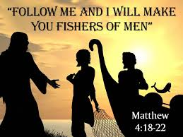
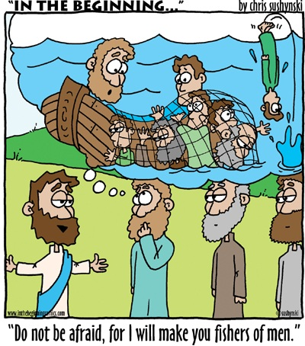
Jesus said he would turn the fishermen into ‘fishers of people’.
What did he mean?
Think about what the disciples did?
Draw a picture of the disciples fishing for people or someone
you know who is a fisher of men.

