Slide 1
Year 2 – Home Learning Maths – Spring 1 – Week 2
Money

Slide 2
Day 1
https://classroom.thenational.academy/lessons/to-compare-different-amounts-of-money-6gwk8c
Watch the video with Ms Sidhu very carefully. Work through the questions about money with Ms Sidhu. You will need to think very carefully to compare the amount of money that Ms Sidhu is showing you.
Have a go at the independent task that Ms Sidhu has set for you.
Now you have practiced comparing different amounts of money with Ms Sidhu, work through the questions on your worksheet.
1 star – need support
2 star – confident/independent

Slide 3
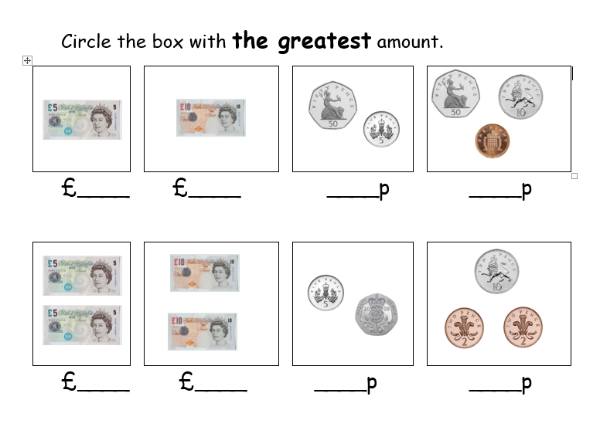

Slide 4
Day 2
https://classroom.thenational.academy/lessons/to-use-addition-and-subtraction-in-the-context-of-money-cmv32c
Today Miss Charlton will be showing you how to add and subtract different amounts of money.
Following Miss Charlton’s instructions, have a go at the independent task.
Once you have completed the lesson with Miss Charlton, you will have been able to practice adding and subtracting money in many different ways.
Now independently have a go at the find the total activity – remember to read the question carefully.
Choose which sheet you think is best for you.
Developing – need support
Expected – confident with a bit of support
Greater Depth – confident and independent

Slide 5
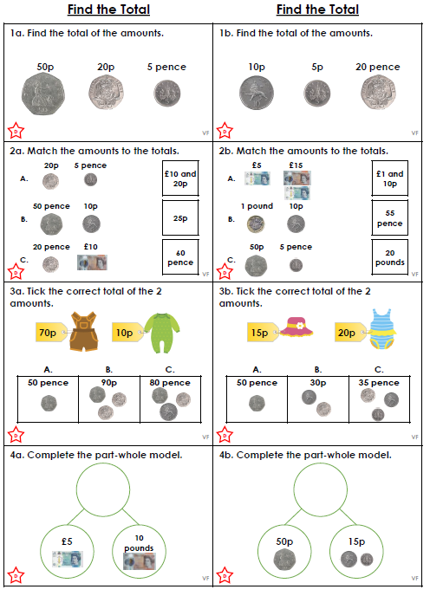

Slide 6
Day 3
https://classroom.thenational.academy/lessons/to-calculate-the-amount-of-change-needed-part-1-69j3ee
Miss Sidhu is back today and she is showing you how to calculate the amount of change you will get. You will be working with notes and coins today so listen carefully!
Remember if we are buying something we will need to take the cost of the item away from the amount of money we give.
Have a go at the independent task set by Miss Sidhu, she will give you the instructions about what to do.
Now have a go at the 2Do set on Purple Mash – Money up to £1.

Slide 7
Day 4
https://classroom.thenational.academy/lessons/to-calculate-the-amount-of-change-needed-part-2-64uk0e
This is the second lesson on calculating change. Use what you learnt yesterday as you follow Miss Sidhu through the tasks. Remember we will be using taking away today.
Follow Miss Sidhu’s instructions and work your way through the independent task, calculate how much change each child will get.

Slide 8
Day 5 – Arithmetic Work
You have been given an arithmetic test paper to complete. Try to read each question carefully and write your answer in the box.
Remember that you can use paper to do any working out that you need to.
Once you have completed your paper, ask an adult to help you mark it.
Good luck! ☺

Slide 9
