Slide 1
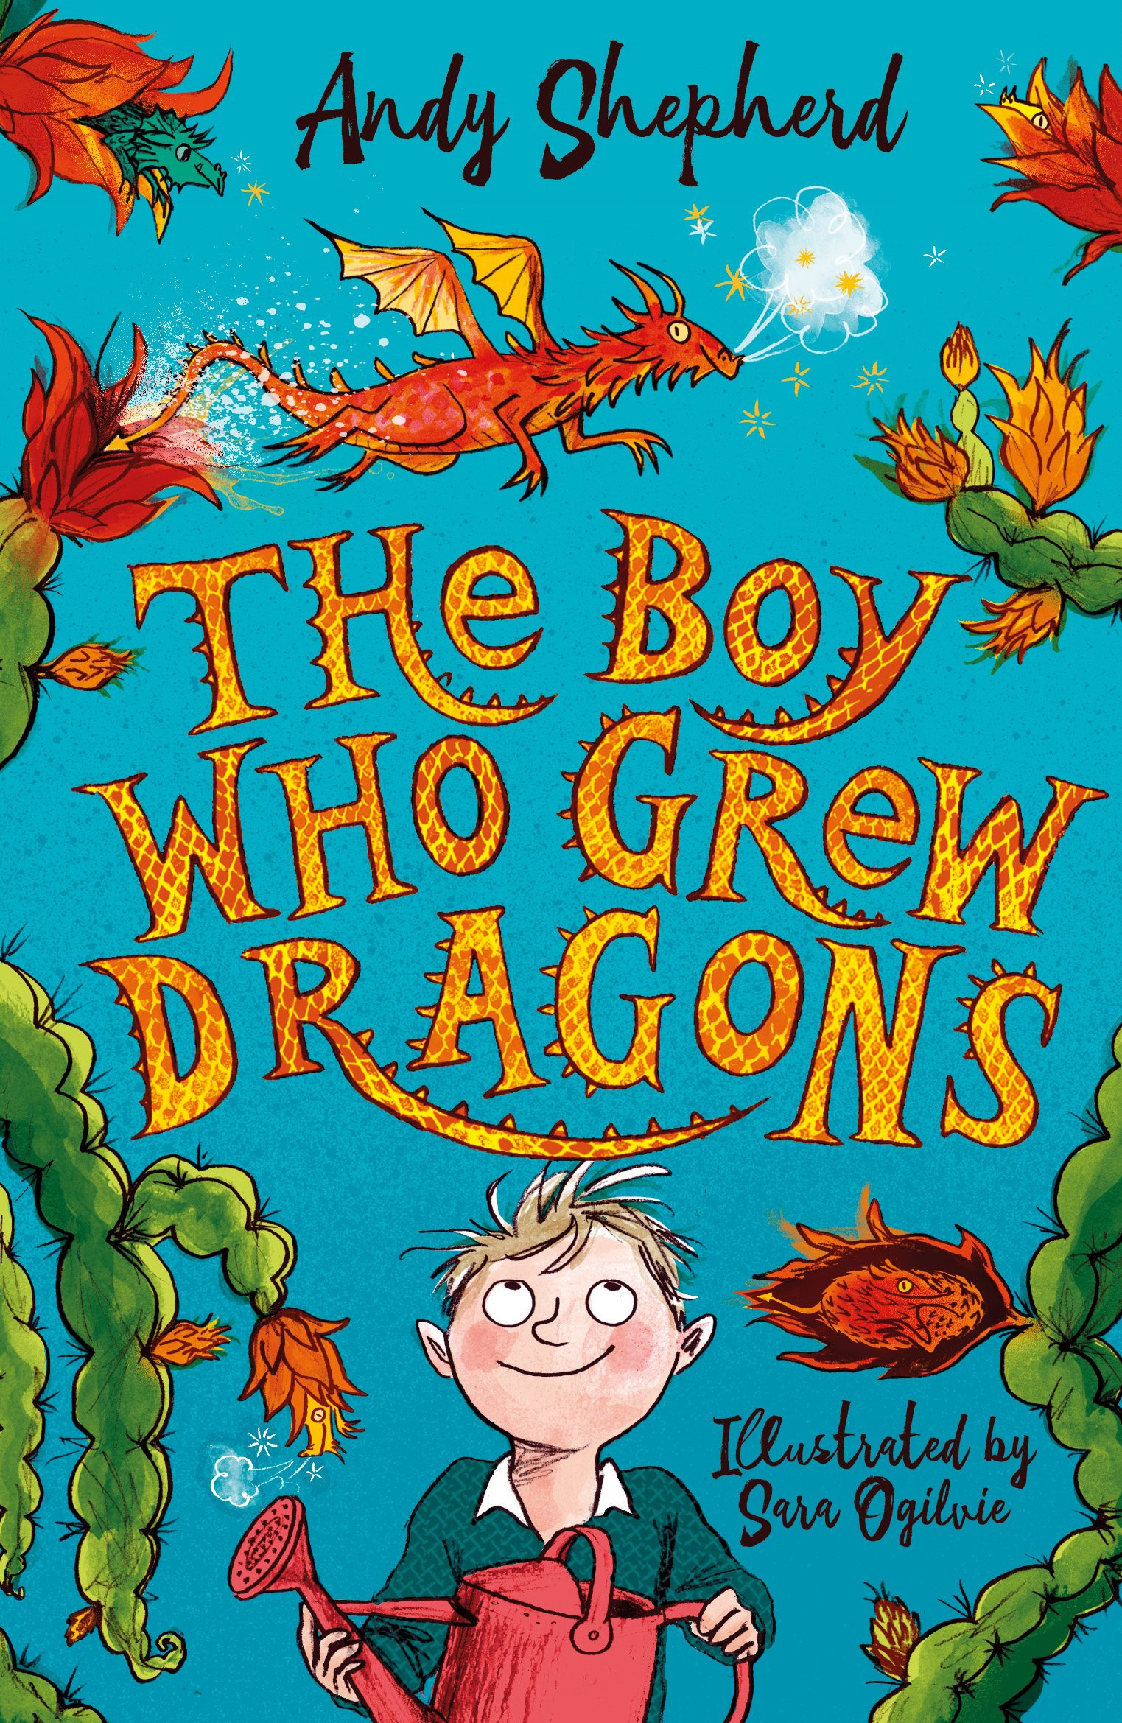
pulsing:
Verb
If something pulses, it moves,
appears, or makes a sound with
a strong regular rhythm.
Synonyms:
Beat, tick, throb, vibrate
“The dragon fruit started pulsing orange, red and blazing yellow. .”
1
toxic:
Adjectives
A substance that is poisonous.
Synonyms:
Poisonous, deadly, lethal, harmful
“The boy remembered what his Grandad had said about the mould. Maybe it was toxic?”
1

Slide 2
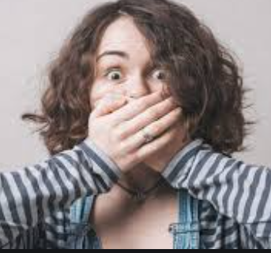
blurted:
Verb
To say something suddenly
without thinking.
Synonyms:
Babble, jabber, call out.
“Dad needed to step in quick before the boy blurted out something he shouldn’t.”
1
menacing:
Adjectives
Suggesting the presence
of danger.
Synonyms:
Threatening, dangerous.
“Lolli stared across the table at me menacingly.
1

