Slide 1
Year 2 – Home Learning Maths – Spring 1 – Week 3
Statistics

Slide 2
Day 1 – Reading pictograms
Look carefully at the pictogram.
If each picture represents 1 vote -
a)How many children voted the snake as their favourite animal?
b) How many children voted the goose as their favourite animal?
c)How many children voted the dog as their favourite animal?

Slide 3
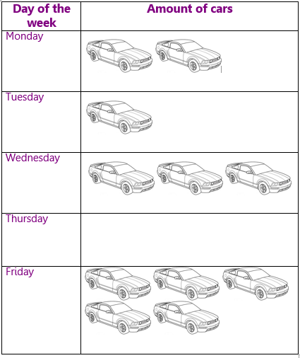
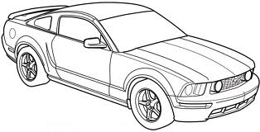
Sometimes on a pictogram, each picture can represent more than one vote.
So, on Monday there were 4 cars.
How many cars were there on Tuesday?
What if
= 2 cars?

Slide 4
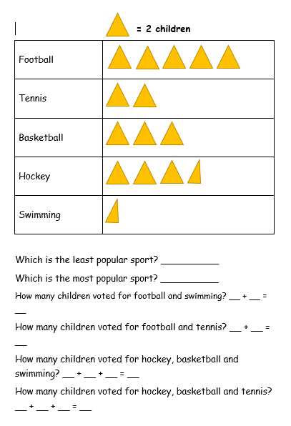
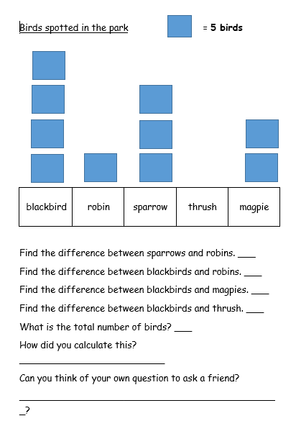
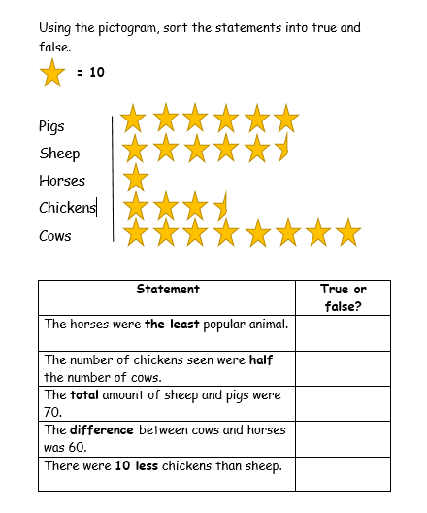
Activity…
Now that you have practised reading information from a pictogram – have a go at the activity sheets.
Either work your way through the stars or decide which is your level.

Slide 5
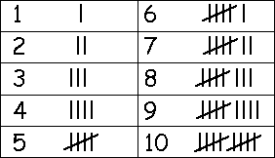
Day 2 – Reading tally charts
A tally chart lets us record numbers using little lines
Each line represents 1 vote – once you get 5 you use a diagonal line which goes through the previous 4 lines.

Slide 6
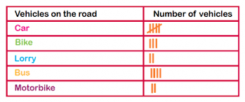
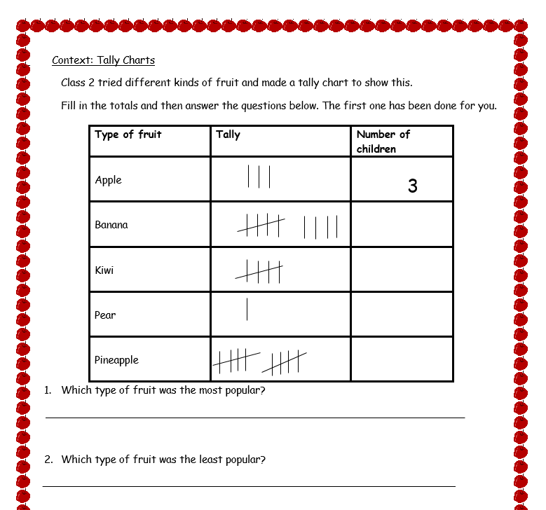
So if this tally chart shows that there are 5 cars on the road…
How many bikes were on the road?
How many lorries were on the road?
Now you have had a go at reading tally charts, see if you can complete the task set on purple mash.
If you cannot access purple mash, try the worksheet saved for today’s session.

Slide 7
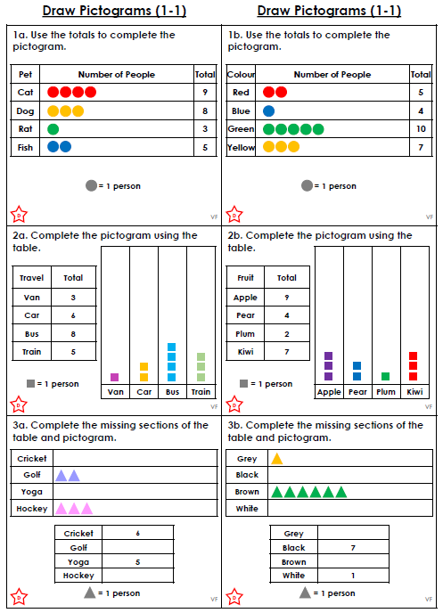
Day 3 – Drawing pictograms
Now that you can read pictograms, the next step is to be able to draw them to represent data.
Use what you have learnt from reading pictograms to help you complete the questions in the activity.
Choose what level you feel most comfortable with.
Sheet 1 – developing
Sheet 2 – expected
Sheet 3 – greater depth

Slide 8
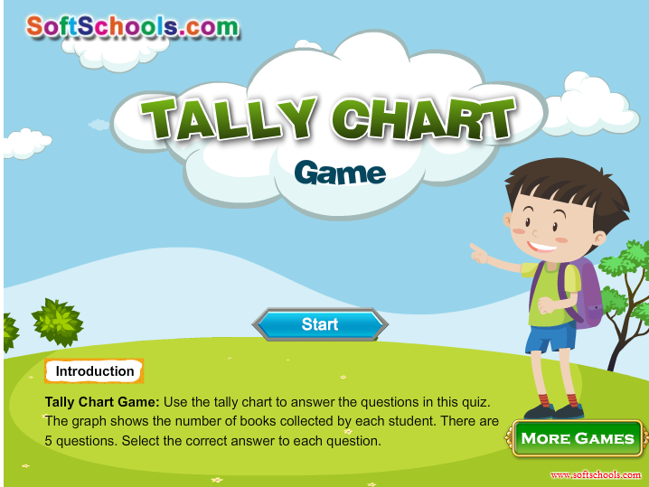
Day 4 – Drawing tally charts
https://www.softschools.com/math/data_analysis/tally_chart/
Have a go at practising what you have learnt about reading tally charts on this interactive game.
Before completing the drawing activity – watch this clip to remind you about tally charts
https://www.bbc.co.uk/bitesize/clips/z7r9jxs

Slide 9
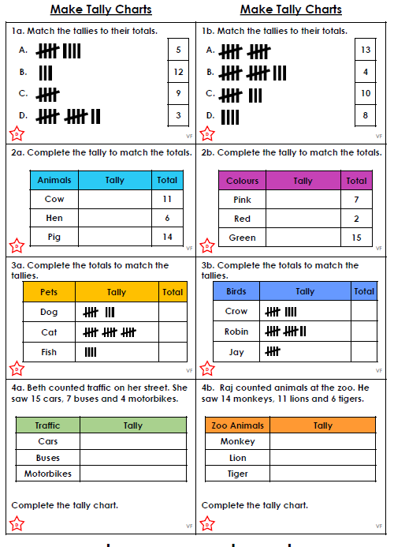
Activity…
Choose what level you feel most comfortable with.
Sheet 1 – developing
Sheet 2 – expected
Sheet 3 – greater depth

Slide 10
Day 5 – Arithmetic Work
You have been given an arithmetic test paper to complete. Try to read each question carefully and write your answer in the box.
Remember that you can use paper to do any working out that you need to.
Once you have completed your paper, ask an adult to help you mark it.
Good luck! ☺

Slide 11
