Slide 1
Year 2 – RE Spring 1 – Week 3
Courageous Advocacy

Slide 2
What is a ‘Courageous Advocate’?
The Christian Gospel says that every person has a unique task to do, with God, and for God, whether they know it or not.
A ‘Courageous Advocate’ means they champion causes which are special and meaningful to them. These may be global issues or matters far more personal and closer to home.

Slide 3
Your task…
Last session you researched all about Greta Thunberg and why she is seen to be a courageous advocate.
Now that you know a bit more about Greta, you will be creating a biography all about her.
Don’t forget, a biography tells you all about someone’s life.
This session you will plan your biography for Greta. Use the planning sheet to help organise your information.

Slide 4
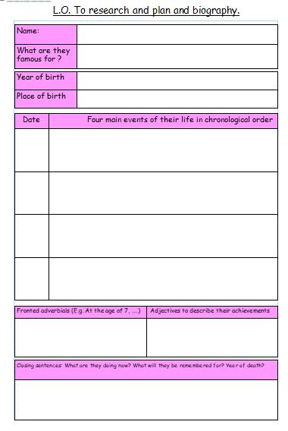

Slide 5
Sub-headings
In English we have been looking at sub-headings. Today you will need to plan a sub-heading for each section of your biography.
A sub-heading is a mini-title for each section which tells you what the paragraph will be about.
Use the example texts to see what sub-headings you could use.

