Slide 1
Maths
Algebra
Year One
Maths | Year 6 | Algebra | Use Simple Formulae | Lesson 1 of 4: Forming Expressions

Slide 3
Aim
I can draw and write algebraic expressions.
Success Criteria
I can draw representations of algebraic expressions.
I can write algebraic expressions using standard notation.
I can begin to substitute values into algebraic expressions.

Slide 4
One-Step Function Machines
Use this function machine to find the missing input and output values in the table.
+ 27
Input | 6 | 6.3 | 11 | -4
Output |  |  |  |  | 20 | 12 | 165 | 0
-7
-15
138
-27
33
33.3
38
23

Slide 5
Expressions
A mathematical formula expresses the relationship between two unknown values.
This function machine is an example of a formula, as the output value is dependent on the input value.
?
+ 35
?

Slide 6
Expressions
In algebra, letters are used to represent unknown values. Any letter can be used to represent an unknown value.
When a letter is used in algebra to represent an unknown value, it is called a variable.
a
+ 35
b

Slide 7
Expressions
Any formula can be written down as a number sentence.
The groups of numbers and letters either side of the equals sign are called expressions.
a
+ 35
b
a + 35 = b
expression

Slide 8
Expressions
Look carefully at how the expression has been represented using base ten equipment.
a
+ 35
b
a
=
b
expression

Slide 9
Expressions
Here is a different function machine which uses multiplication. In algebra, the multiplication sign can get confused with the letter ‘x’ so it is not used when we write the expression.
a
× 4
b
a
a
a
a
=
b
expression
4a = b

Slide 10
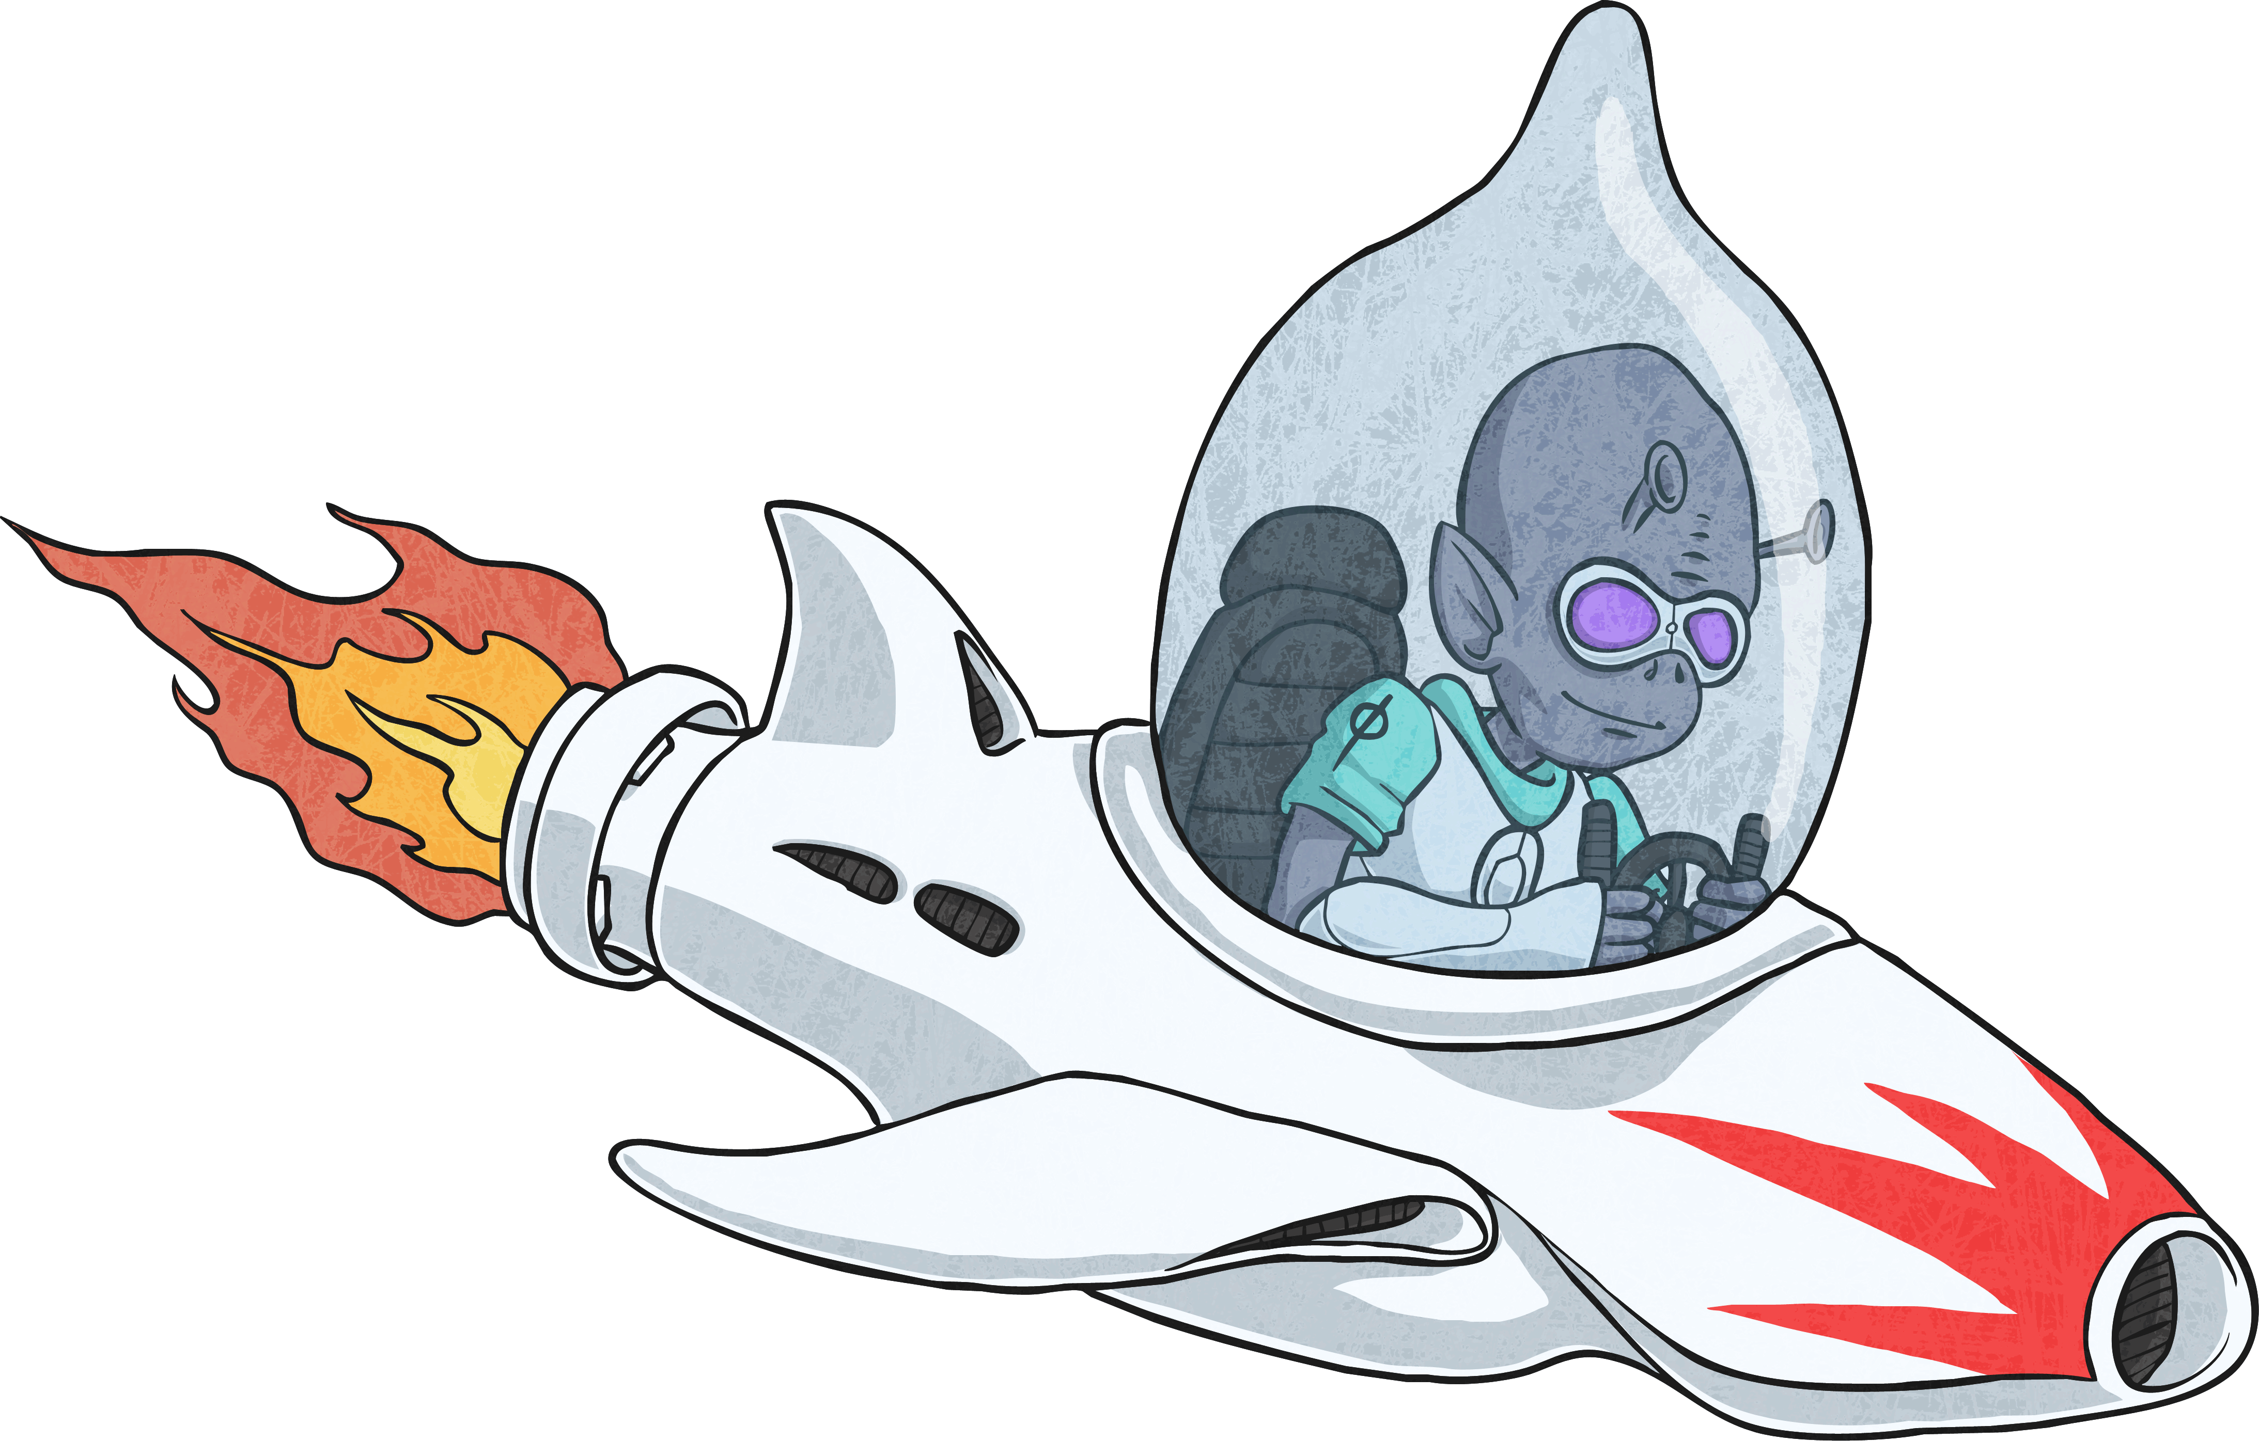
Draw the Expression
Draw or write an expression that represents this function machine formula.
a
× 2
b
a
a
2a

Slide 11
Draw the Expression
Draw or write an expression that represents this function machine formula.
a
+ 12
b
a
a + 12

Slide 12
Draw the Expression
Draw or write an expression that represents this function machine formula.
a
× 3
+ 4
b
a
a
a
3a + 4 = b

Slide 13
Draw the Expression
Draw or write an expression that represents this function machine formula.
a
+ 2
× 3
a
a
a
b
3(a + 2) = b

Slide 14
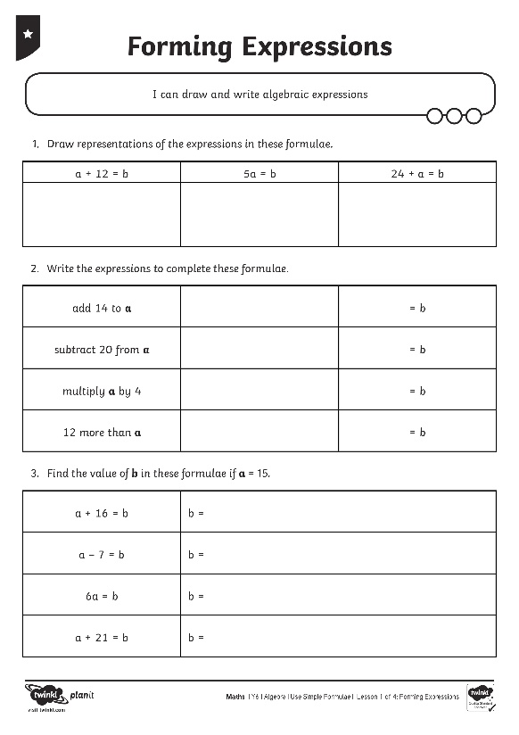
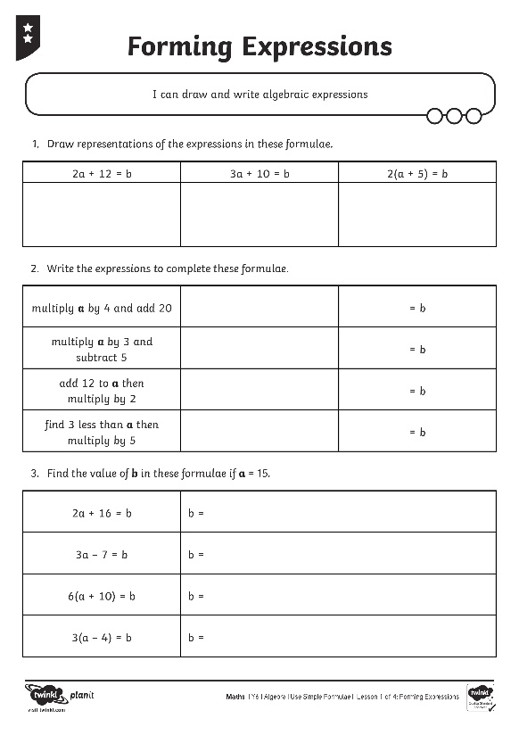
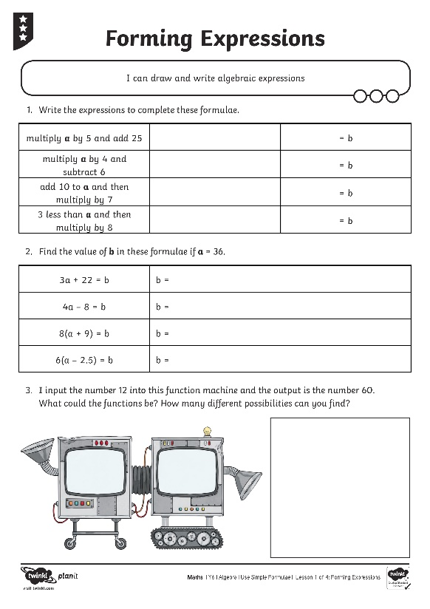
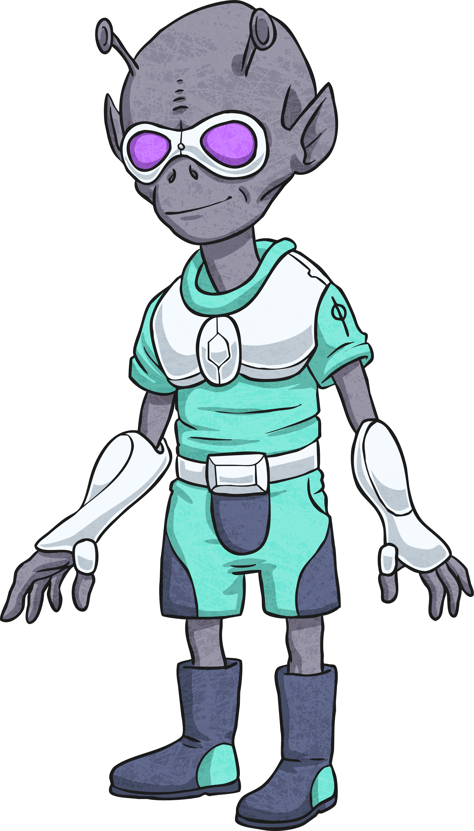
Forming Expressions

Slide 15
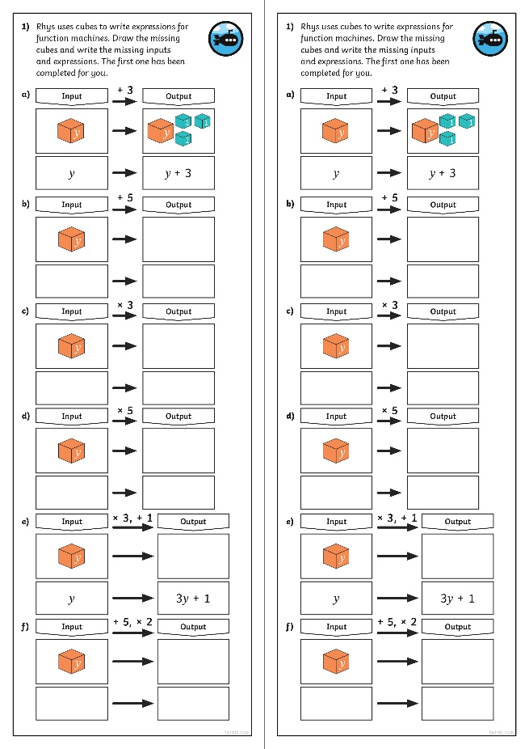
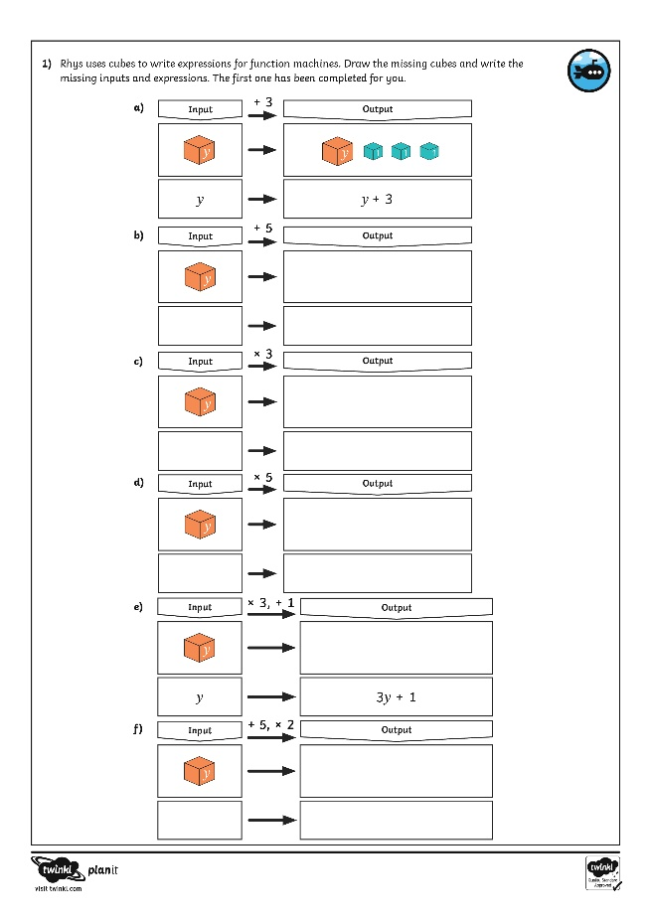
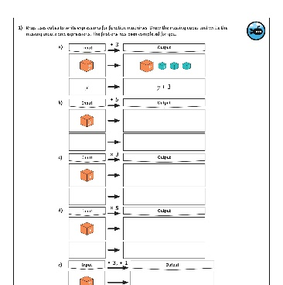
Diving into Mastery
Dive in by completing your own activity!

Slide 16
Function Machine Reasoning
I input the number 7 into this function machine and the output is number 28.
7
?
28
What could the function be? How many different possibilities can you find?
The function could be ×4 or +21.
How would your answers change if it was a two-step function machine?
There are many possibilities, e.g. (×2, +14) or (+30, -9).

Slide 17
Function Machine Reasoning
a
÷ 3
b
I input an unknown number into this function machine.
I then put the output number back into the machine and the new output number is 5.
What was the unknown number I inputted at the beginning?
?
=
45

Slide 18
Aim
I can draw and write algebraic expressions.
Success Criteria
I can draw representations of algebraic expressions.
I can write algebraic expressions using standard notation.
I can begin to substitute values into algebraic expressions.

