Slide 1
Maths
Algebra
Year One
Maths | Year 6 | Algebra | Use Simple Formulae | Lesson 2 of 4: Shape Formulae

Slide 3
Aim
I can use simple formulae for calculating the area and perimeter of shapes.
Success Criteria
I can write algebraic expressions using standard notation.
I can solve a formula substituting in known variables.
I can recognise and use formulae in geometry.

Slide 4
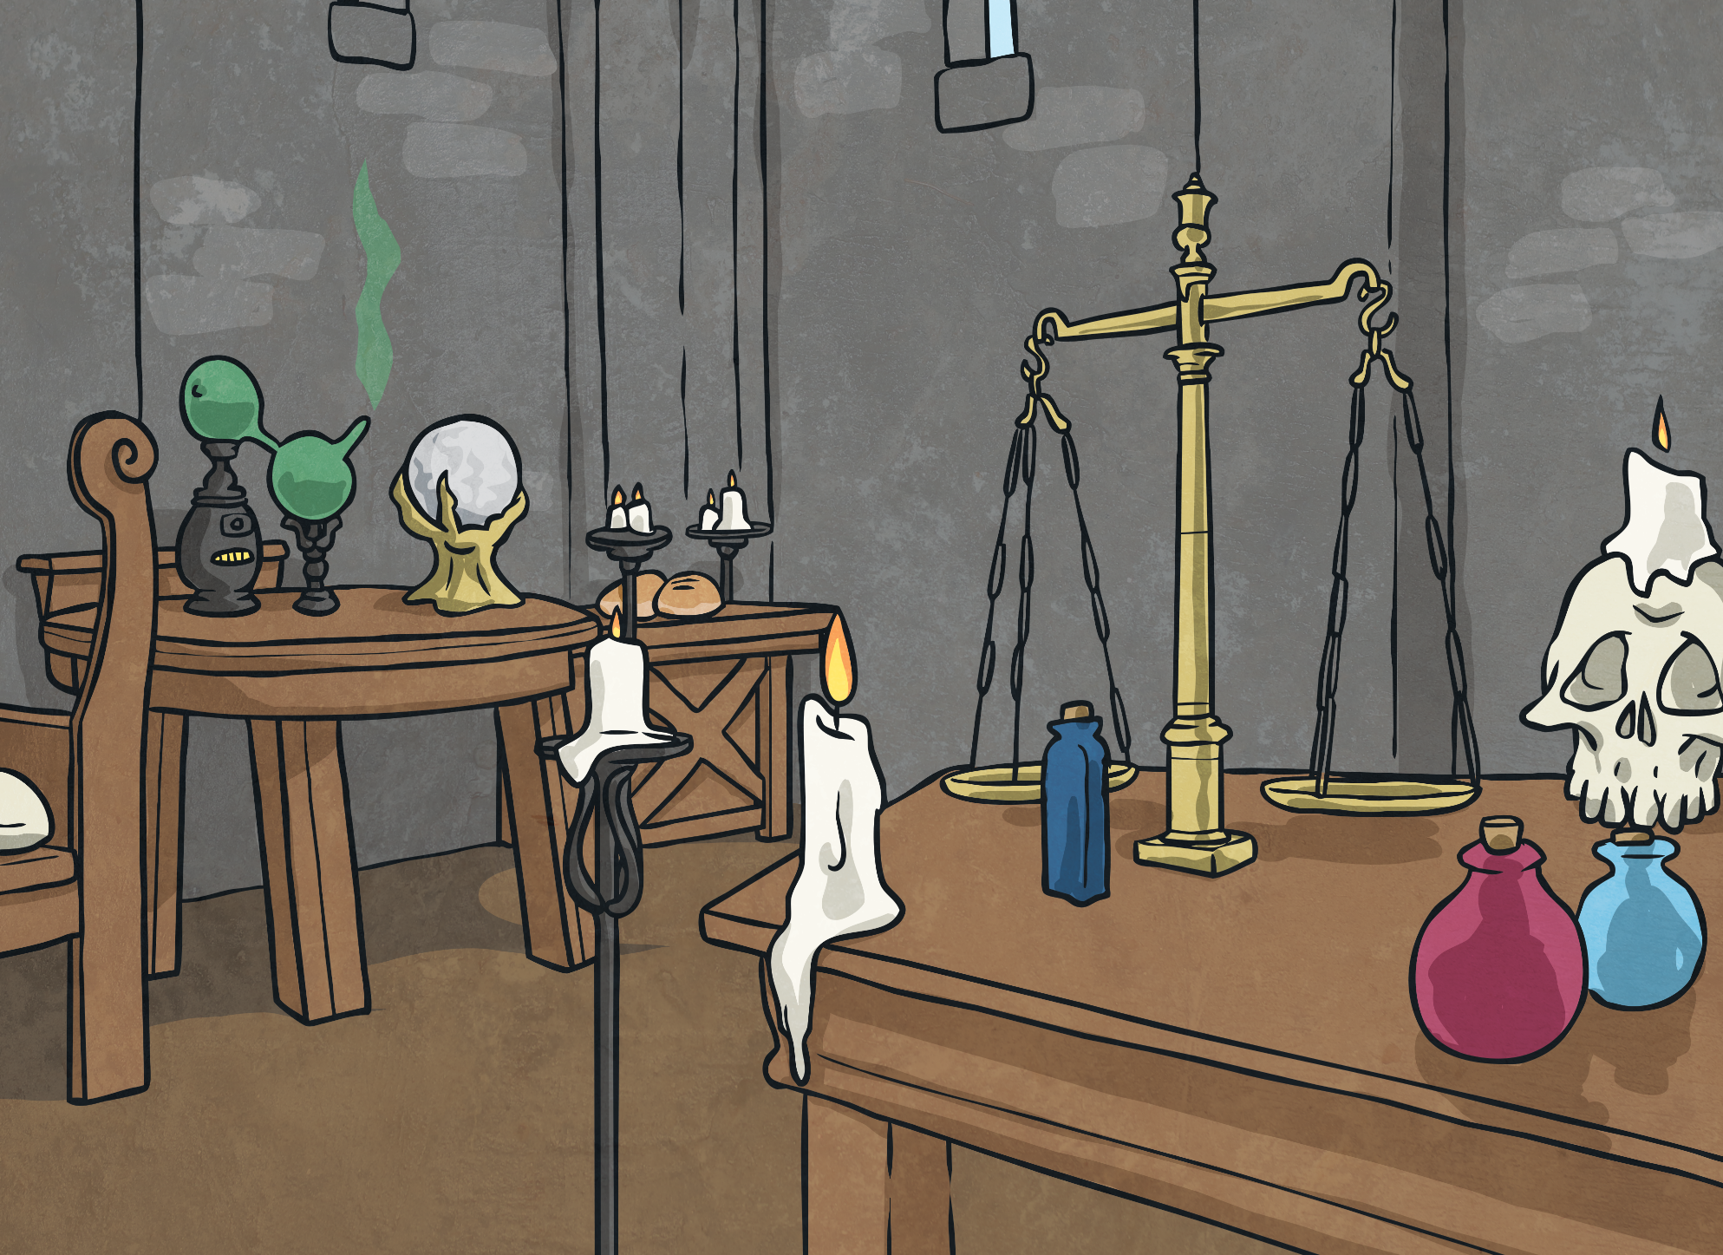
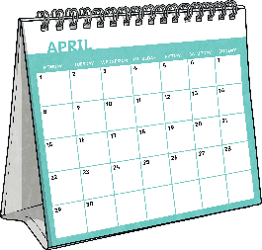
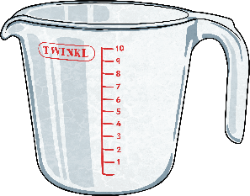
Formulae All Around Us
Formulae are all around us in our everyday lives.
7 days in a week
×
number of weeks
total number of days
=
60 minutes in an hour
×
number of hours
total number of minutes
=
1000ml in a litre
×
number of litres
total number of ml
=
Can you think of other examples of common formulae?

Slide 5
Rectangle Formulae
Formulae are used to calculate the dimensions of rectangles.
width
×
length
width
=
area
area
lw = a
length
width
area
÷
length
=
width
a
= w
l
length
area
area
÷
width
=
length
a
= l
w

Slide 6
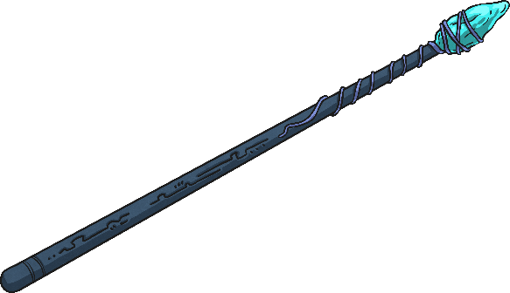
Rectangle Dimensions
Use the formulae to calculate the unknown dimensions of these rectangles.
length
×
width
area
=
lw = a
Length | Width | Area
3cm | 2cm | 6cm²
14m | 7m | 98m²
32cm | 16cm | 512cm²
area
÷
length
=
width
a
= w
l
area
÷
width
=
length
a
= l
w

Slide 7
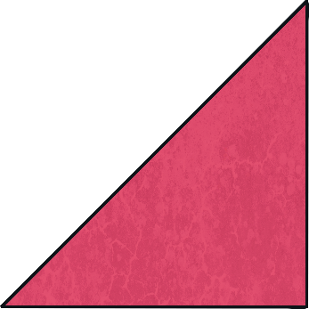
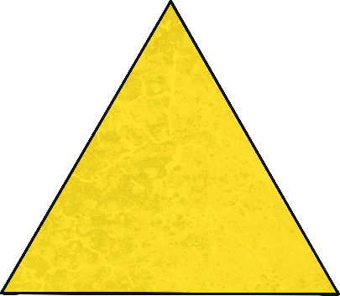
Triangle Formulae
Formulae are used to calculate the dimensions of triangles.
(
)
base
height
÷
2
=
area
×
height
bh
area
= a
2
(
)
base
area
2
÷
base
=
height
×
2a
area
= h
b
(
)
height
area
2
height
base
×
÷
=
2a
base
= b
h

Slide 8
Triangle Dimensions
Use the formulae to calculate the unknown dimensions of these triangles.
(
)
base
height
÷
2
=
area
×
bh
= a
Base | Height | Area
8cm | 5cm | 20cm²
10m | 24m | 120m²
36cm | 21cm | 378cm²
2
(
)
area
2
÷
base
=
height
×
2a
= h
b
(
)
area
2
÷
height
=
base
×
2a
= b
h

Slide 9
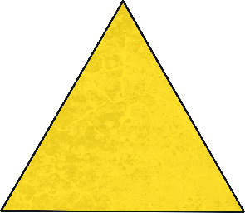
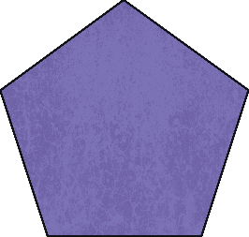
Perimeter Formulae
Can we use these formulae to calculate the perimeter or dimensions of irregular polygons? Explain your reasoning.
Formulae are used to calculate the perimeters of regular polygons.
length of one side
×
number of sides
perimeter
=
ln = p
perimeter
÷
length of one side
=
number of sides
p
= n
l
perimeter
÷
number of sides
=
length of one side
p
= l
n

Slide 10
Perimeter Formulae
Can you think of a different way to write the formula to show how to calculate the perimeter of a rectangle?
Formulae can be used to calculate the perimeter of rectangles.
(
)
×
length
+
width
2
=
perimeter
length
2l + 2w = p
2(l + w) = p
(
)
width
perimeter
÷
2
-
length
=
width
p
- l = w
2
(
)
length
perimeter
÷
2
-
width
=
length
p
- w = l
2

Slide 11
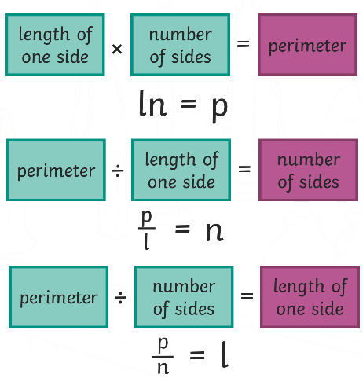
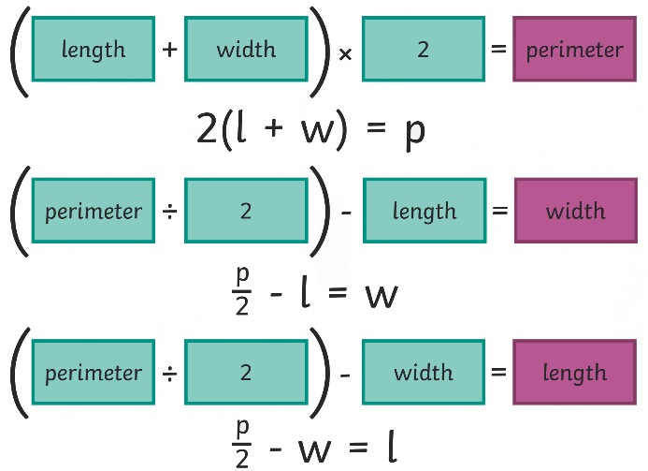
Calculate the Perimeter
Use the formulae to calculate the unknown dimensions of these 2D shapes.
Regular Polygons
Length of One Side | Number of Sides | Perimeter
5cm | 4 | 20cm
11cm | 3 | 33cm
8cm | 5 | 40cm
Rectangles
Length | Width | Perimeter
3cm | 2cm | 10cm
14m | 7m | 42m
32.5cm | 16cm | 97cm

Slide 12
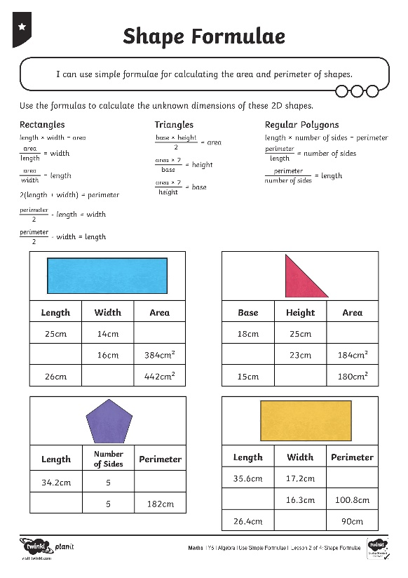
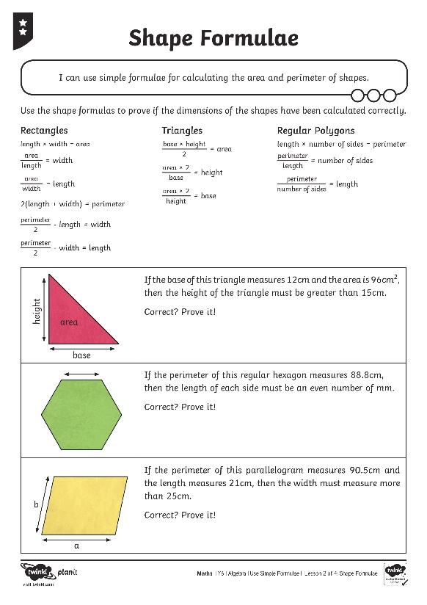
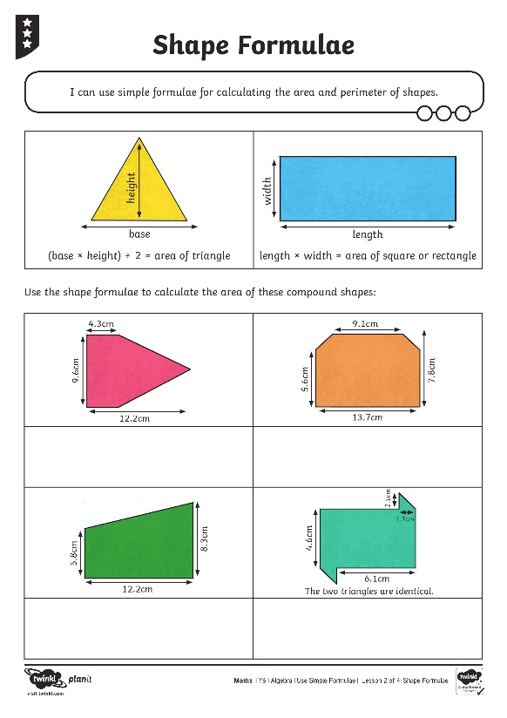
Shape Formulae

Slide 13
Algebra Cadabra
Robbie the Wizard is putting together shapes to create amazing area formulae. He noticed that some shape combinations can be calculated in different ways and create the same answer.
area a
area a
a + b
area b
area b
area b
area b
area a
area a
a + b
2a + 2b
2a + 2b = 2(a+b)

Slide 14
Algebra Cadabra
How many different formulae can you write for these shapes?
area a
area a
area a
area b
area b
area b
area a
area a
area a
area a
area b
area b
area a
area a
area a
area b
area a
area b
area b
area a
area b

Slide 15
Aim
I can use simple formulae for calculating the area and perimeter of shapes.
Success Criteria
I can write algebraic expressions using standard notation.
I can solve a formula substituting in known variables.
I can recognise and use formulae in geometry.

