Slide 1
Maths
Algebra
Year One
Maths | Year 6 | Algebra | Use Simple Formulae | Lesson 3 of 4: Formula Word Problems

Slide 3
Aim
I can use simple formulae to answer algebraic word problems.
Success Criteria
I can write a formula to solve a problem.
I can use a formula to calculate an answer by substituting in known variables.

Slide 4
Sensational Substitution
Spin to give the value of y.
Substitute this value into the formula below to find the value of z.
2y + 34 = z
y = 60
y = 96
2y + 34 = z
When y = 81, z = 196
2y + 34 = z
When y = 27, z = 88
2y + 34 = z
When y = 33, z = 100
2y + 34 = z
When y = 96, z = 226
2y + 34 = z
When y = 105, z = 244
2y + 34 = z
When y = 60, z = 154
2y + 34 = z
When y = 54, z = 142
2y + 34 = z
When y = 75, z = 184
2y + 34 = z
When y = 16, z = 66
2y + 34 = z
When y = 42, z = 118
y = 33
y = 105
y = 54
y = 16
Click here to spin!
Back
Back
Back
Back
Back
Back
Back
Back
Back
Back
Show answer
y = 81
y = 75
y = 27
y = 42

Slide 5
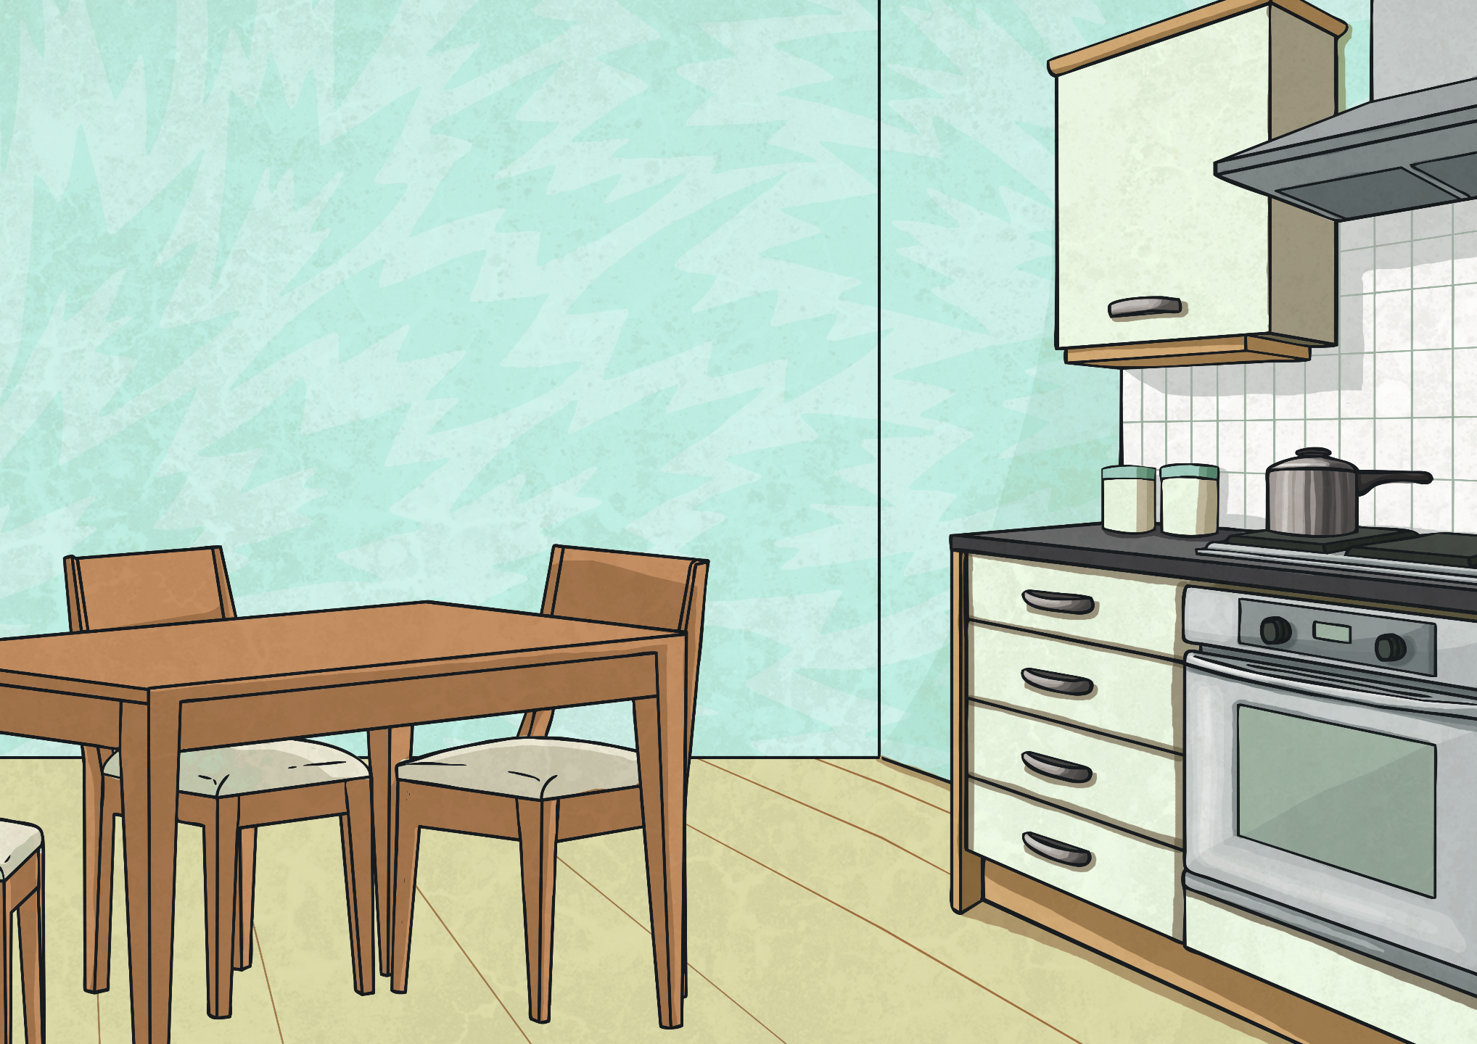
Formula Match-Up
The recipe for making a fruit smoothie is to use 3 times as much apple juice (a) as orange juice (b).
Which of these is the correct formula to represent this rule?
b
b
a = ½ | a = 3b
a = b + 3 | 3a = b
a = ½ | a = 3b
a = b + 3 | 3a = b
3
3
Explain why the others are incorrect.

Slide 6
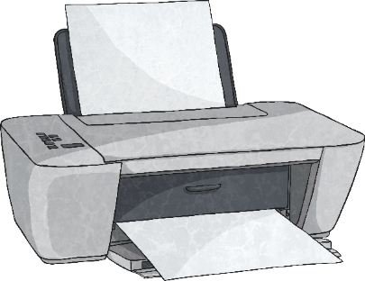
Formula Match-Up
A shop prints posters using the rule that the cost (c) is 75p for each poster (d).
Which of these is the correct formula to represent this rule?
75
75
c = 3 | c = d + 75
75d = c | 75c = d
c = 3 | c = d + 75
75d = c | 75c = d
d
d
Explain why the others are incorrect.

Slide 7
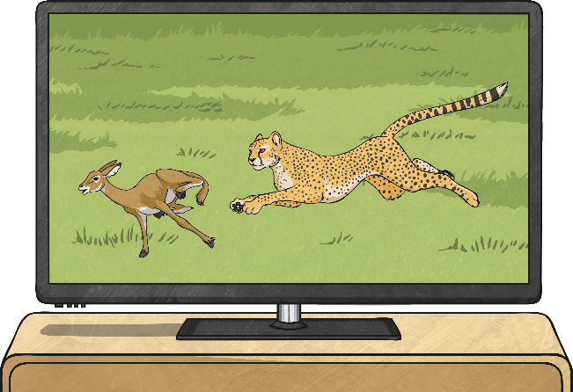
Formula Word Problems
Formulae can be used to help us solve two-step word problems.
If we write out this problem as a formula, we can see that the total cost of renting a TV is dependent on the number of weeks it is rented for.
A company rents out flat screen TVs based on an one-off payment of £35 and then a weekly hire cost of £12.
Use the formula to find out the cost of renting a TV when:
n = 7 weeks
n = 12 weeks
n = 18 weeks
n = 23 weeks
Show answers
(
)
£119
weekly hire cost £12
number of weeks
⁺
one-off payment £35
Total cost
×
=
£179
£251
12n + 35 = cost
£311

Slide 8
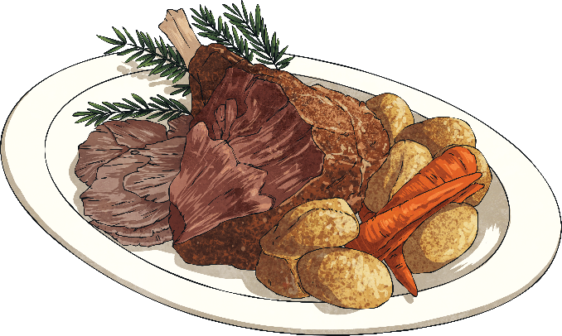
Formula Word Problems
Here is another two-step word problem which can be solved using a formula. If we write out this problem as a formula, we can see that the time to cook a joint of lamb is dependent on the weight of the lamb in kg.
It takes 40 minutes for every kilogram plus an additional 20 minutes to cook a joint of lamb.
Use the formula to find out how long it will take to cook the lamb when:
n = 3kg
n = 5kg
n = 7kg
n = 8kg
Show answers
(
)
40 minutes
number of kilograms
⁺
20 minutes
time to cook
140 minutes
=
×
220 minutes
300 minutes
40n + 20 = time to cook
340 minutes

Slide 9
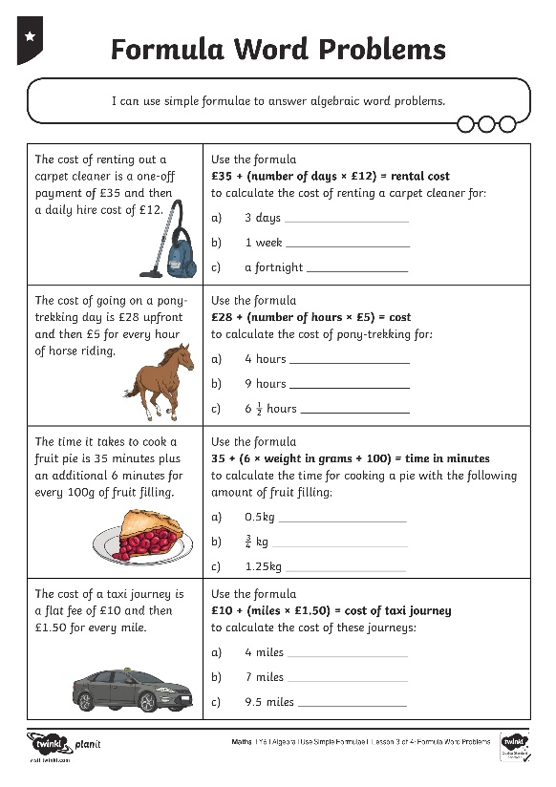
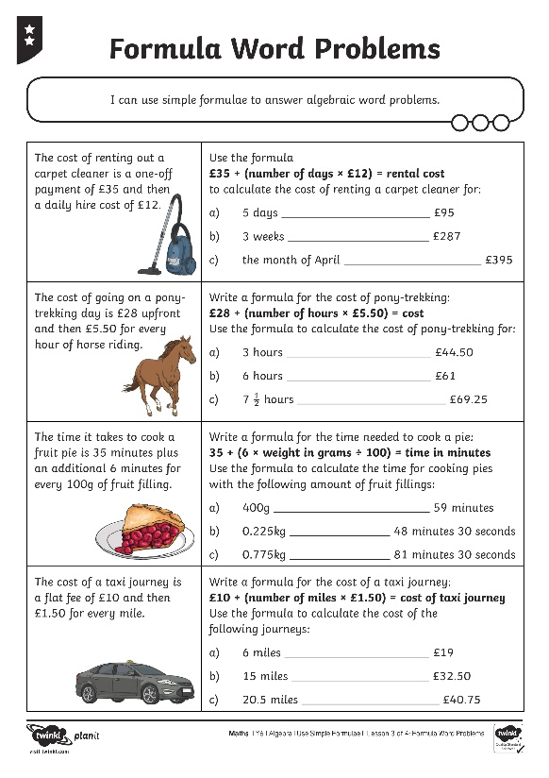
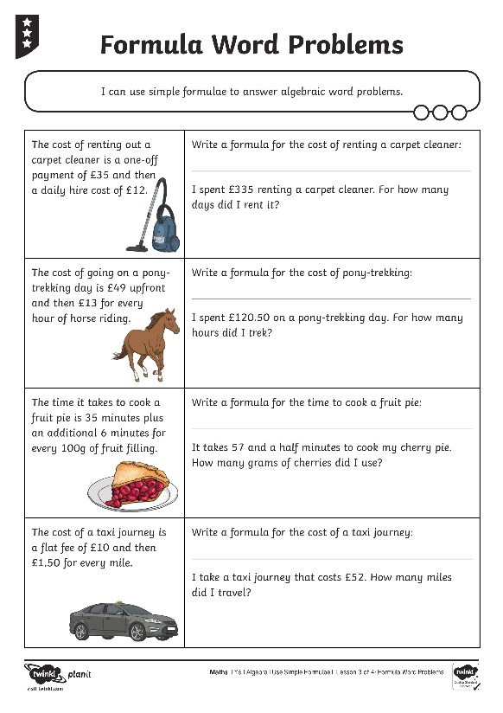
More Formula Word Problems

Slide 10
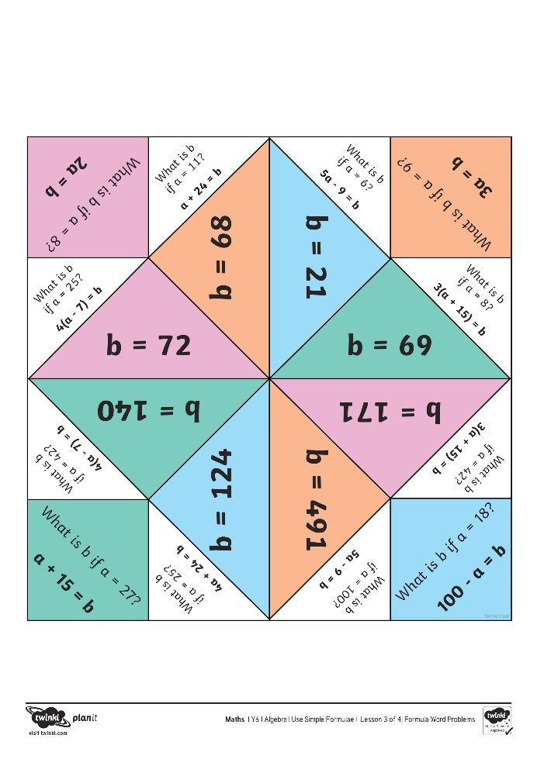
Formulae Fortune Teller

Slide 11
Aim
I can use simple formulae to answer algebraic word problems.
Success Criteria
I can write a formula to solve a problem.
I can use a formula to calculate an answer by substituting in known variables.

