Slide 1
Maths
Algebra
Year One
Maths | Year 6 | Algebra | Use Simple Formulae | Lesson 4 of 4: Reasoning Using Formulae

Slide 3
Aim
I can solve reasoning questions using simple formulae.
Success Criteria
I can break down complex problems into smaller steps.
I can use mathematical language to explain solutions to problems.
I can apply my understanding of simple formulae.

Slide 4
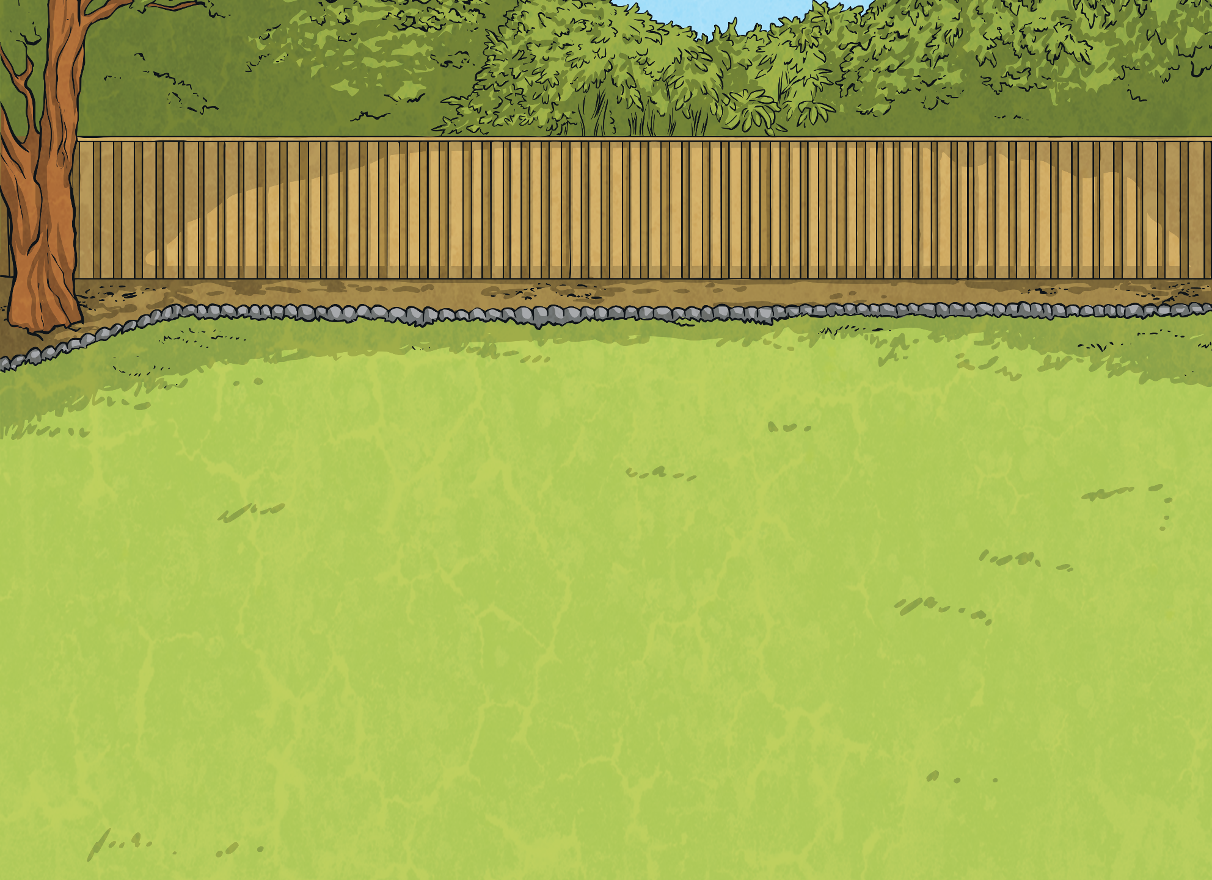
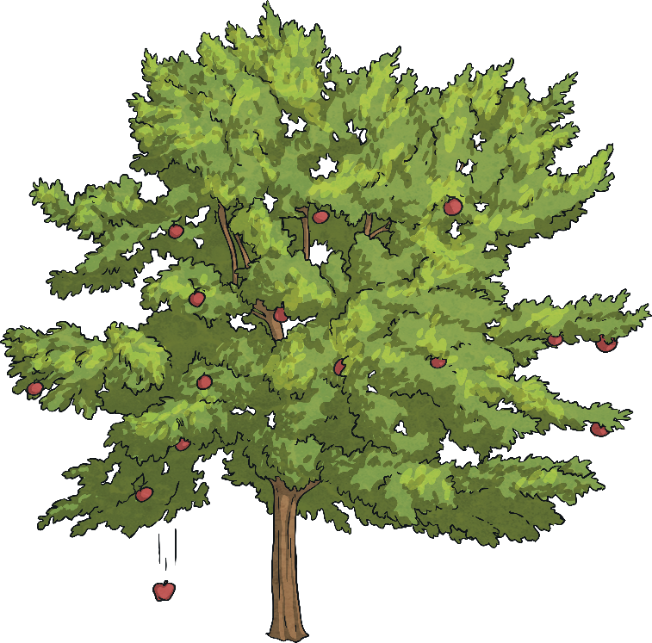
Guided Maths Question 1
Read this reasoning question carefully.
Barney picks apples from his apple tree and then sells them in bags.
He charges 35p for each apple and 45p for each bag. A bag can hold 10 apples.
Use a formula to answer these questions:
a) How much does it cost to buy 15 apples?
b) How many apples are there when he has 2 bags of apples and the total cost is £7.20?
Barney picks apples from his apple tree and then sells them in bags.
He charges 35p for each apple and 45p for each bag. A bag can hold 10 apples.
Use a formula to answer these questions:
a) How much does it cost to buy 15 apples?
b) How many apples are there when 2 bags of apples sell for £7.20?
Let’s highlight the important information and key vocabulary to make sure that we understand the question.

Slide 5
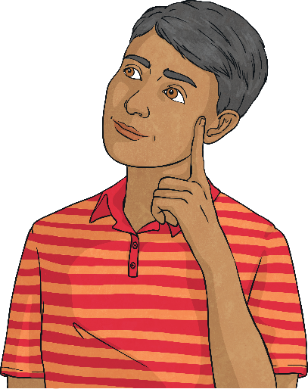
Guided Maths Question 1
Next, let’s think about what we already know in order to help us answer the question correctly.
Barney picks apples from his apple tree and then sells them in bags. He charges 35p for each apple and 45p for each bag. A bag can hold 10 apples.
Use a formula to answer these questions:
a) How much does it cost to buy 15 apples?
b) How many apples are there when he has 2 bags of apples and the total cost is £7.20?
To answer the first question, I know that 2 bags will be needed to carry 15 apples. I can substitute these numbers into the formula.
To answer the second question, I know that 2 bags of apples cost £7.20. I can substitute these numbers into the formula.
I know that the cost is dependent on the number of apples and the number of bags. I can write this as a formula.
(number of apples × 35p) + (number of bags × 45p) = cost
(15 apples × 35p) + (2 bags × 45p) = cost
(number of apples × 35p) + (2 bags × 45p) = £7.20

Slide 6
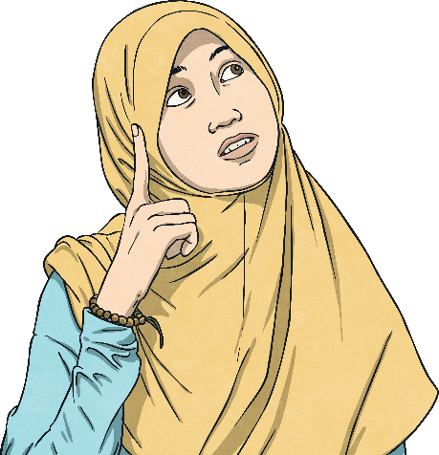
Guided Maths Question 1
Now, we are ready to apply our learning to solve the first question.
Barney picks apples from his apple tree and then sells them in bags. He charges 35p for each apple and 45p for each bag. A bag can hold 10 apples.
Use a formula to answer these questions:
a) How much does it cost to buy 15 apples?
b) How many apples are there when 2 bags of apples sell for £7.20?
Finally, add the cost of the apples and bags together using either a mental or written method of addition.
Second, calculate the cost of the bags using either a mental or written method of multiplication.
First, calculate the cost of the apples using a written method of multiplication.
(15 apples × 35p) + (2 bags × 45p) = cost
£5.25 + (2 bags × 45p) = cost
£5.25 + 90p = cost
£5.25 + 90p = £6.15

Slide 7
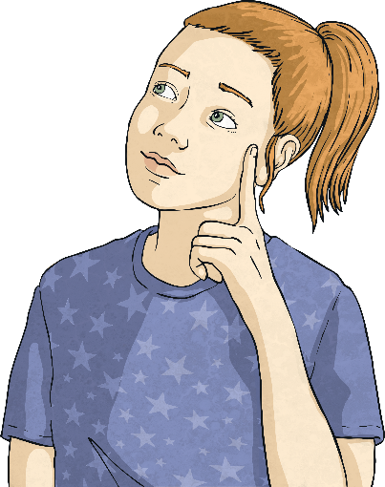
Guided Maths Question 1
Now, we are ready to apply our learning to solve the second question.
Barney picks apples from his apple tree and then sells them in bags. He charges 35p for each apple and 45p for each bag. A bag can hold 10 apples.
Use a formula to answer these questions:
a) How much does it cost to buy 15 apples?
b) How many apples are there when 2 bags of apples sell for £7.20?
Second, subtract the cost of the bags from the total cost to give the cost of the apples, using a mental or written method of subtraction.
Finally, if I divide the cost of the apples by the price of one apple I will find out how many apples were sold.
First, calculate the cost of the bags using either a mental or written method of multiplication.
(number of apples × 35p) + (2 bags × 45p) = £7.20
(number of apples × 35p) + 90p = £7.20
(number of apples × 35p) = £7.20 - 90p
(number of apples × 35p) = £6.30
£6.30 ÷ 35p =
18 apples

Slide 8
Guided Maths Question 1
Finally, let’s check our answer with the information and key vocabulary in the question to check we have answered the question fully.
Barney picks apples from his apple tree and then sells them in bags.
He charges 35p for each apple and 45p for each bag. A bag can hold 10 apples.
Use a formula to answer these questions:
a) How much does it cost to buy 15 apples?
b) How many apples are there when 2 bags of apples sell for £7.20?
It will cost £6.15 to buy 15 apples.
There are 18 apples when 2 bags sell for £7.20.

Slide 9
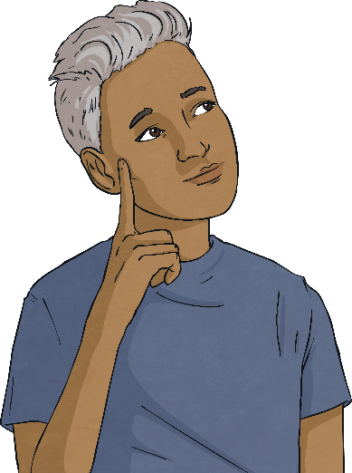
Partner Maths Question 1
Working with a partner, use your reasoning skills to answer this question.
Malik picks apples from his apple tree and then sells them in bags.
He charges 28p for each apple and 40p for each bag. A bag can hold 10 apples.
Use a formula to answer these questions:
a) How much does it cost to buy 13 apples?
b) How many apples are there when 3 bags of apples sell for £8.48?
13 apples cost £4.44.
Show answers
There are 26 apples when 3 bags sell for £8.48.

Slide 10
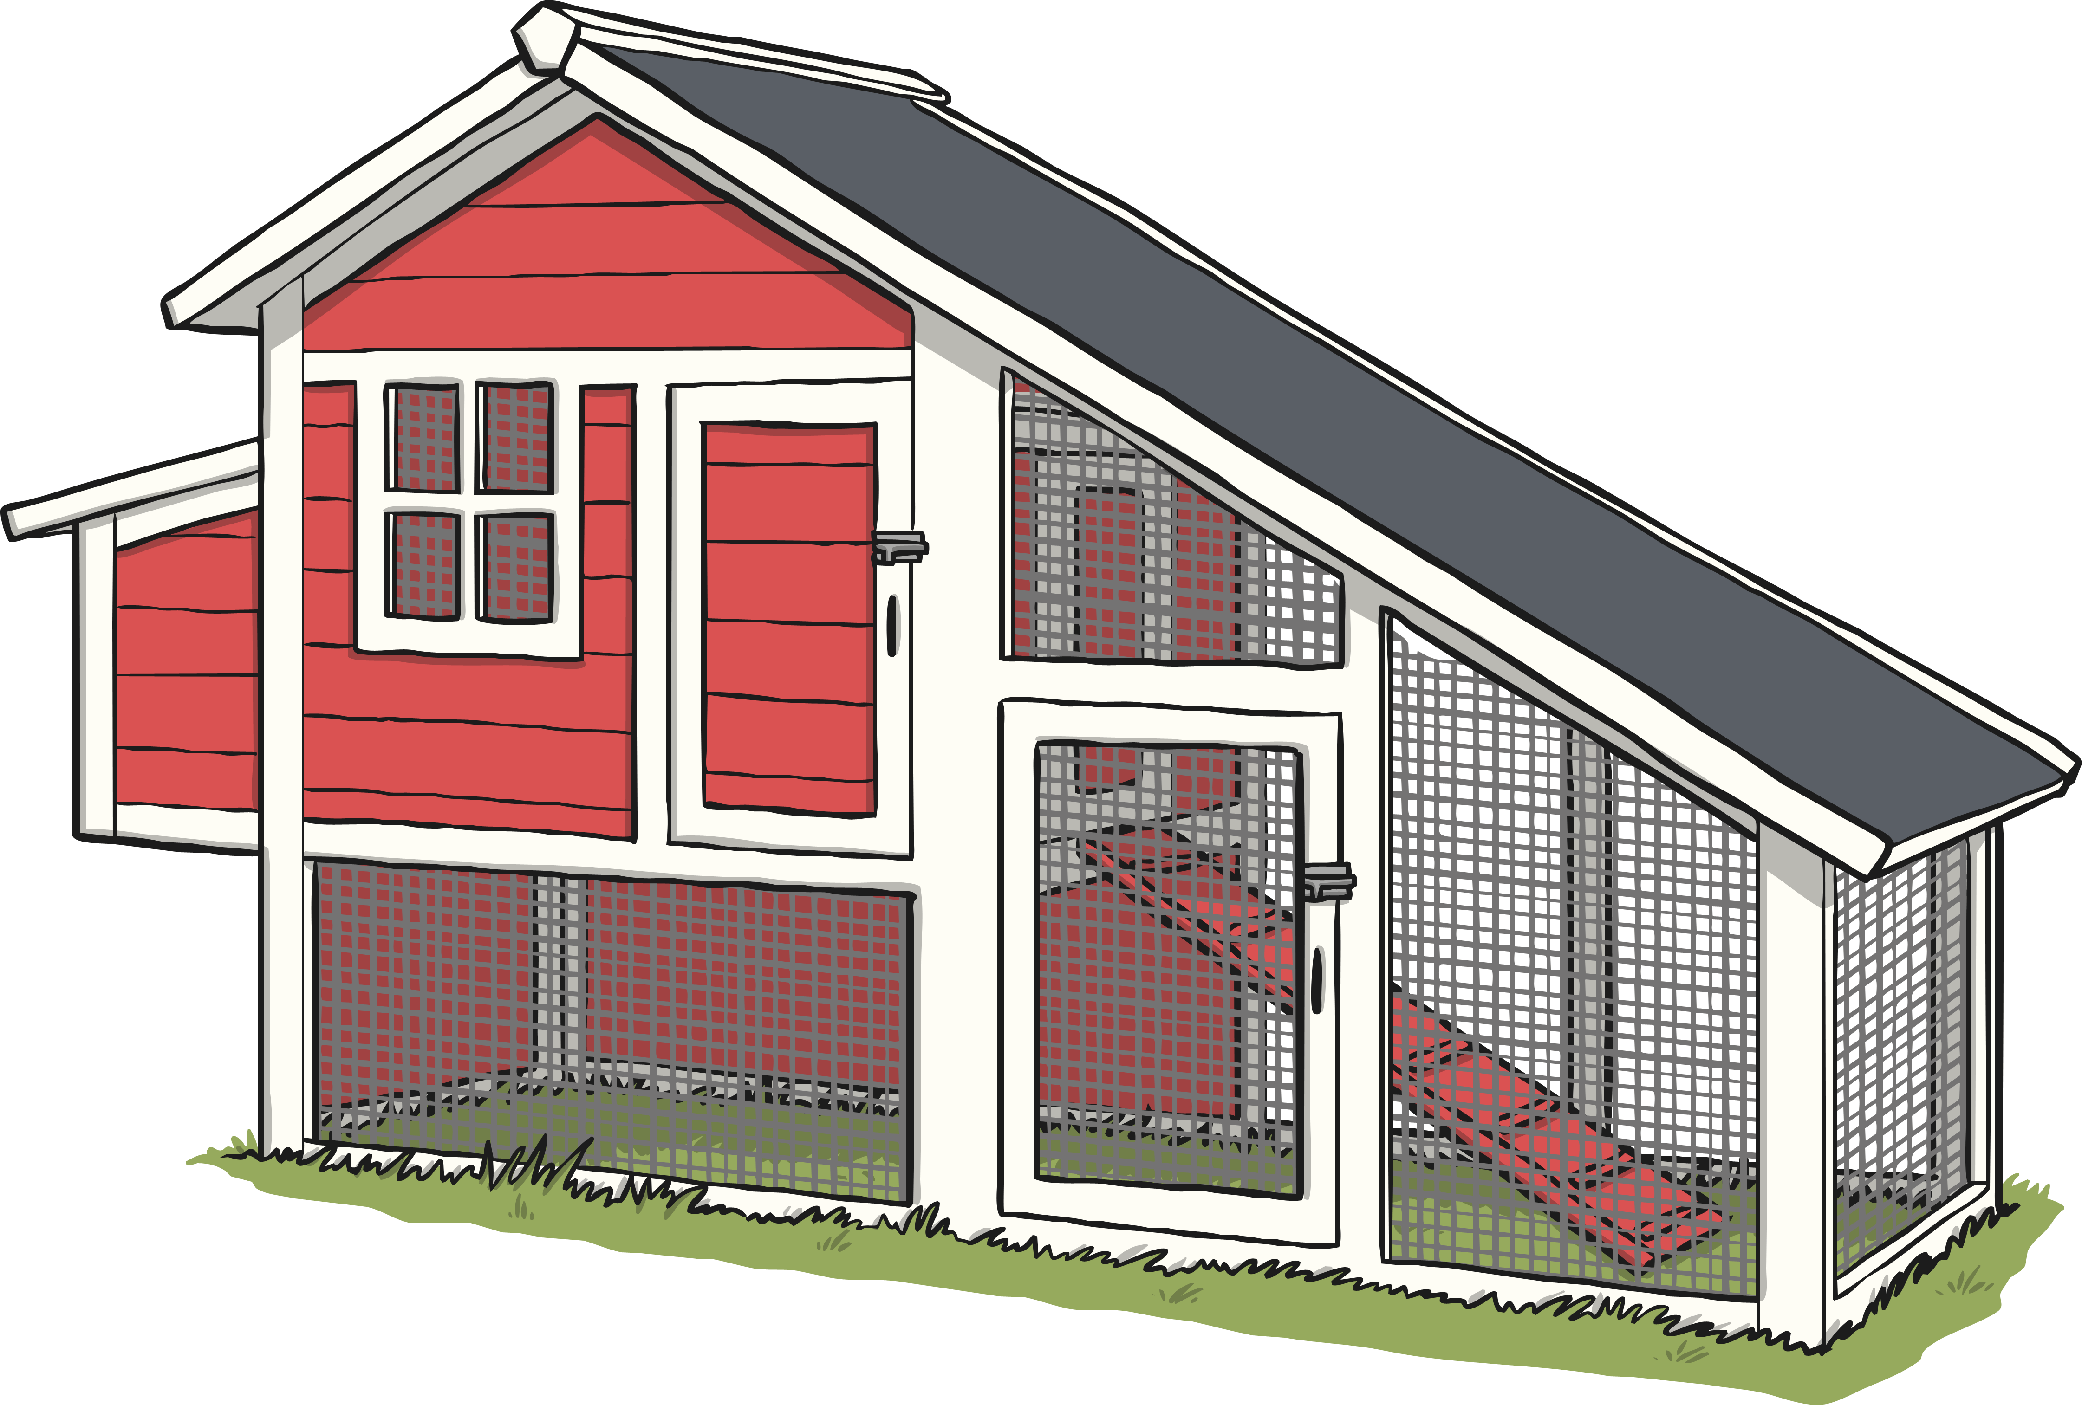
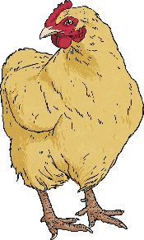
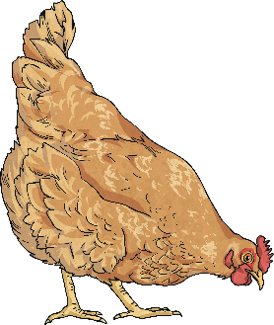
Guided Maths Question 2
Read this reasoning question carefully.
The base of Gethin’s chicken coop is a rectangle. The length measures 2.5m and the width measures 0.8m. Calculate the area and perimeter of the chicken coop.
The base of Gethin’s chicken coop is a rectangle. The length measures 2.5m and the width measures 0.8m. Calculate the area and perimeter of the chicken coop.
Let’s highlight the important information and key vocabulary to make sure that we understand the question.

Slide 11
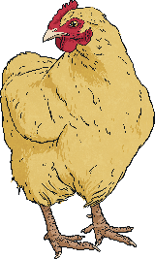
Guided Maths Question 2
Next, let’s think about what we already know in order to help us answer the question correctly.
The base of Gethin’s chicken coop is a rectangle. The length measures 2.5m and the width measures 0.8m. Calculate the area and perimeter of the chicken coop.
I know the formula to calculate area.
I know the formula to calculate perimeter.
length × width = area
(length × 2) + (width × 2) = perimeter or (length + width) × 2 = perimeter

Slide 12
Guided Maths Question 2
Now, we are ready to apply our learning to solve the question.
The base of Gethin’s chicken coop is a rectangle. The length measures and the width measures . Calculate the area and perimeter of the chicken coop.
Second, substitute the values we know into the perimeter formula.
2.5m
First, substitute the values we know into the area formula.
Now, calculate the area using a written method of multiplication.
0.8m
Now, calculate the perimeter.
length × width = area
(length + width) × 2 = perimeter
2.5m × 0.8m = area
(2.5m + 0.8m) × 2 = perimeter
2.5m × 0.8m = 2m²
(2.5m + 0.8m) × 2 = 6.6m

Slide 13
Guided Maths Question 2
Finally, let’s check our answer with the information and key vocabulary in the question to check we have answered the question fully.
The base of Gethin’s chicken coop is a rectangle.
The length measures 2.5m and the width measures 0.8m.
Calculate the area and perimeter of the chicken coop.
2.5m × 0.8m = area
area = 2m²
(2.5m + 0.8m) × 2 = perimeter
perimeter = 6.6m

Slide 14
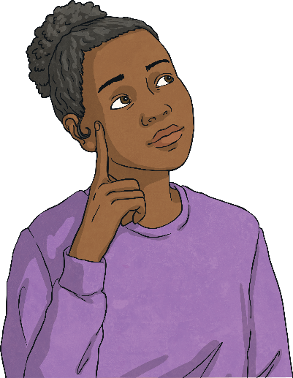
Partner Maths Question 2
Working with a partner, use your reasoning skills to answer this question.
The base of Karolina’s chicken coop is a rectangle. The length measures 3.4m and the width measures 1.6m. Calculate the area and perimeter of the chicken coop.
3.4m × 1.6m = area
area = 5.44m²
Show answers
(3.4m + 1.6m) × 2 = perimeter
perimeter = 10m

Slide 15
Guided Maths Question 3
Read this reasoning question carefully.
When placed next to each other, this equilateral triangle and parallelogram create a trapezium. Calculate the area of the trapezium.
When placed next to each other, this equilateral triangle and parallelogram create a trapezium. Calculate the area of the trapezium.
10cm
10cm
8cm
5cm
Let’s highlight the important information and key vocabulary to make sure that we understand the question.

Slide 16
Guided Maths Question 3
Next, let’s think about what we already know in order to help us answer the question correctly.
When placed next to each other, this equilateral triangle and parallelogram create a trapezium.
Calculate the area of the trapezium.
(base × height) ÷ 2 = area of triangle
base × height = area of parallelogram
area of triangle + area of parallelogram = area of trapezium
10cm
10cm
8cm
5cm
I know that the trapezium is created when the triangle and parallelogram are combined.
I know the formula for calculating the area of a parallelogram.
I know the formula for calculating the area of a triangle.

Slide 17
Guided Maths Question 3
Now, we are ready to apply our learning to solve the question.
When placed next to each other, this equilateral triangle and parallelogram create a trapezium.
Calculate the area of the trapezium.
base × height = area of parallelogram
5cm × 10cm = area of parallelogram
5cm × 10cm = 50cm²
10cm
10cm
Now, I can substitute the known values into the formula for calculating the area of the parallelogram.
8cm
5cm
First, substitute the values we know into the formula for calculating the area of the triangle.
Now, I can calculate the area of the trapezium.
Now, I can calculate the area of the triangle.
Now, I can calculate the area of the parallelogram.
(base × height) ÷ 2 = area of triangle
(8cm × 10cm) ÷ 2 = area of triangle
(8cm × 10cm) ÷ 2 = 40cm²
40cm² × 50cm² = 90cm²

Slide 18
Guided Maths Question 3
Finally, let’s check our answer with the information and key vocabulary in the question to check we have answered the question fully.
When placed next to each other, this equilateral triangle and parallelogram create a trapezium. Calculate the area of the trapezium.
10cm
10cm
8cm
5cm
40cm² + 50cm² = 90cm²
area of trapezium = 90cm²

Slide 19
Partner Maths Question 3
Working with a partner, use your reasoning skills to answer this question.
When placed next to each other, this equilateral triangle and parallelogram create a trapezium. Calculate the area of the trapezium.
7.5cm
7.5cm
6.4cm
11cm
24cm² + 82.5cm² = 106.5cm²
Show answers
area of trapezium = 106.5cm²

Slide 20
Reasoning Using Formulae

Slide 21
Reasoning Answers
Did you answer the first reasoning question correctly?
Isla picks tomatoes from her vegetable patch and then sells them in boxes.
She charges 14p for each tomato and 25p for each box. A box can hold 12 tomatoes.
Use a formula to answer these questions:
a) How much does it cost to buy 18 tomatoes in boxes?
b) How many tomatoes are in 3 boxes costing £4.39?
Amena bakes cupcakes and then sells them in boxes.
She charges £1.25 for each cupcake and 35p for each box.
A box can hold 6 cupcakes.
Use a formula to answer these questions:
a) How much does it cost to buy 24 cupcakes in boxes?
b) How many cupcakes are in 5 boxes costing £35.50?
Marcin is having a car boot sale and selling his old clothes.
He charges £2.60 for each item of clothing and 20p for a bag to carry them in. A bag can hold 3 items of clothing.
Use a formula to answer these questions:
a) How much does it cost to buy 13 items of clothing with bags to carry them?
b) How many items of clothing are sold in 10 bags costing £77.40?
£3.02
26 tomatoes
£31.40
27 cupcakes
£34.80
29 items of clothing

Slide 22
Reasoning Answers
Did you answer the second reasoning question correctly?
The base of Jack’s rabbit hutch is a rectangle.
The length measures 2.8m and the width measures 1.7m.
Calculate the area and perimeter of the base of the rabbit hutch.
The base of Ola’s tent is a rectangle.
The length measures 2.45m and the width measures 1.75m.
Calculate the area and perimeter of the base of the tent. Round your answers to the nearest cm.
Sami’s climbing frame is a cuboid.
The length measures 2.35m, the width measures 1.65m and the height measures 1.9m.
Calculate the area and perimeter of the base and the volume of the whole climbing frame. Round your answers to the nearest cm.
area = 4.76m²
perimeter = 9m
area = 4.29m²
perimeter = 8.40m
area = 3.88m²
perimeter = 8m
volume = 7.37m³

Slide 23
Reasoning Answers
Did you answer the third reasoning question correctly?
When an equilateral triangle and parallelogram are placed next to each other, they create a trapezium.
Calculate the area of the trapezium. Round your final answer to the nearest cm².
When two equilateral triangles are placed at either end of a parallelogram, a larger parallelogram is created.
Calculate the area of the larger parallelogram. Round your answers to the nearest cm².
When three equilateral triangles are placed at either end of a parallelogram, a trapezium is created.
Calculate the area of the trapezium. Round your answers to the nearest cm².
8.2cm
8.2cm
10.2cm
10.2cm
12.6cm
12.6cm
5.3cm
10.7cm
9.8cm
20.5cm
11.6cm
19.8cm
a) area of trapezium = 110cm²
a) area = 309cm²
a) area = 468cm²

Slide 24
Reasoning Answers
How confident do you feel about solving reasoning questions using simple formulae?
Show me using a silent signal:

Slide 25
Aim
I can solve reasoning questions using simple formulae.
Success Criteria
I can break down complex problems into smaller steps.
I can use mathematical language to explain solutions to problems.
I can apply my understanding of simple formulae.

