Slide 1
Picture Reflections
Resilience when facing challenges

Slide 2
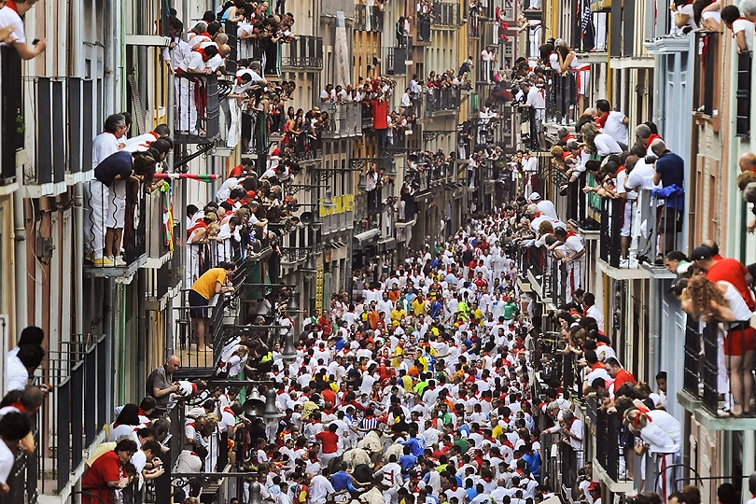

Slide 3
What do you see in the picture?
Can you make a prediction about what we are going to be talking about?
What questions do you have about this picture?
Come up with three questions.

Slide 4
Why is never giving up and showing resilience important? Luke 5: 17-25
Jesus Heals a Paralysed Man
17 One day Jesus was teaching the people. The Pharisees and teachers of the law were there, too. They had come from every town in Galilee and from Judea and Jerusalem. The Lord was giving Jesus the power to heal people. 18 There was a man who was paralysed. Some men were carrying him on a mat. They tried to bring him in and put him down before Jesus. 19 But because there were so many people there, they could not find a way to Jesus. So the men went up on the roof and made a hole in the ceiling. They lowered the mat so that the paralyzed man was lying right before Jesus. 20 Jesus saw that these men believed. So he said to the sick man, “Friend, your sins are forgiven.”
21 The Jewish teachers of the law and the Pharisees thought to themselves, “Who is this man? He is saying things that are against God! Only God can forgive sins.”
22 But Jesus knew what they were thinking. He said, “Why do you have thoughts like that in your hearts? 23 Which is easier: to tell this paralyzed man, ‘Your sins are forgiven,’ or to tell him, ‘Stand up and walk’? 24 But I will prove to you that the Son of Man has authority on earth to forgive sins.” So Jesus said to the paralyzed man, “I tell you, stand up! Take your mat and go home.”
25 Then the man stood up before the people there. He picked up his mat and went home, praising God. 26 All the people were fully amazed and began to praise God. They were filled with much respect and said, “Today we have seen amazing things!”
Why might the friends have given up? What would have happened then?

Slide 5
Why is showing gratitude so important?
How do you feel about this story?
What do you think we can learn from this story?
What is your one key emotional response word?

Slide 6
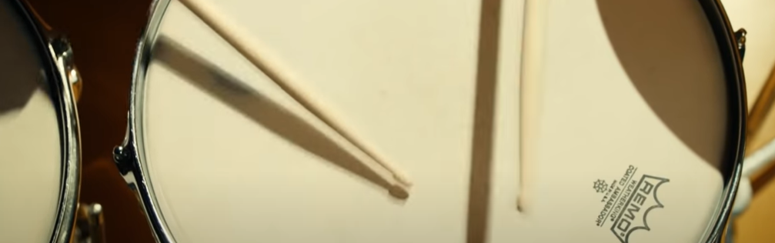
Challenge Question: How have these people shown resilience? What can we learn from these amazing examples? Watch this clip: https://www.youtube.com/watch?v=IocLkk3aYlk

Slide 7
reflection
We can sometimes find so many excuses to give up…
it is too difficult, I can’t do it, I don’t know what to do.
Yet when we keep going, when we show resilience then something amazing might just happen. We may become more confident, we may learn something (even from our mistakes) and what’s more we might find that in fact we can do it. It is only in trying that we can ever succeed.

Slide 8
British Values
Individual Liberty
We promote the freedom of choice and the right to respectfully express views and beliefs in a safe environment. With this comes a responsibility to make good choices that impact ourselves and others in a positive way.
This Photo by Unknown Author is licensed under CC BY-SA

