Slide 1
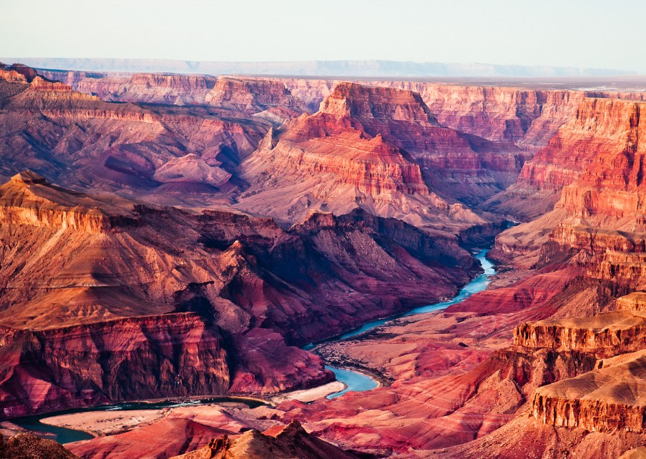
The Havasupai and Hualapai of The Grand Canyon
UKS2: Topic: Comparing People & Places Block B: The Grand Canyon Session 1
© Original resource copyright Hamilton Trust, who give permission for it to be adapted as wished by individual users.
We refer you to our warning, at the foot of the block overview, about links to other websites.

Slide 2
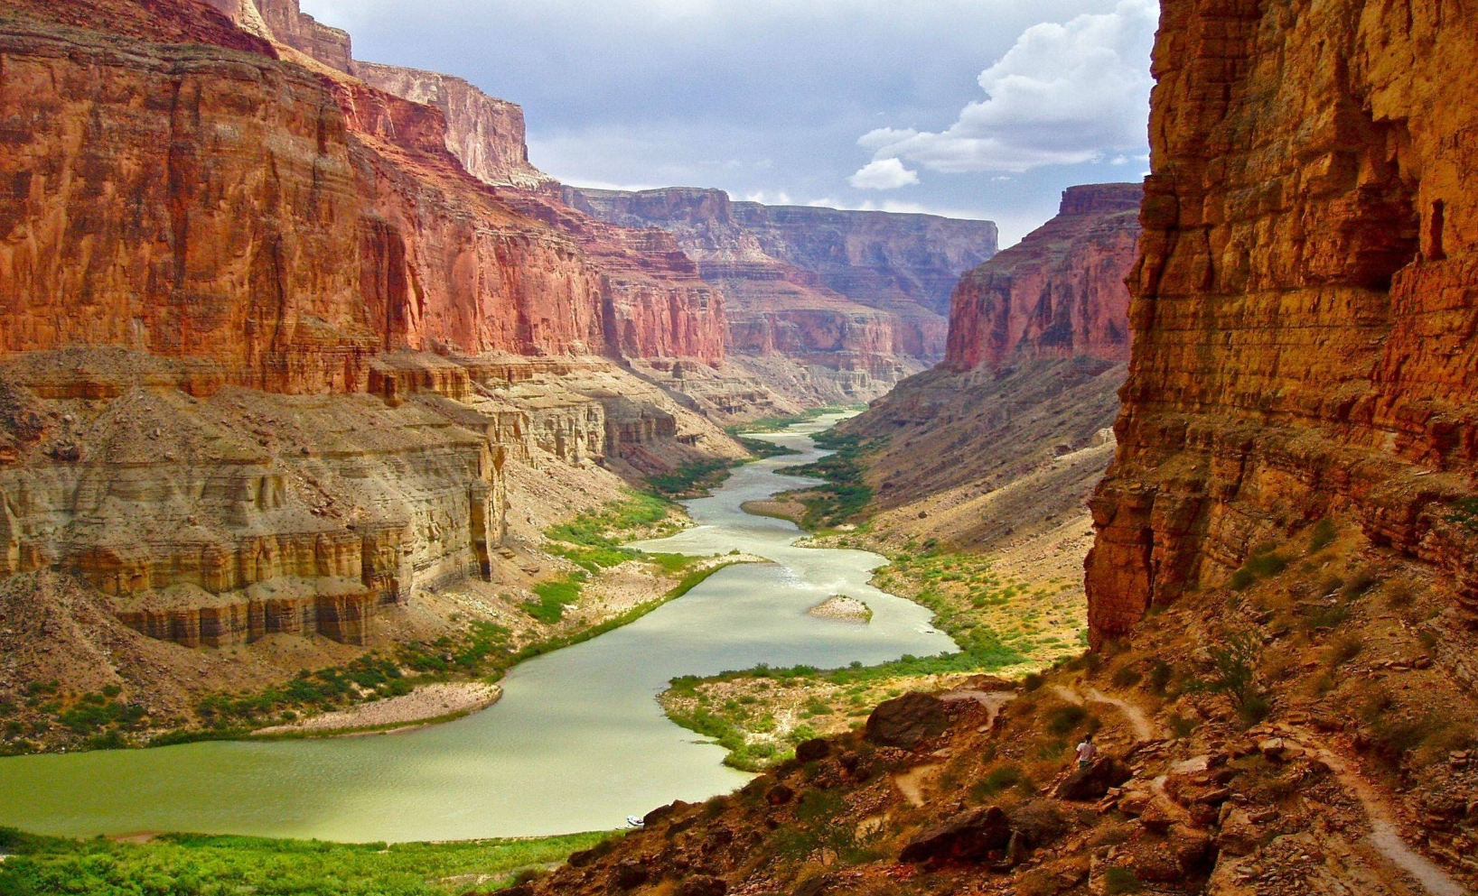
Living in the Grand Canyon
The Grand Canyon region has been inhabited for thousands of years. Initially it is thought that inhabitants were more nomadic and not permanently settled in the region. However, two tribes – the Havasupai (people of the blue-green waters) and Hualapai (people of the tall pines) have lived permanently in the region for over 800 years. Currently there are about 650 Havasupai and 1,600 Hualapai living in the Grand canyon region. Traditionally both tribes move between the plateaus and canyon sections depending on the season – winter on the plateau and summer in the canyon. The Hopi and Navaho tribes also inhabit parts of the region.

Slide 3
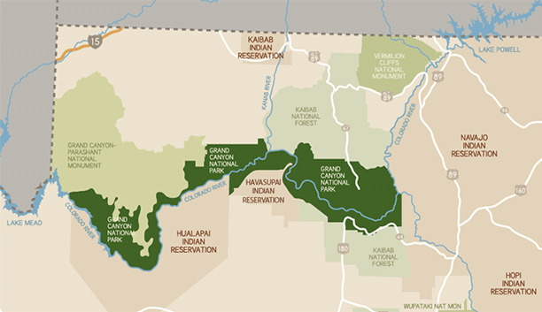
Havasupai and Hualapai reservations
Towards the end of the 19th and beginning of the 20th Century, much of the land owned by the Havasupai and Hualapai was claimed as national land belonging to the state. Two small reservations were initially created which belonged exclusively to these two tribes – these grew dramatically, though not back to the original size, when, in the 1970s, much more of their lands were returned to them. This resulted in the Havasupai reservation being 188,077 acres in size and the Hualapai reservation growing back to a million acres in size. This map shows the location of the reservations within the Grand Canyon National Park.

Slide 4
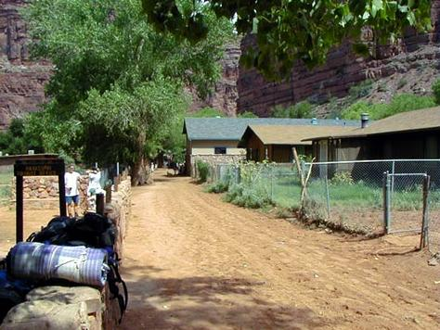
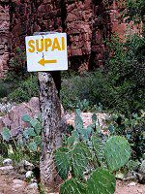
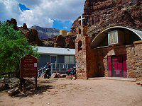
Settlements
Within each reservation there are settlements which take the form of small towns or villages. The 650 members of the Havasupai tribe lives in a settlement called Supai in the Havasu Canyon, which consists approximately 136 houses, and other buildings such as a school, chapel, café and shops. The Hualapai capital is called Peach Springs and is where most of these tribespeople reside.

Slide 5
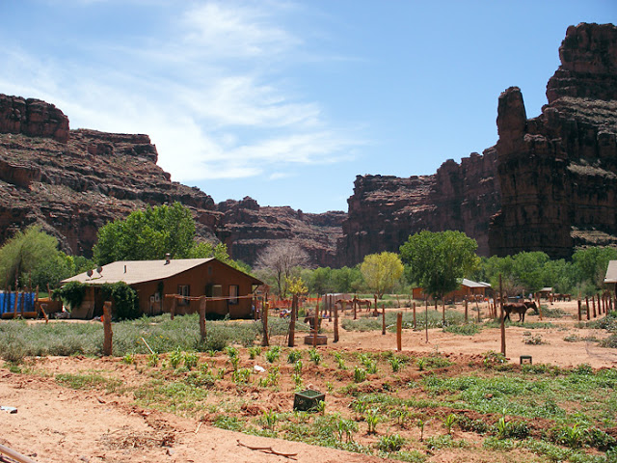
Traditional land-use
There is a range of physical features to be found in the Grand Canyon, from forests and grasslands to rivers and bare rock. Traditionally the Havasupai people grew crops such as corn, beans and squash, down in the canyon on grassy lands, while the Hualapai tended to be hunter-gatherers trading hides and meat with the Havasupai for squash, corn and pumpkins.

Slide 6
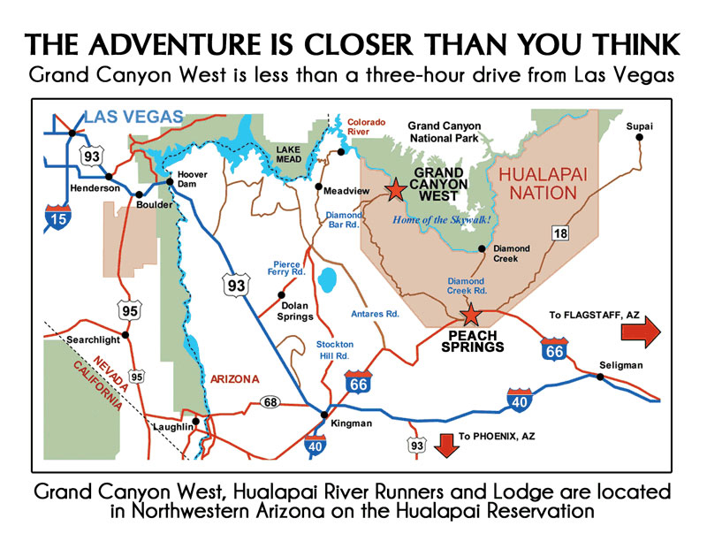
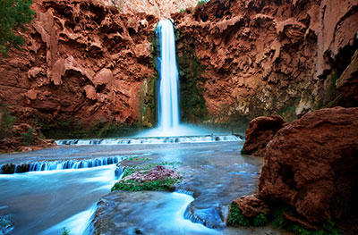
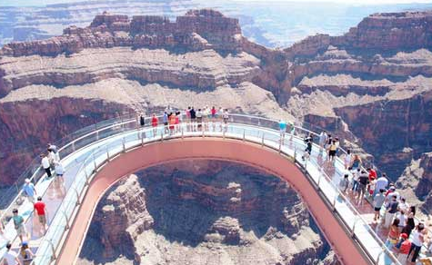
Tourism and economic sustainability
12,000 tourists visit the Havasupai reservation every year mainly to see the four spectacular waterfalls within their lands: the Navajo Falls, the Havasu Falls, the Mooney Falls and the Beaver Falls. The Hualapai tribe have built a tourist destination known as Grand Canyon West, which has approximately 40,000 visitors a year. It also built the Grand Canyon Skywalk, which is a glass-bottomed walkway sticking out from the edge of the canyon so that visitors can see right down to see the Colorado River. Both tribes charge entrance fees to their lands and attractions and have economies based solely on tourism. The Grand Canyon West tourist destination also provides jobs for many Hualapai people.
Notes:
12,000 tourists visit the Havasupai reservation every year mainly to see the four spectacular waterfalls within their lands: the Navajo Falls, the Havasu Falls, the Mooney Falls and the Beaver Falls. The Hualapai tribe have built a tourist destination known as Grand Canyon West, which has approximately 40,000 visitors a year. It also built the Grand Canyon Skywalk, which is a glass-bottomed walkway sticking out from the edge of the canyon so that visitors can see right down to see the Colorado River. Both tribes charge entrance fees to their lands and attractions and have economies based soleyl on tourism. The Grand Canyon West tourist destination also provides jobs for many Hualapai people.

Slide 7
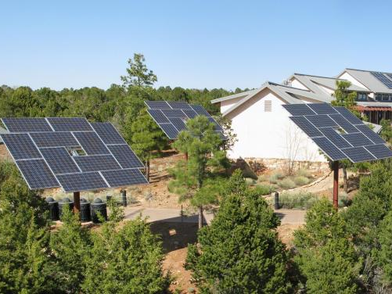
Natural resources
The Grand Canyon has plenty of edible plants, such as agave and cactus fruits, as well as wild animals such as rabbit and deer. These alongside locally grown crops using carefully developed irrigation systems, provide good sources of food. In more recent times solar panels have been introduced to the region to harness the sun’s energy for electricity.

Slide 8
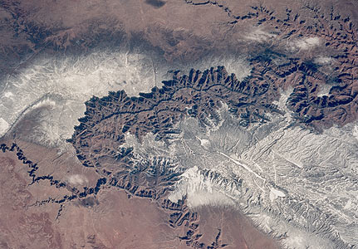
The future of the region
As the Grand Canyon continues to increase in popularity as a tourist destination (nearly 5 million visitors a year), consideration needs to be given to local resources, communities, education and preservation to ensure the region and its people continue to thrive.
Notes:
As the Grand Canyon continues to increase in popularity as a tourist destination (nearly 5 million visitors a year), consideration needs to be given to local resources, communities, education and preservation to ensure the region and its people continue to thrive.

