Slide 1
LIFE/work balance
We have started a #LIFEworkbalance campaign and we need your help to complete our LIFE/work balance survey.
We hope to publish the results soon, so please give 15 minutes of your time to help us get a true picture of school life.
Want to be a part of this campaign? Take the survey on our website and share it with your colleagues!
© Classroom Secrets Limited 2020

Slide 2
Year 6 – Spring Block 3 – Algebra – Find A Rule – Two Step
About This Resource:
This PowerPoint has been designed to support your teaching of this small step. It includes a starter activity and an example of each question from the Varied Fluency and Reasoning and Problem Solving resources also provided in this pack. You can choose to work through all examples provided or a selection of them depending on the needs of your class.
National Curriculum Objectives:
Mathematics Year 6: (6A1) Express missing number problems algebraically
Mathematics Year 6: (6A2) Use simple formulae
More Year 6 Algebra resources.
Did you like this resource? Don’t forget to review it on our website.
© Classroom Secrets Limited 2019

Slide 3
Year 6 – Spring Block 3 – Algebra
Step 2: Find a Rule – Two Step
© Classroom Secrets Limited 2019

Slide 4
Introduction
Find the function that the function robot below is using.
Inputs:
Outputs:
10
-5
?
95
80
25
10
© Classroom Secrets Limited 2019

Slide 5
Introduction
Find the function that the function robot below is using.
Inputs:
Outputs:
10
-5
– 15
95
80
25
10
© Classroom Secrets Limited 2019

Slide 6
Varied Fluency 1
Write the outputs for the two-step function machine below.
Inputs:
Outputs:
Functions:
25
45
+ 5
÷ 5
5
© Classroom Secrets Limited 2019

Slide 7
Varied Fluency 1
Write the outputs for the two-step function machine below.
Inputs:
Outputs:
Functions:
25
6
45
+ 5
÷ 5
10
5
2
© Classroom Secrets Limited 2019

Slide 8
Varied Fluency 2
Use the two-step function to match the inputs to the correct outputs.
Functions:
+ 9, ÷ 2
Inputs:
Outputs:
11
10
25
9
9
17
© Classroom Secrets Limited 2019

Slide 9
Varied Fluency 2
Use the two-step function to match the inputs to the correct outputs.
Functions:
+ 9, ÷ 2
Inputs:
Outputs:
11
10
25
9
9
17
© Classroom Secrets Limited 2019

Slide 10
Varied Fluency 3
Complete the two-step function machine below.
Inputs:
Outputs:
Functions:
9.5
6
4
– 8.5
?
0.5
10
6.5
© Classroom Secrets Limited 2019

Slide 11
Varied Fluency 3
Complete the two-step function machine below.
Inputs:
Outputs:
Functions:
9.5
6
4
– 8.5
+ 5
0.5
10
6.5
© Classroom Secrets Limited 2019

Slide 12
Problem Solving 1
Insert two functions that could be used to make
the function machine correct.
Input:
Functions:
Output:
11
?
?
28
© Classroom Secrets Limited 2019

Slide 13
Problem Solving 1
Insert two functions that could be used to make
the function machine correct.
Various answers, for example:
x 3; – 5
Input:
Functions:
Output:
11
?
?
28
© Classroom Secrets Limited 2019

Slide 14
Reasoning 1
True or false? Explain your answer.
Suggest what the functions could be.
Inputs:
Function:
Outputs:
3
?
?
9
15
13
I think that the function is x 2 and then add 3 because 3 x 2, then + 3 is 9.
© Classroom Secrets Limited 2019

Slide 15
Reasoning 1
True or false? Explain your answer.
Suggest what the functions could be.
The answer is false because…
Inputs:
Function:
Outputs:
3
?
?
9
15
13
I think that the function is x 2 and then add 3 because 3 x 2, then + 3 is 9.
© Classroom Secrets Limited 2019

Slide 16
Reasoning 1
True or false? Explain your answer.
Suggest what the functions could be.
The answer is false because x 2, then + 3 doesn’t work for an input of 15 to give an output of 13. The function could be ÷ 3, + 8.
Inputs:
Function:
Outputs:
3
÷ 3
+ 8
9
15
13
I think that the function is x 2 and then add 3 because 3 x 2, then + 3 is 9.
© Classroom Secrets Limited 2019

Slide 17
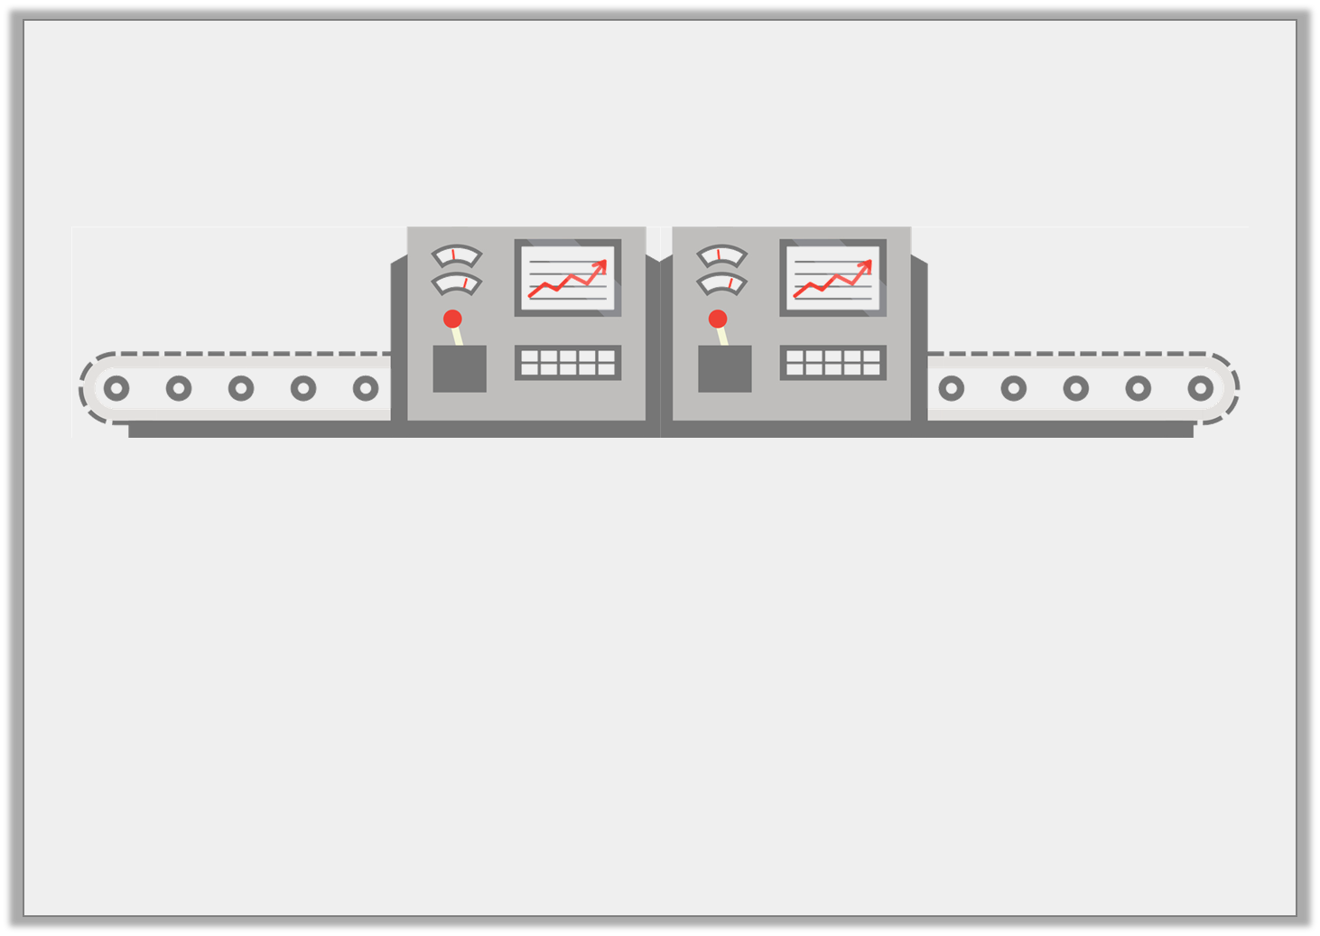
Problem Solving 2
Jaxon is using this function machine.
He puts an input into the function machine to generate an output. He then puts that output into the machine as an input. He now has the output of 40.
What was Jaxon’s original number?
x 5
– 10
© Classroom Secrets Limited 2019

Slide 18
Problem Solving 2
Jaxon is using this function machine.
He puts an input into the function machine to generate an output. He then puts that output into the machine as an input. He now has the output of 40.
What was Jaxon’s original number?
4
x 5
– 10
© Classroom Secrets Limited 2019

