Slide 1

Week 1 - Phonics
Week commencing: Wednesday 6th January 2021

Slide 2
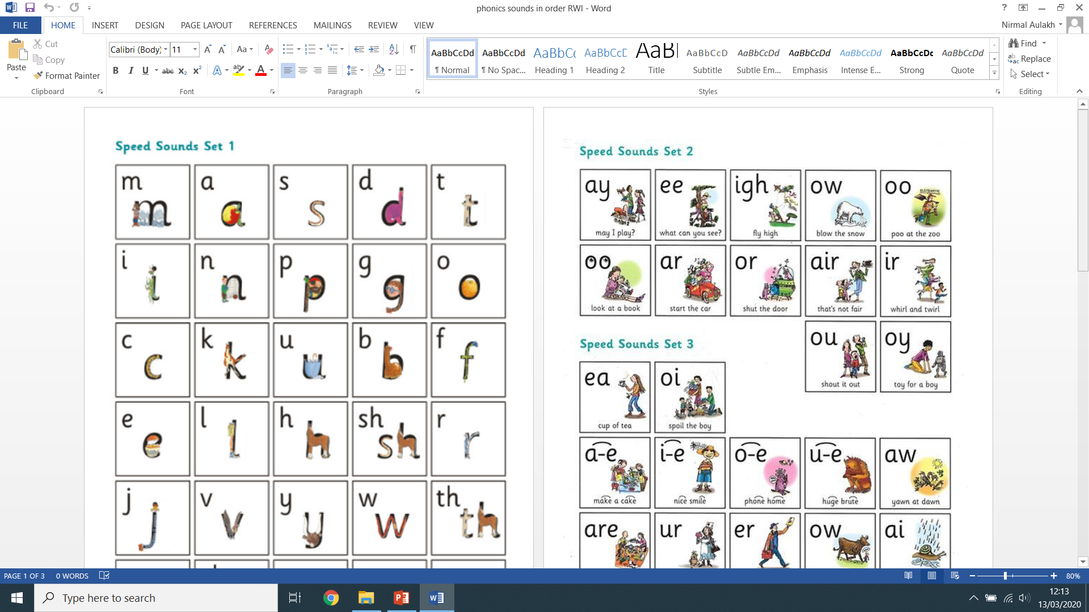
Recap (previous set 2 sounds):
Say each diagraph below and write down as many ‘green’ words as you can remember!

Slide 3
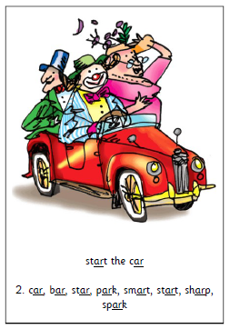
Lesson 1:
ar
Green Words:
part
hard
.
.
.
.
car
sharp
.
.
star
start
.
.
.
.
.

Slide 4

Have a go at practicing writing the ‘ar’ sound:
ar
ar
ar
ar
Write me two sentence describing what you can see, don’t forget to use you phonics knowledge:
________________________________________________________________________________________________________________________________________________________________________________________________________________________________________________________________________________
________________________________________________________________________________________________________________________________________________________________________________________________________________________________________________________________________________

Slide 5
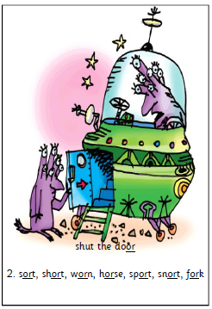
Lesson 2:
or
Green Words:
sort
short
.
.
.
horse
sport
.
.
.
.
fork
snort
.
.
.
.
.

Slide 6
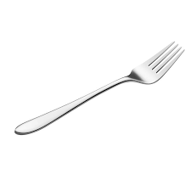
Have a go at practicing writing the ‘or’ sound:
or
or
or
or
Write me two sentence describing what you can see, don’t forget to use you phonics knowledge:
________________________________________________________________________________________________________________________________________________________________________________________________________________________________________________________________________________
________________________________________________________________________________________________________________________________________________________________________________________________________________________________________________________________________________

Slide 7

Write two sentences using any ‘ar’ word and an ‘or’ word. Can you think of an adjective or conjunction to make your sentence more interesting?

