Slide 1

Week 2/3 - Phonics
Week commencing: Monday 11th January 2021 and Monday 18th January 2021.

Slide 2
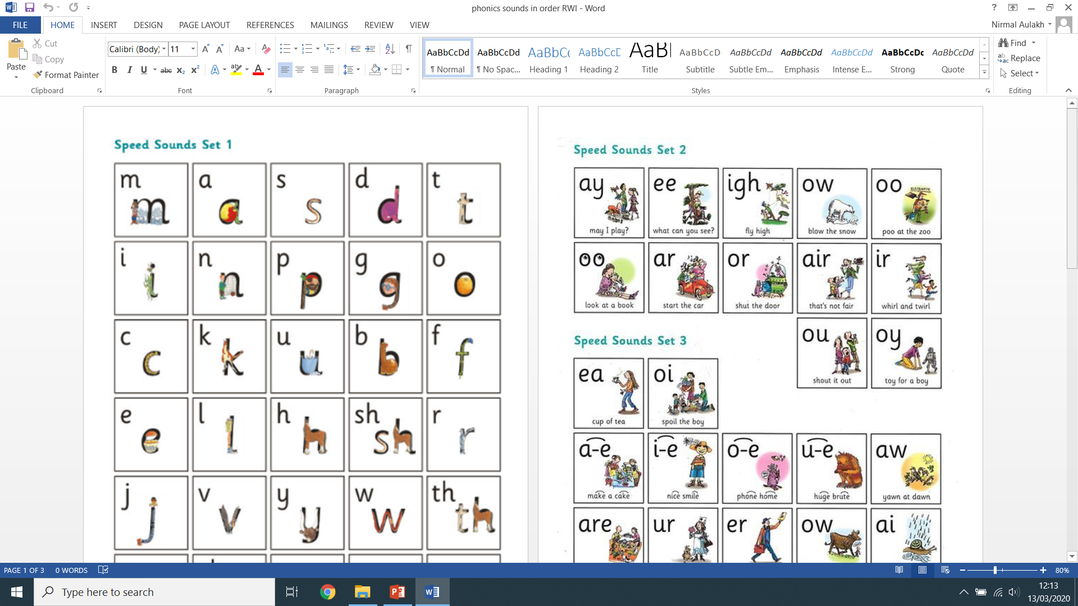


Recap (previous set 2 sounds):
Say each diagraph below and write down as many ‘green’ words as you can remember!

Slide 3
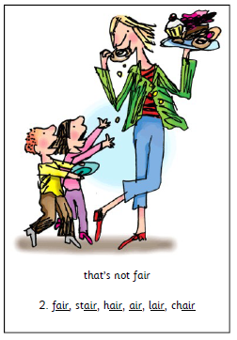
Lesson 3:
air
Green Words:
fair
air
.
hair
lair
.
.
stair
chair
.
.

Slide 4
Have a go at practicing writing the ‘air’ sound:
air
air
air
air
Write me two sentence describing what you can see, don’t forget to use you phonics knowledge:
________________________________________________________________________________________________________________________________________________________________________________________________________________________________________________________________________________
________________________________________________________________________________________________________________________________________________________________________________________________________________________________________________________________________________

Slide 5
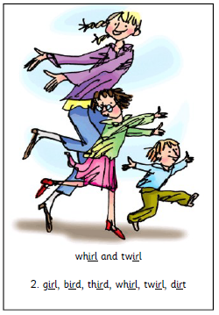
Lesson 4:
ir
Green Words:
girl
twirl
.
.
.
.
.
third
whirl
.
.
bird
dirt
.
.
.
.

Slide 6
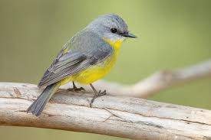
Have a go at practicing writing the ‘ir’ sound:
ir
ir
ir
ir
Write me two sentence describing what you can see, don’t forget to use you phonics knowledge:
________________________________________________________________________________________________________________________________________________________________________________________________________________________________________________________________________________
________________________________________________________________________________________________________________________________________________________________________________________________________________________________________________________________________________

Slide 7

Lesson 5:
ou
Green Words:
out
shout
.
.
loud
mouth
.
.
.
round
found
.
.
.
.
.
.

Slide 8
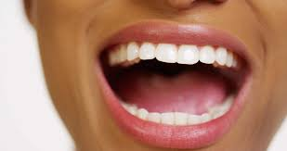
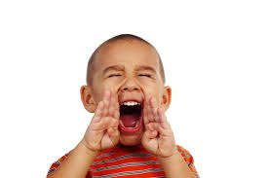
Have a go at practicing writing the ‘ou’ sound:
ou
ou
ou
ou
Write me two sentence describing what you can see, don’t forget to use you phonics knowledge:
________________________________________________________________________________________________________________________________________________________________________________________________________________________________________________________________________________
________________________________________________________________________________________________________________________________________________________________________________________________________________________________________________________________________________

Slide 9

Lesson 6:
oy
Green Words:
toy
.
boy
.
enjoy
.
.
.

Slide 10
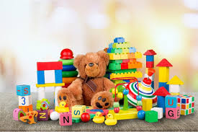
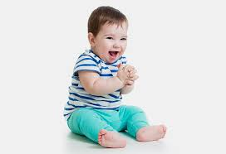
Have a go at practicing writing the ‘oy’ sound:
oy
oy
oy
oy
Write me two sentence describing what you can see, don’t forget to use you phonics knowledge:
________________________________________________________________________________________________________________________________________________________________________________________________________________________________________________________________________________
________________________________________________________________________________________________________________________________________________________________________________________________________________________________________________________________________________

Slide 11

Write as many sentences as you can using any ‘air, ir, ou and oy’ words. Can you think of an adjective or conjunction to make your sentence more interesting?

