Slide 1
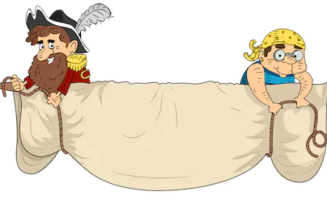
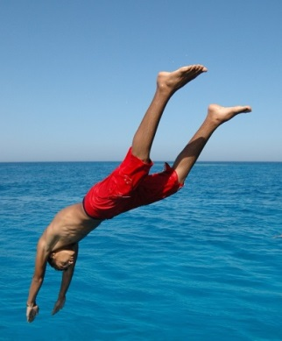
unfurled:
Verb
Spread out wide from a
rolled or folded position.
Synonyms:
Unroll, unfold.
“It kept its wings half unfurled as it swept its head from side to side.”
1
plunge:
Verb
If something or someone
plunges in a particular direction,
especially into water, they fall,
rush, or throw themselves in that
direction.
Synonyms:
Descend, fall, drop, crash.
“Before I could open my mouth to speak, he had taken the plunge.”
1

Slide 2
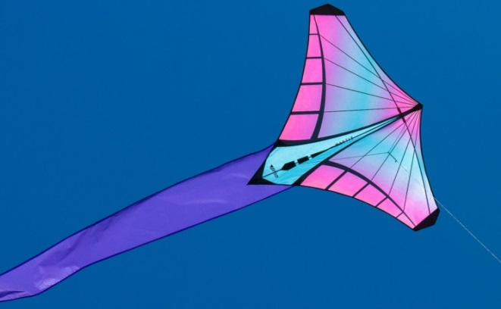
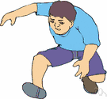
soaring:
Verb
If something such as a
bird soars into the air,
it goes quickly up into the
air.
Synonyms:
Rise, wing, climb, ascend.
“The dragon was off. Soaring away over the bed.”
1
lurched:
Verb
Make an abrupt,
unsteady movement.
Synonyms:
Stagger, stumble, sway.
“I lurched forwards to catch the dragon but before I could, he flapped and rose in the air.”
1

