Slide 1
Picture Reflections
Be intrigued by mystery

Slide 2
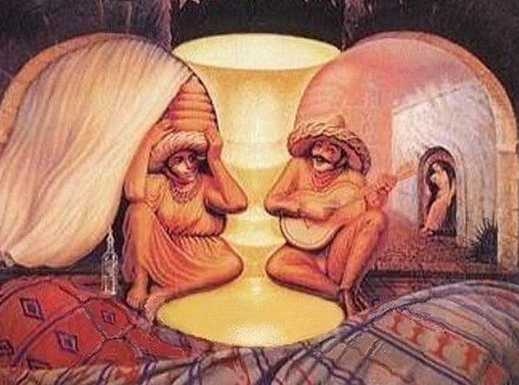

Slide 3
What do you see in the picture?
Can you make a prediction about what we are going to be talking about?
What questions do you have about this picture?
Come up with three questions.

Slide 4
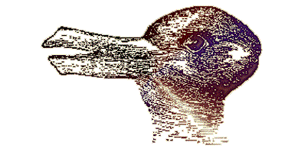
Two pictures In one – optical illusions
Jesus often used parables to teach about God and His kingdom. In many ways these are like optical illusions. The stories can be seen as having two meanings – an earthly meaning and a spiritual meaning. There is also a mystery around parables too – not everyone understands them and it can take quite a bit of thinking to understand them fully.
What is an Optical Illusion?
There is often a mystery around optical illusions. With optical illusions you can often see two pictures in one and you need to really try hard to see the full picture.
Can you see a rabbit, a duck or both?

Slide 5
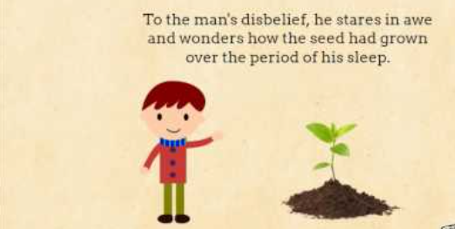
A story with a hidden meaning, A parable of the growing seeds
Jesus Uses a Story About Seed
²⁶ Then Jesus said, “The kingdom of God is like a man who plants seed in the ground. ²⁷ The seed comes up and grows night and day. It doesn’t matter whether the man is asleep or awake; the seed still grows. The man does not know how it grows. ²⁸ Without any help, the earth produces grain. First the plant grows, then the head, and then all the grain in the head. ²⁹ When the grain is ready, the man cuts it. This is the harvest time.”

Slide 6
Intrigue and mysteries
What do you think this story means?
What do you think we can learn from this story?
What is your one key emotional response word?

Slide 7
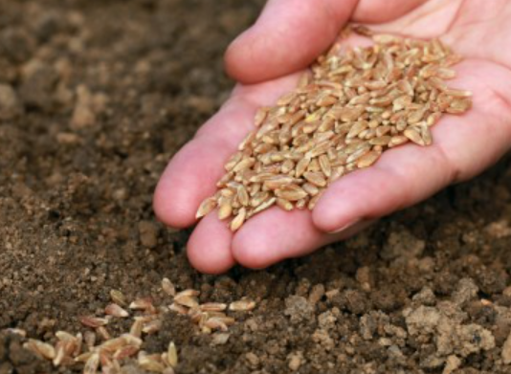
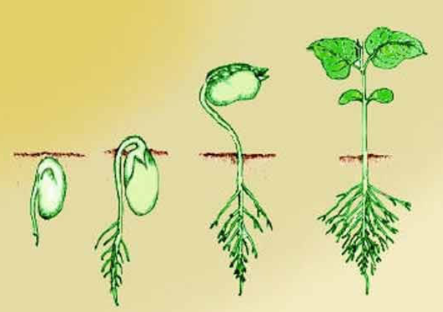
Reflection PARABLES AND HIDDEN MEANINGS
People often asked Jesus questions about faith, God and the Kingdom of God – he used the ordinary things in life to explain these mysteries.
In this parable Jesus compares the Kingdom of God and people’s faith with seeds growing secretly in the ground.
Christians believe that the Kingdom of God is not a physical place on earth – you cannot draw a map of it or visit it for holidays. The Kingdom of God is wherever God reigns. So, wherever people have faith in God that’s where His kingdom is.
The meaning of the Parable of the Growing Seed is about the mystery of faith. How God plants His Word in the heart of an individual to help grow faith. How this works is mysterious – just like an actual seed growing into a plant, the way it works is hidden but it doesn’t stop us asking questions about it.

Slide 8
Mysteries and intrigues
When you think about the world, about God, about faith, about the universe – what questions do you have?
Take some time to share your questions and ideas.

Slide 9
British Values
Individual Liberty
We promote the freedom of choice and the right to respectfully express views and beliefs in a safe environment. With this comes a responsibility to make good choices that impact ourselves and others in a positive way.
This Photo by Unknown Author is licensed under CC BY-SA

