Slide 1
Year 2 – Home Learning Maths – Spring 1 – Week 4
Place Value Recap

Slide 2
Day 1: Recognise the place value of each digit in a 2-digit number.
This session we will be looking at how many 10’s and how many ones are in a number.
To help us we will use partitioning.
Have a look through the slides to see how to partition numbers to show how many 10’s and ones it has.
Then have a go at the activity sheet.
45
40
45 = 40 + 5

Slide 3
Day 2: Recognise the place value of each digit in a 2-digit number.
52
50
52 = 50 + 2

Slide 4
Day 2: Recognise the place value of each digit in a 2-digit number.
Let’s read this number sentence together.
50 + 2 = 52
Notes:
Tell children that splitting up a number like this is called partitioning.

Slide 5
Day 2: Recognise the place value of each digit in a 2-digit number.
Can we partition 88?
88 = 80 + 8
80 + 8 = 88

Slide 6
Day 2: Recognise the place value of each digit in a 2-digit number.
Can we partition 63?
63 = 60 + 3
60 + 3 = 63

Slide 7
Day 2: Recognise the place value of each digit in a 2-digit number.
Can we partition 97?
97 = 90 + 7
90 + 7 = 97

Slide 8
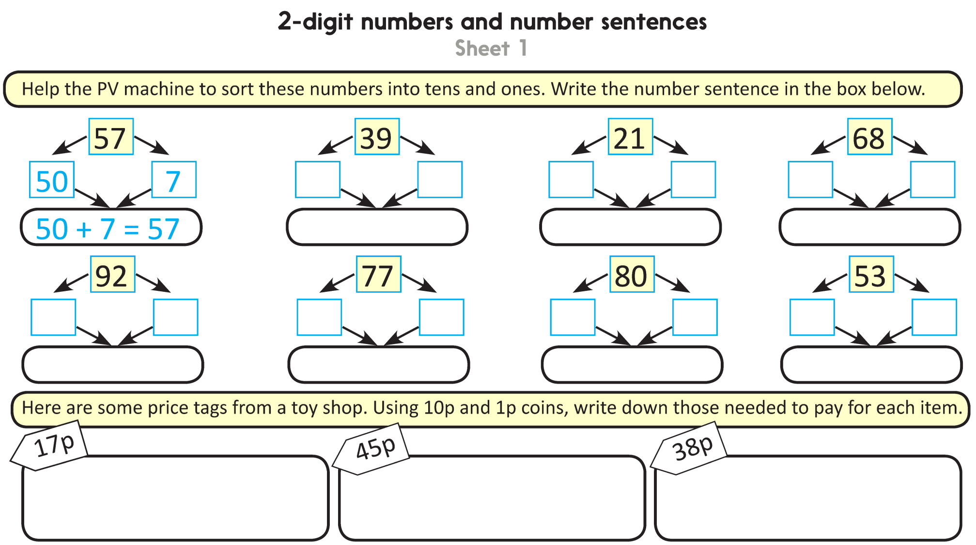
Challenge
Notes:
The Practice Sheet on this slide is suitable for most children.
Differentiated PRACTICE WORKSHEETS are available on Hamilton’s website in this unit’s PROCEDURAL FLUENCY box.
WT/ARE/GD: 2-digit numbers and number sentences Sheet 1

Slide 9
Day 2 – compare and order numbers
Number Machine
The number machine is very special and can compare things using comparing vocabulary:
smaller
smallest
larger
largest
larger than
smaller than

Slide 10
Number Machine
The number machine can also compare numbers.
smaller
smallest
larger
largest
122
345
345 is larger than 122.
122 is smaller than 345.

Slide 11
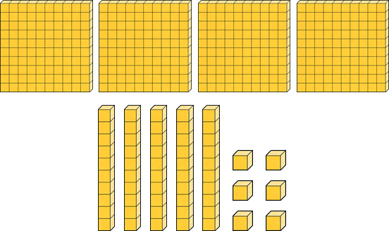
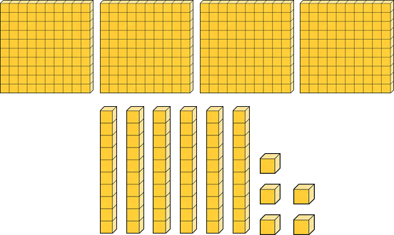
Number Machine
The number machine is comparing these numbers.
456
465
smaller
larger

Slide 12
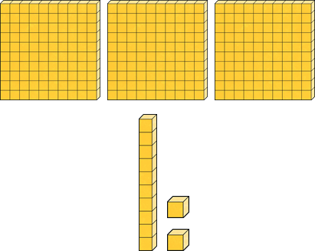
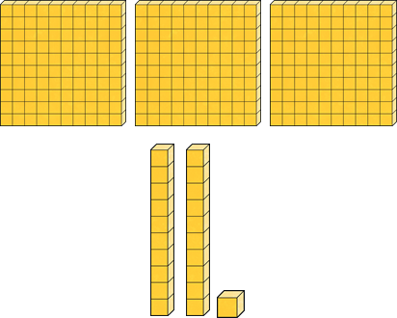
Number Machine
The number machine is comparing these numbers.
312
321
smaller
larger

Slide 13
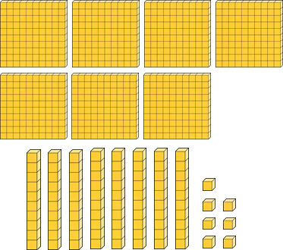
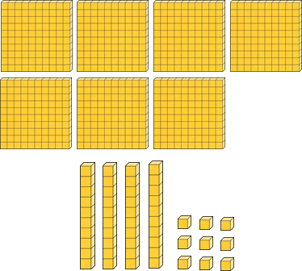
Number Machine
The number machine is comparing these numbers.
787
749
larger
smaller

Slide 14
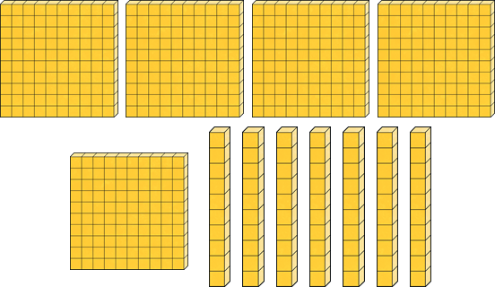
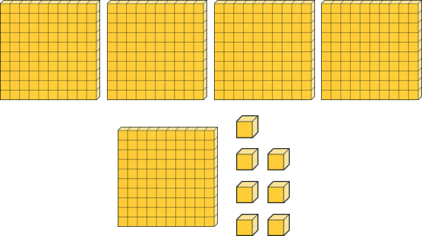
Number Machine
The number machine is comparing these numbers.
570
507
larger
smaller

Slide 15
Can you count to fill in the missing numbers?
Day 3 – Read and write numbers
1.
2.
3.
Which is the biggest number on this page?

Slide 16
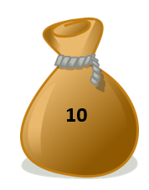
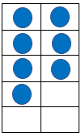
Which numbers are represented here?
Can you write your answer in numerals. How about words?

Slide 17
Can you match the numeral to the word?
37
16
60
77
sixteen
sixty
Thirty-seven
Which numeral doesn’t match up?

Slide 18
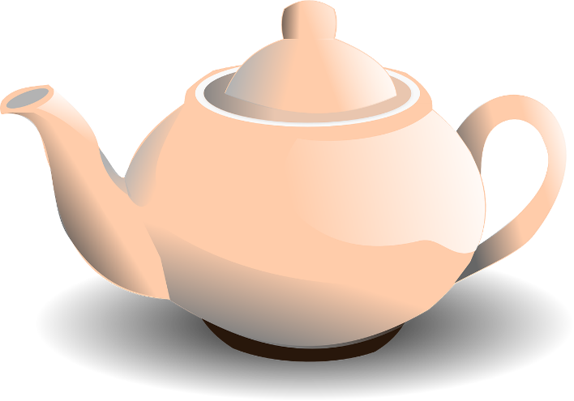
How many servings of tea altogether?
How many servings of tea altogether?
Can you write your answer in numerals and words?
How did you work it out?
Did everybody do it the same way?
10
10
10

Slide 19
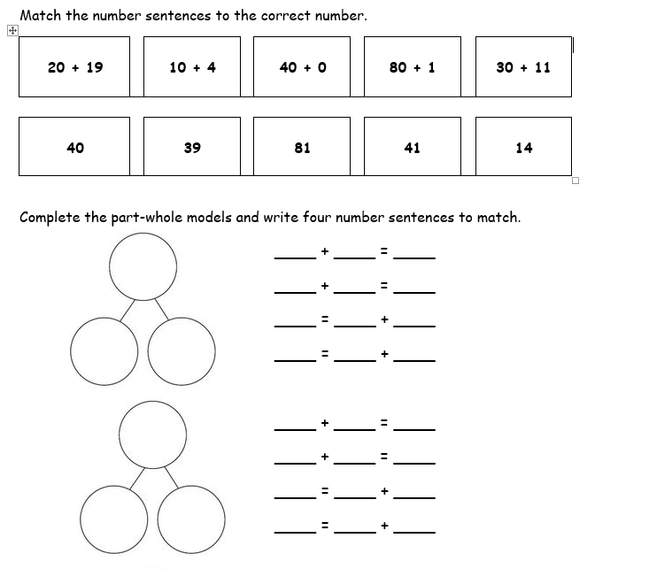
Day 4 – Problem solving
Use what you have learnt over the past sessions to help you solve the problems on the sheet.
Choose which problems you think suit you best…
1 star
2 star
3 star

Slide 20
Day 5 – Arithmetic Work
You have been given an arithmetic test paper to complete. Try to read each question carefully and write your answer in the box.
Remember that you can use paper to do any working out that you need to.
Once you have completed your paper, ask an adult to help you mark it.
Good luck! ☺

Slide 21
