Slide 1
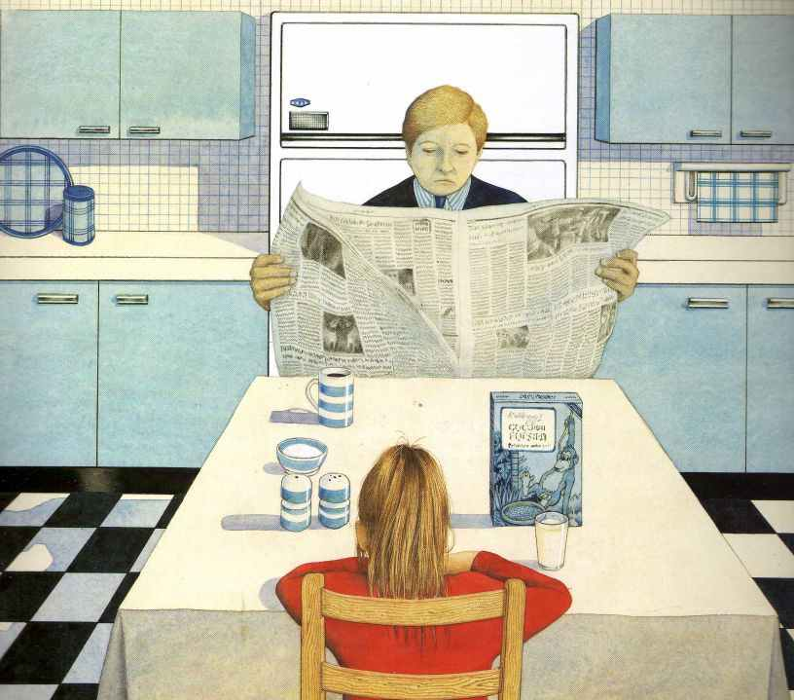
What does the word ‘ignored’ mean?
How many items are on the kitchen table?
What sort of man do you think Hannah’s father is?
Why has Anthony Browne chosen blue for the kitchen?
Taken from Gorilla by Anthony Browne

