Slide 1
Recap Set 2 sounds
Say each diagraph below that you can remember!

Slide 2
Recap ‘oo’
Read these green words :
poo zoo boot
moon food

Slide 3
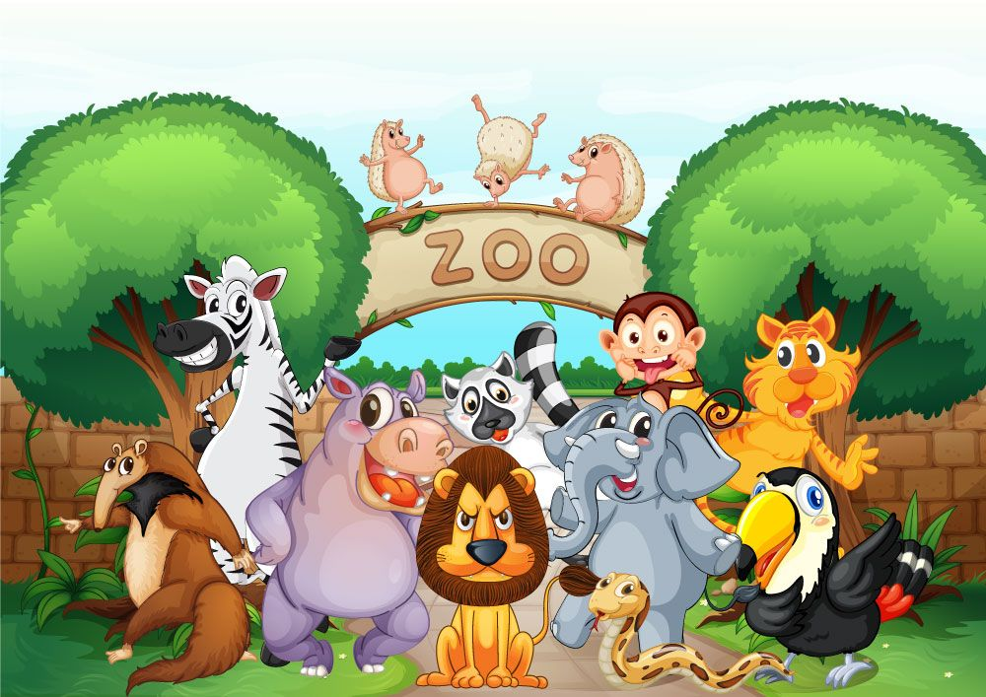
Read and underline the ‘oo’ sounds in these sentences
I can see the moon.
I went to the zoo.

Slide 4
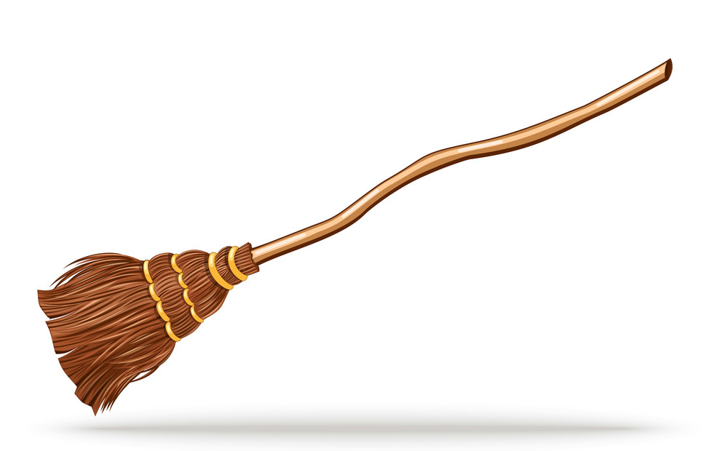
Can you write a sentence using the ‘oo’ sound?
_____________________________________________
_____________________________________________

