Slide 1
Year 2 – Home Learning English – Spring 1 – Week 6
Poetry

Slide 2
Reminder
Well done Year 2, you are working very hard! Don’t forget to have a go at all of the tasks set on Purple Mash and save them so that I can see what you have been up to!
We also have the blog on Purple Mash so please use this so we can keep in touch!
Try your best to continue to read out loud every day – parents can log reading on the Purple Mash blog.
All paper work should be saved and returned to school when we are open again!
Keep it up ☺

Slide 3
Day 1
Last week you were thinking carefully about stars. You created adjectives to describe what you think the stars might look and feel like. You read the text about how the little boy wanted to have a star of his very own.
We will be continuing to look at stars this week and will build up to writing our own poem about stars and the night sky.
Read through the poem on the next slide. Think carefully about the techniques the poet has used to grab your attention. Make a note of anything that you notice.

Slide 4
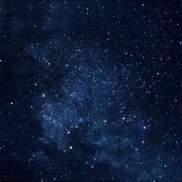
Counting the Stars
It’s late at night
and John is counting the stars
he’s walking through the woods
and counting the stars.
The night is clear
and the stars are like salt
on a black tablecloth.
John counts silently,
his lips moving, his head tilted.
It’s late at night
and John is counting stars
until he walks into a tree
that he never saw
because he was counting stars.
Look at John
lying in the woods.
The woodland creatures are gathering around him
laughing.
In little woodland voices.

Slide 5
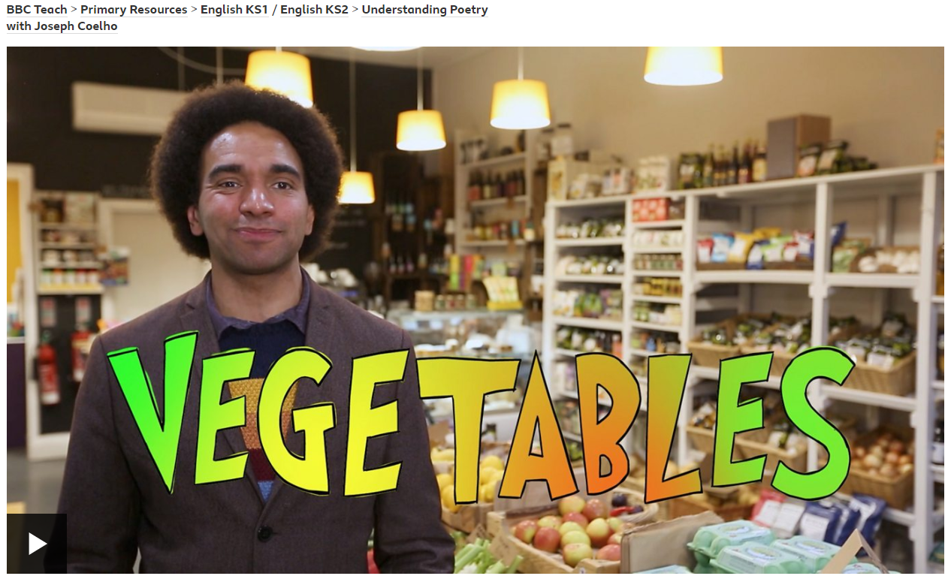
What did you notice?
The poet has used quite a few language techniques to make his poem interesting! He has thought carefully about what he can compare the stars to and has used something called repetition.
Watch this video to find out more about what repetition is and some other features that are often used in poems.
https://www.bbc.co.uk/teach/class-clips-video/english-ks1-ks2-understanding-poetry/zvrjscw

Slide 6
Repetition
Now that you have learnt a bit more about what repetition is and why it is used – you are going to have a go at creating your own repetition to engage your reader.
1 star – You will be identifying repetition in an extract of a text. You will then have a go at creating your own.
2 star – You have been given a poem called ‘sticks’. The poet has chosen to repeat the same word at the beginning of each line. There is not much repetition. Can you re-write the poem adding in your own repetition?
3 star – You have been given the first verse of a poem. The first and last line in the verse are repeated. Can you write two more verses for the poem, making sure that the first and last line in each verse are repeated?

Slide 7
Day 2 – writing your poem.
Now you have had a look at some different techniques that you can use in your poem and you have created descriptions for your stars, it’s time to start writing our poems.
Watch the videos from the following BBC link and carefully read the tips they give you on how to start writing your poem.
https://www.bbc.co.uk/bitesize/articles/zrgytrd

Slide 8
Don’t forget that some poems have verses (almost like mini paragraphs).
Not all poems have to rhyme.
You should use repetition in your poem.
You should use adjectives to describe your stars.
You should punctuate your poem accurately.
Once you have finished, could you produce some artwork to go alongside your poem?
There are some different examples of star poems for you to use to help get you started!

Slide 9
Day 3 - Activity
You have looked at a wide range of poems over the past week.
As you are working at home, we will be using the theme of family for this session.
Read through the poem on the next slide…

Slide 10
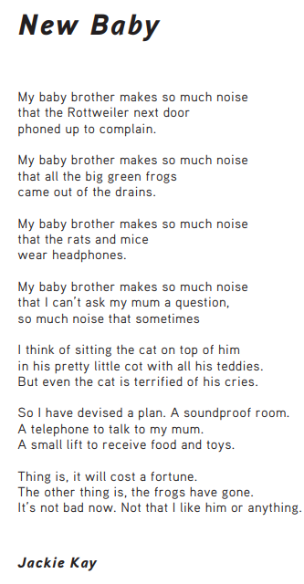
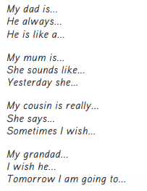
1 star – Contrast poem
Using the poem as inspiration, you need to create lines for a poem about noisy and quiet actions in a house.
Think about dogs barking, hoovers, babies.
Quiet actions such as; fish swimming, babies sleeping and snow falling.
2 star – Write a family poem
Think about the people you live with, create descriptions to use in a poem. Here are some ways you could start…

Slide 11
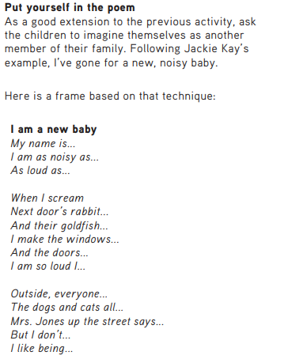
Extension

Slide 12
Day 4 - Poetry reading
Use the knowledge that you have learnt this week to help you answer the reading questions on the ‘New Years’ poem.
1 star – complete pages 2 and 4
2 star – complete pages 3 and 5.
Once you have completed a task, ask an adult to help you mark your work using the answer sheet.

Slide 13
Day 5 - SPAG
Today you will be looking at recognising questions. We must remember that if we use a question in our work, the sentence must end with a question mark.
Watch the video to see examples of where we should be using question marks;
https://vimeo.com/188168911
Once you have been through the slides, complete the activity.
1 star – page 2
2 star – page 3
3 star – page 4

Slide 14
Year 2 – Autumn Block 5 – Sentence Types 1
Step 1: Recognising Questions
© Classroom Secrets Limited 2018

Slide 15
Introduction
Use any of the words below to make a question.
who
what
where
eggs
the
cake
my
ate
is
are
shoes
© Classroom Secrets Limited 2018

Slide 16
Introduction
Use any of the words below to make a question.
Various answers, for example: Where is my cake?
who
what
where
eggs
the
cake
my
ate
is
are
shoes
© Classroom Secrets Limited 2018

Slide 17
Varied Fluency 1
Which sentences below are questions?
A. Do you like school?
B. Can we go to the park today?
C. It is raining outside.
© Classroom Secrets Limited 2018

Slide 18
Varied Fluency 1
Which sentences below are questions?
A. Do you like school?
B. Can we go to the park today?
C. It is raining outside.
© Classroom Secrets Limited 2018

Slide 19
Varied Fluency 2
Circle the question word in the sentence below.
Are we nearly at the theme park yet?
© Classroom Secrets Limited 2018

Slide 20
Varied Fluency 2
Circle the question word in the sentence below.
Are we nearly at the theme park yet?
© Classroom Secrets Limited 2018

Slide 21
Varied Fluency 3
Which question word(s) would make sense in the sentence below?
________________ we go back home now?
Are | Should | Can
© Classroom Secrets Limited 2018

Slide 22
Varied Fluency 3
Which question word(s) would make sense in the sentence below?
Should we go back home now?
Can we go back home now?
Are | Should | Can
© Classroom Secrets Limited 2018

Slide 23
Varied Fluency 4
Which option has used a question correctly?
A. Could that news be true?
B. Could that news be it true?
C. Be true that news could it?
© Classroom Secrets Limited 2018

Slide 24
Varied Fluency 4
Which option has used a question correctly?
A. Could that news be true?
B. Could that news be it true?
C. Be true that news could it?
© Classroom Secrets Limited 2018

