Slide 1
Picture Reflections
Be guided by your values

Slide 2
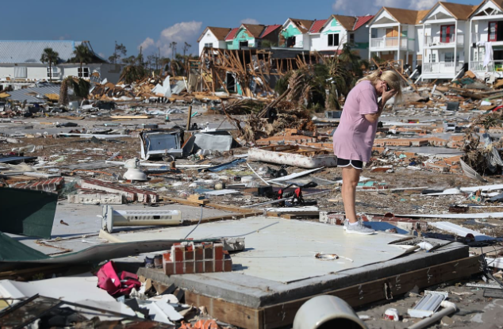

Slide 3
What do you see in the picture?
Can you make a prediction about what we are going to be talking about?
What questions do you have about this picture?
Come up with three questions.

Slide 4
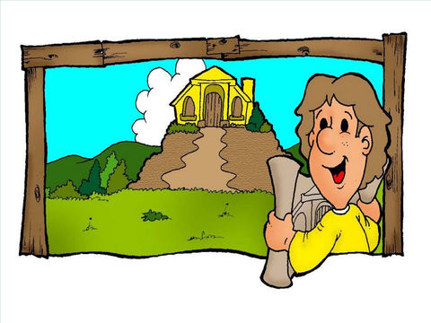
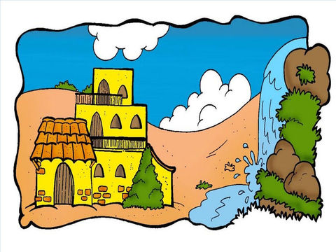
Which values make strong foundations? Matthew 7:24-27
http://request.org.uk/restart/story-time-wise-foolish-builders/

Slide 5
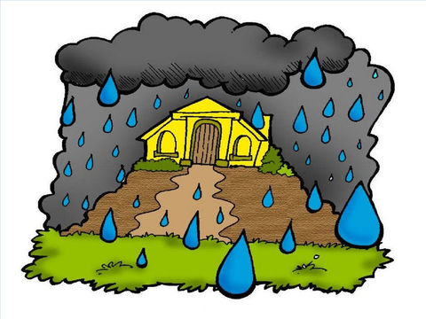
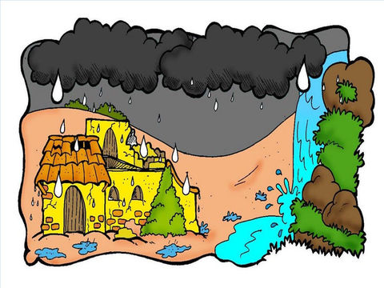
Which values make strong foundations? Matthew 7:24-27
24 “Everyone who hears these things I say and obeys them is like a wise man. The wise man built his house on rock. 25 It rained hard and the water rose. The winds blew and hit that house. But the house did not fall, because the house was built on rock. 26 But the person who hears the things I teach and does not obey them is like a foolish man. The foolish man built his house on sand. 27 It rained hard, the water rose, and the winds blew and hit that house. And the house fell with a big crash.”

Slide 6
Which values make strong foundations?
How do you feel about this story?
What do you think we can learn from this story?
What is your one key emotional response word?

Slide 7
Which values make strong foundations? Matthew 7:24-27
Jesus told the story of the two builders to teach us the best way to live.
He explained that when we listen and do what is then we are like the wise man who builds his house on the rock.
An example of doing what is right is when we live by our school’s values. These give us a good foundation for our lives and help us live lives that show love and respect to others. When we live like this then we are wise! To be wise or have wisdom is not how smart we are but more what we do that's important.
When we know what we should do, the way that we should live and the values that we should be guided by BUT we don’t follow them then we are like a foolish man who built his house on the sand.
Would you rather be foolish or wise? If you build your life on godly values that is like building your life on the rock. We will be strong when situations around us are hard to handle.

Slide 8
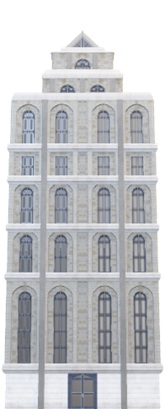
Challenge question: Which of these would be good values to have as foundations for your life?
Respect
Greedy
Friendly
Faith
Listening to other viewpoints
Taking responsibility for my own actions
Wanting my own way
Aspiring to do my best
Kindness
Wanting to be heard
Trustworthy

Slide 9
reflection
If we want our lives to have value, if we want to be people that others can trust, who they turn to when they need help and who they can rely up on in the good and the bad times then we need firm foundations in our lives.
The values that we live by will shape the person we turn out to be like. So be wise in which values you choose.

Slide 10
British Values
Individual Liberty
We promote the freedom of choice and the right to respectfully express views and beliefs in a safe environment. With this comes a responsibility to make good choices that impact ourselves and others in a positive way.
This Photo by Unknown Author is licensed under CC BY-SA

