Slide 1
Recap Set 2 sounds
Say each diagraph below that you can remember!

Slide 2
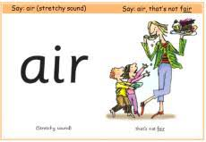
Recap ‘air’
Read these green words :
fair fairy hair
chair lair

Slide 3
Read and underline the ‘air’ sounds in these sentences
Look at my hair!
I can see the tooth fairy.

Slide 4
Can you write a sentence using the ‘air’ sound?
_____________________________________________
_____________________________________________

