Slide 1
Monday 1st March 2021
English: Descriptive write LO: To use senses to describe a picture

Slide 2
Look at the images on the next 3 pages. Use your sense of sight and write down what you can see. E.g. boats in a river, buildings on fire

Slide 3
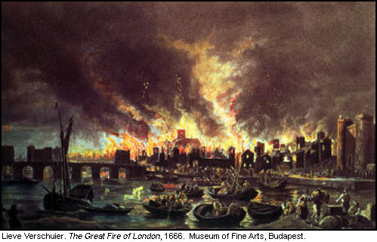

Slide 4
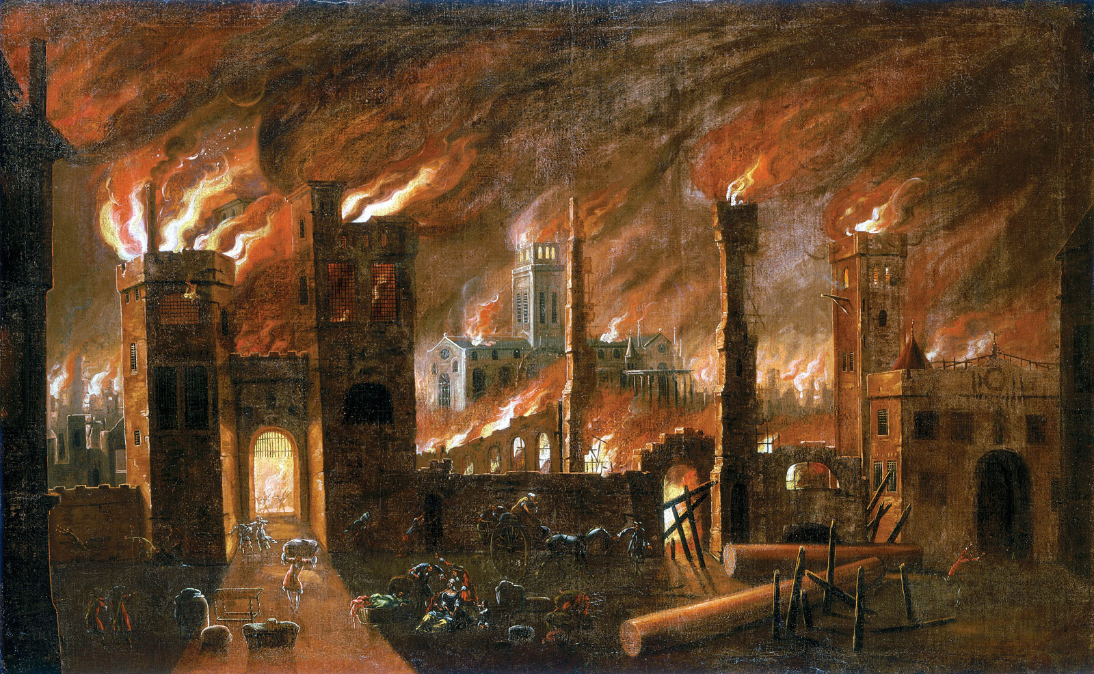

Slide 5
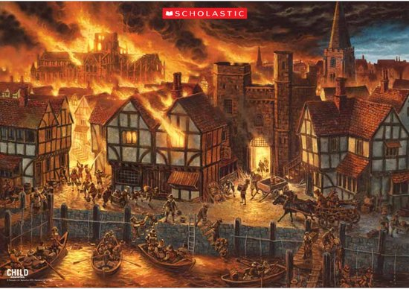

Slide 6
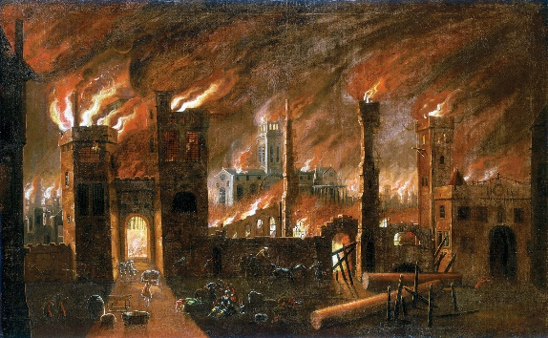
Can you write words to describe what you can see?
Example
Houses on fire
Black sky
Boats in the river
Lots of flames

Slide 7
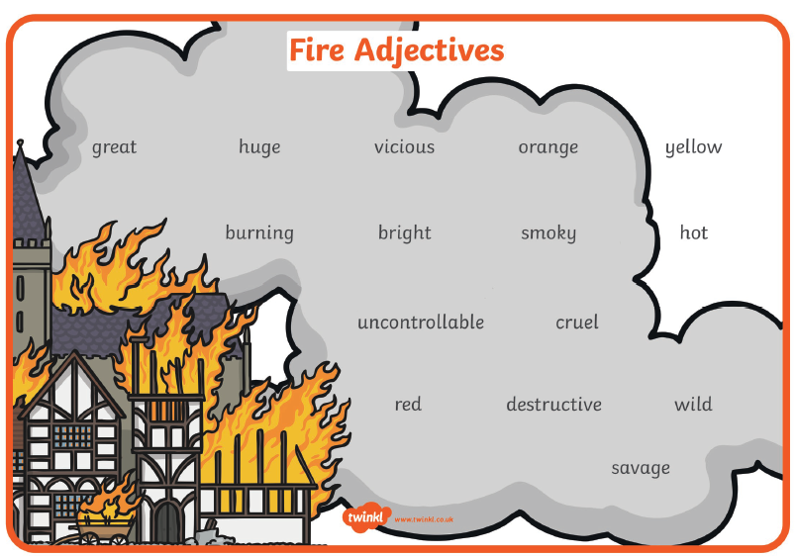
Now, can you add adjectives to describe what you saw? Remember to write in full sentences using a capital letter at the start and a full stop at the end of your sentences. CHALLENGE: Can you include an exclamation mark?

Slide 8
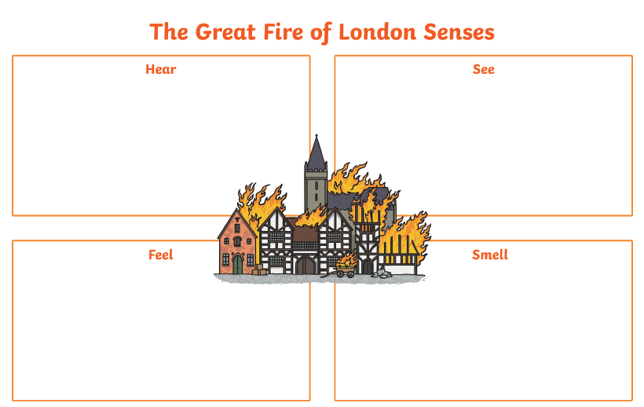
Example – adjectives highlighted in red.
Houses on fire – The uncontrollable fire cruelly spreads to houses .
Black sky – Thick, black smoke fills the vast sky!
Boats in the river – Wooden boats crowd in the great River Thames.
Lots of flames – The destructive, hot, orange flames burn brightly all around.

Slide 9
Tuesday 2nd March 2021
English: Descriptive write LO: To use senses to describe a picture

Slide 10
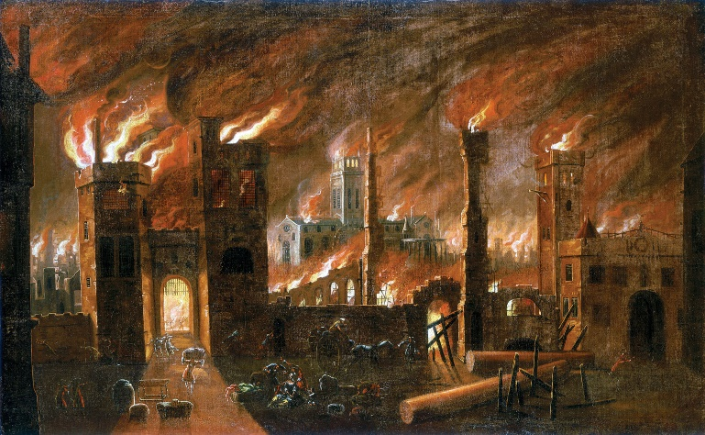
Let’s recap…
What can you see in this picture?
What sense are you using to help you?
What other senses could we use to describe?

Slide 11
What would you be able to hear?
https://www.youtube.com/watch?v=0fYL_qiDYf0

Slide 12
Can you write words to describe what you can hear?
BANG!
BANG!
CRACKLE
CRACKLE

Slide 14
Now let’s turn our words into sentences….
What makes a good sentence?
Capital letter at the start
A full stop, question mark or exclamation mark at the end
A verb – doing word
An adjective – describing word
A subject
The bright, hot flames are crackling and hissing.

Slide 15
Example – adjectives highlighted in red.
Crackling -The bright, hot flames are crackling and hissing.
Wood creaking
Screaming
Shouting
Popping
Hissing
Sizzling
Example – adjectives highlighted in red.
Houses on fire – The uncontrollable fire cruelly spreads to houses .
Black sky – Thick, black smoke fills the vast sky!
Boats in the river – Wooden boats crowd in the great River Thames.
Lots of flames – The destructive, hot, orange flames burn brightly all around.

Slide 16
Wednesday 3rd March 2021
English: Descriptive write LO: To use senses to describe a picture

Slide 17
Let’s recap…
What can you see in this picture?
What sense are you using to help you?
What other senses could we use to describe?

Slide 18
Can you write words to describe what you can smell?
Example
Burning
Smoke
Wood
Sweat
BANG!
CRACKLE
CRACKLE
Now let’s turn our words into sentences….

Slide 19
Example – adjectives highlighted in red.
Crackling -The bright, hot flames are crackling and hissing.
Wood creaking
Screaming
Shouting
Popping
Hissing
Sizzling
Example – adjectives highlighted in red.
Houses on fire – The uncontrollable fire cruelly spreads to houses .
Black sky – Thick, black smoke fills the vast sky!
Boats in the river – I can see wooden boats gathering in the great River Thames.
Lots of flames – The destructive, hot, orange flames burn brightly all around.
Burning – The area was filled with the strong smell of burning houses
Smoke – As the wild fire raged, smoke filled the whole sky.
Sweat
Wood

Slide 21
Thursday 4th March 2021
English: Descriptive write LO: To use senses to describe a picture

Slide 22
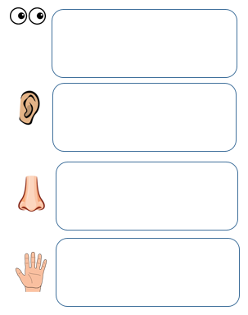
Now it’s your turn to write a setting description of the Great Fire of London. Remember to use your senses mat that we have filled in throughout the week to help you.
Don’t forget:
Write in full sentences
Use capital letters at the start of a sentence.
Use full stops, exclamation or question marks at the end of every sentence
Adjectives to describe
You want your reader to feel as though they are really experiencing the Great Fire of London.

Slide 24
Friday 5th March 2021
English: SPAG LO: To use exclamation marks

Slide 25
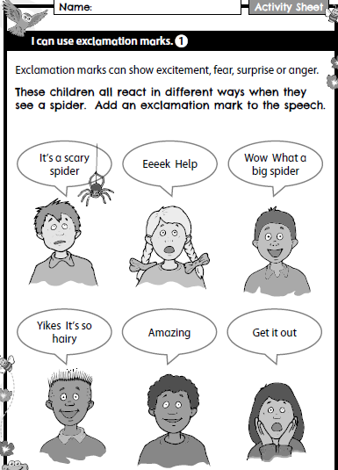
We are going to continue learning about exclamation marks and how to use them in our writing.

Slide 26
