Slide 1
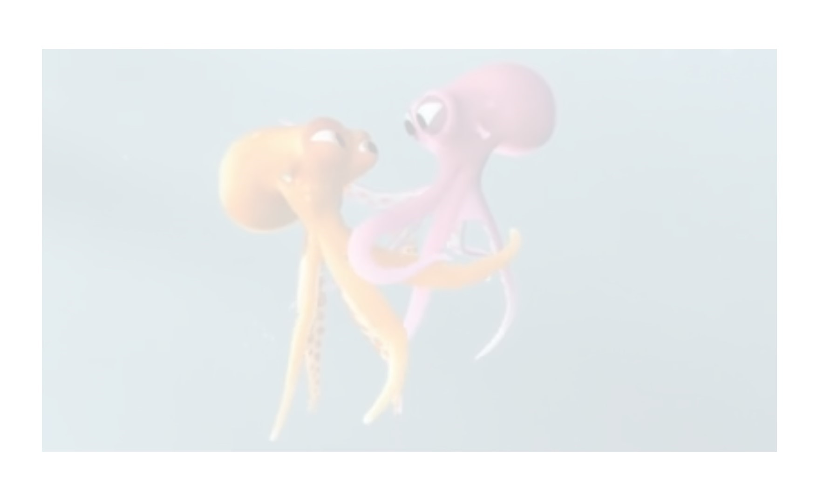
Lesson 4 To plan a narrative (using DADWAVERS and inner thought)

Slide 2
https://www.literacyshed.com/oktapodi.html Watch one last time!

