Slide 1
YEAR 1
Length & Height WB: 1.3.21
Compare lengths & heights
Measure lengths (1)
Block 3 – Week 8

Slide 2
Lesson 1 Monday 1.3.21
Step: Compare lengths & heights (1) (Practical)

Slide 3
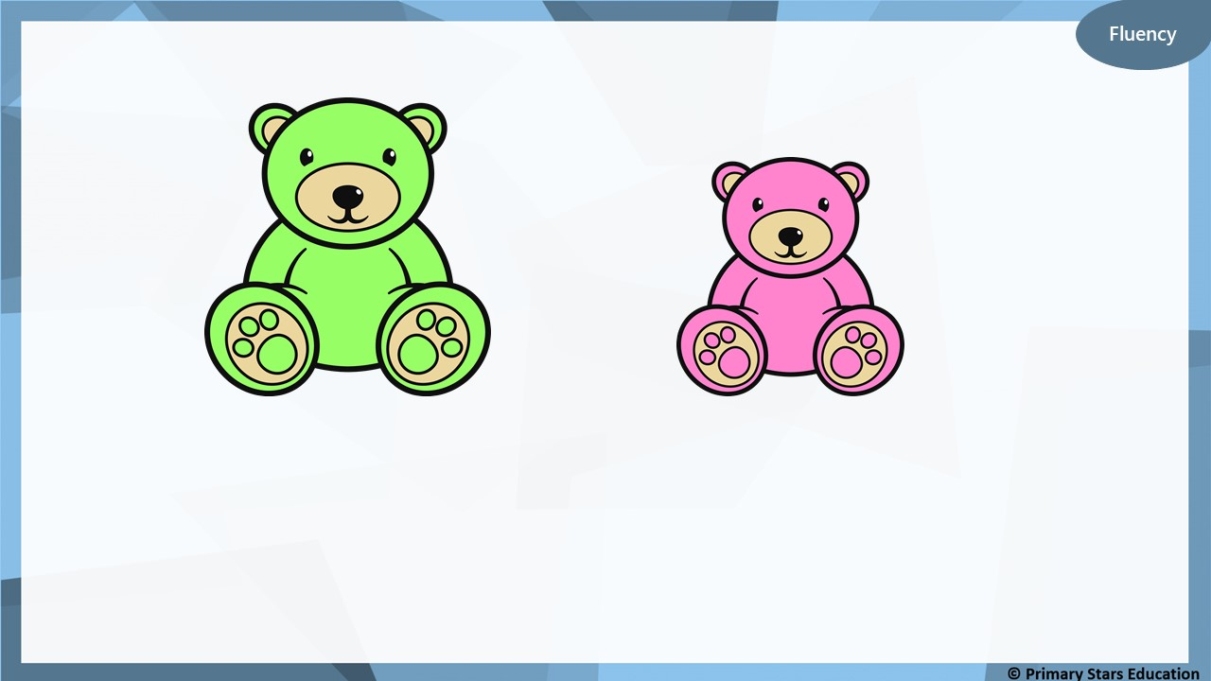
Which is the smallest and which is the biggest?
smallest
biggest

Slide 4
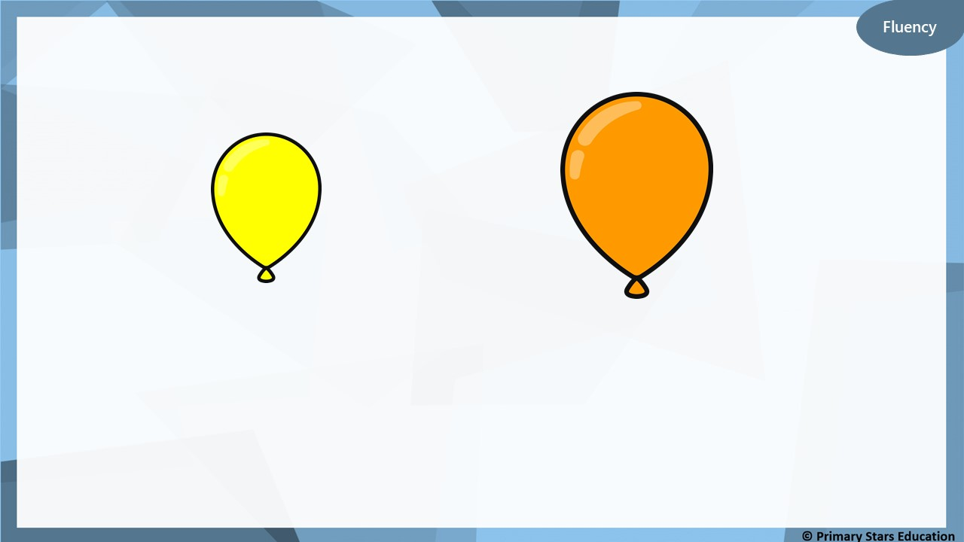
Which is the smallest and which is the biggest?
smallest
biggest

Slide 5
Which is the smallest and which is the biggest?
smallest
biggest

Slide 6
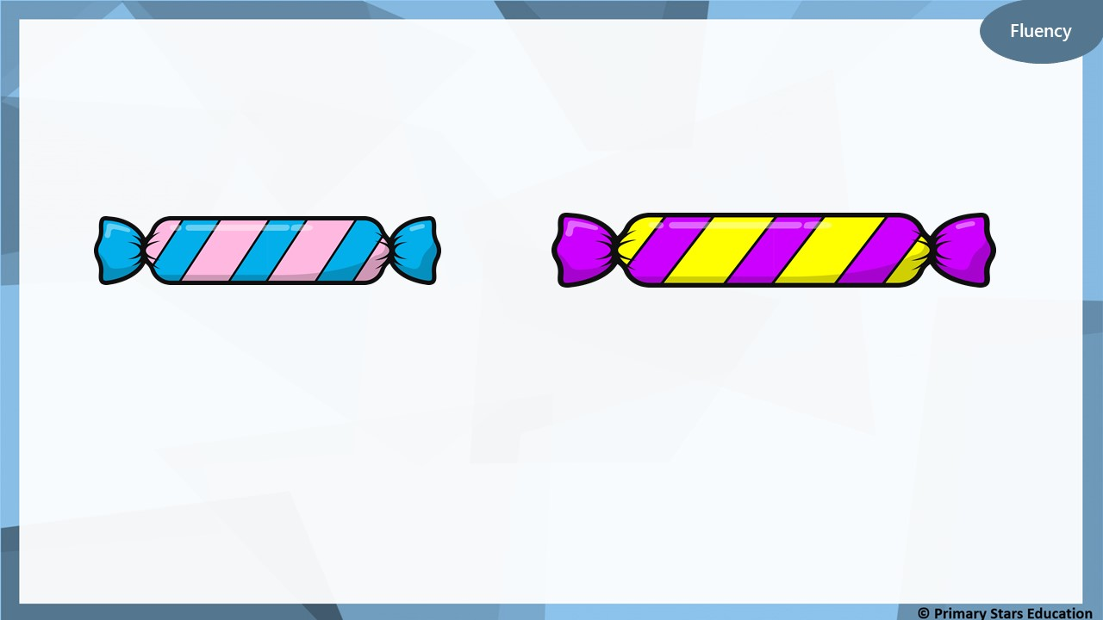
Which is the shortest and which is the longest?
shortest
longest

Slide 7
Which is the shortest and which is the tallest?
shortest
tallest

Slide 8
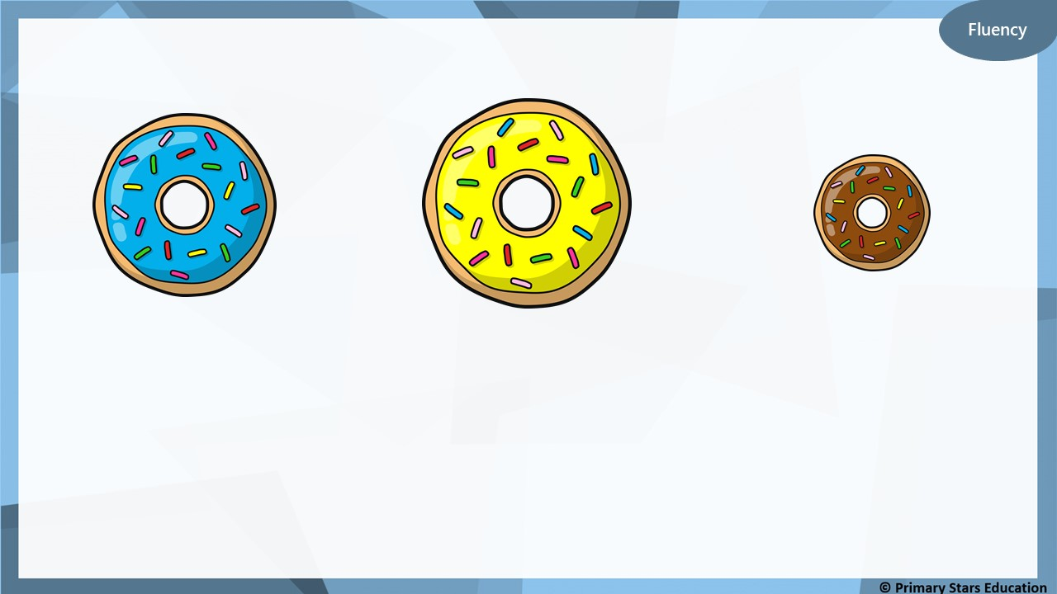
Order by size:
smallest
bigger
biggest

Slide 9
Order by length:
shortest
longer
longest

Slide 10
Order by height:
shortest
taller
tallest

Slide 11
The cube towers have been ordered shortest to tallest.
Do you agree? Explain your answer.
No. The purple and orange towers need to be swapped round as the orange tower is the tallest.

Slide 12
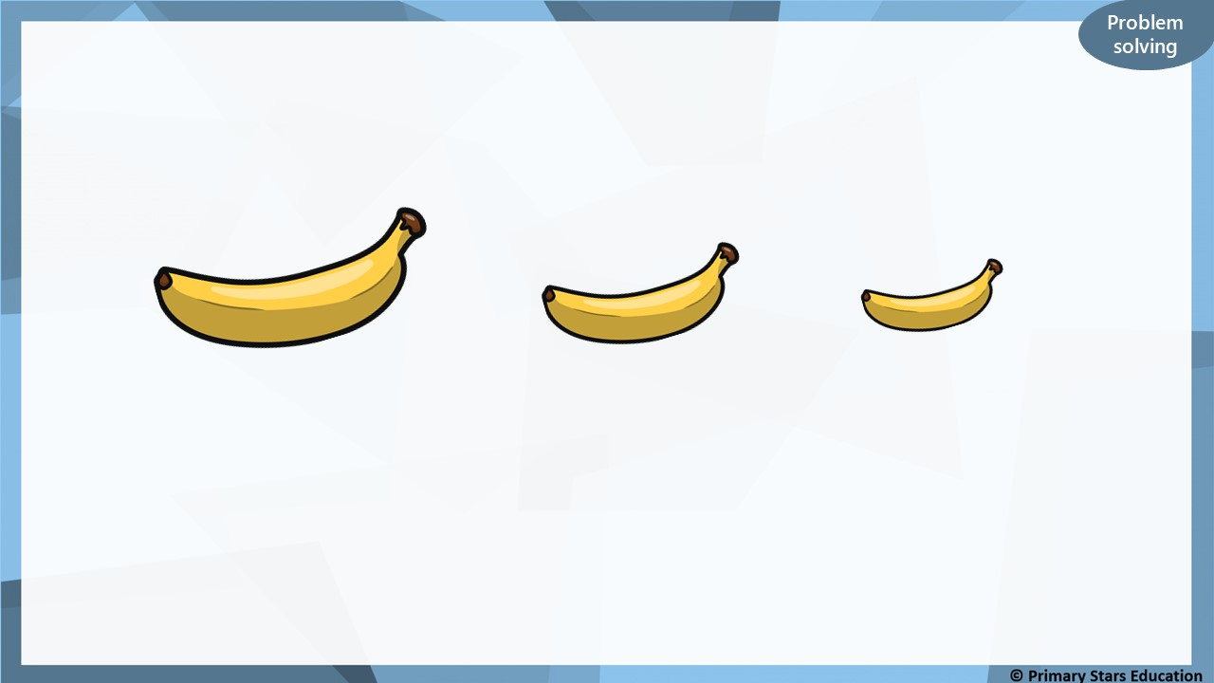
What words could you use to describe how the bananas have been ordered?
Biggest to smallest
or longest to shortest

Slide 13
Lesson 2 Tuesday 2.3.21
Step: Compare lengths & heights (2) (Practical)

Slide 14
Complete the sentences.
blue
red
The ___________ pencil is shorter than the ____________ pencil.
The ___________ pencil is longer than the ____________ pencil.
red
blue

Slide 15
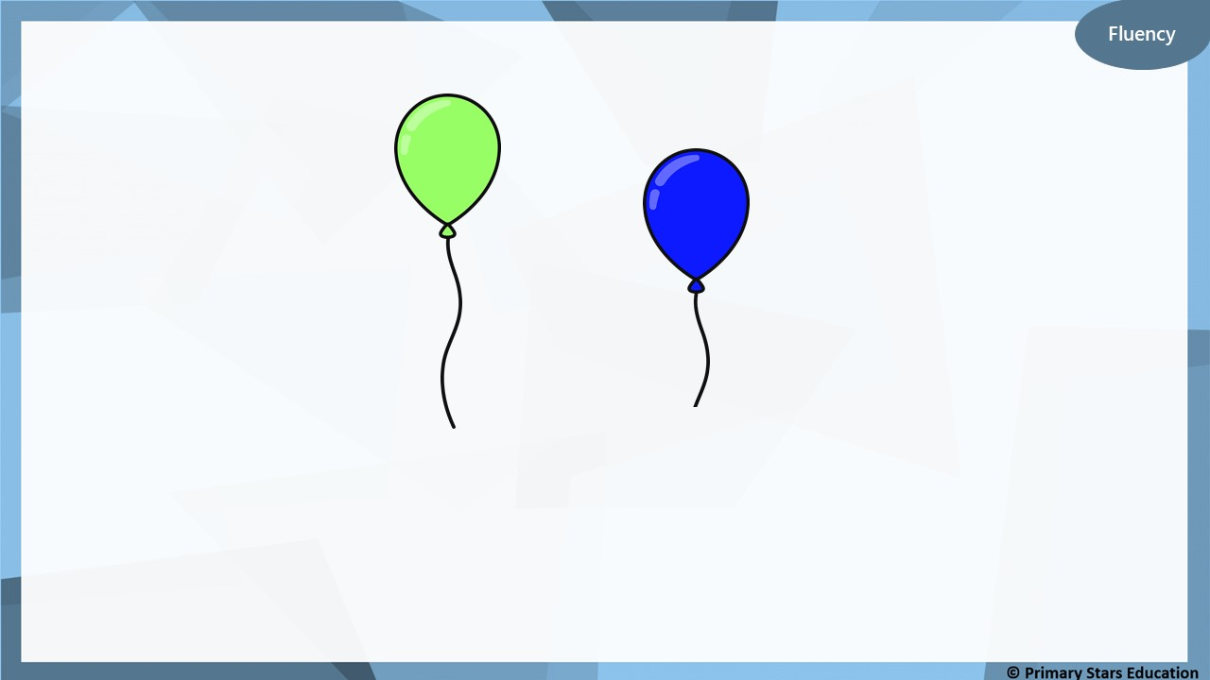
Complete the sentences.
blue
green
The ___________ balloon is shorter than the ____________ balloon.
The ___________ balloon is taller than the ____________ balloon.
green
blue

Slide 16
Flueny
Complete the sentences.
pink
yellow
The ___________ pencil is shorter than the ____________ pencil.
The ___________ pencil is longer than the ____________ pencil.
yellow
pink

Slide 17
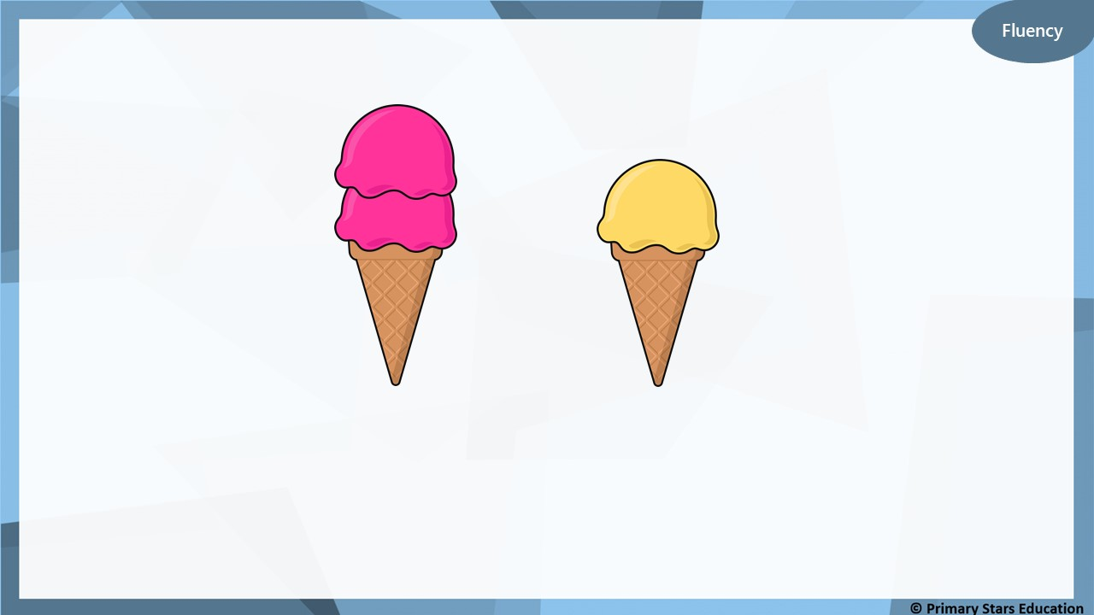
Complete the sentences.
orange
pink
The __________ ice cream is shorter than the ___________ ice cream.
The ___________ ice cream is taller than the ____________ ice cream.
pink
orange

Slide 18
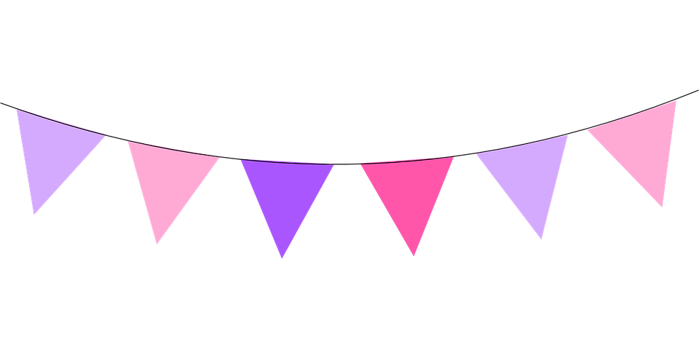
Fluency
Complete the sentences.
blue
green
The ___________ flags are shorter than the ____________ flags.
The ___________ flags are longer than the ____________ flags.
green
blue

Slide 19
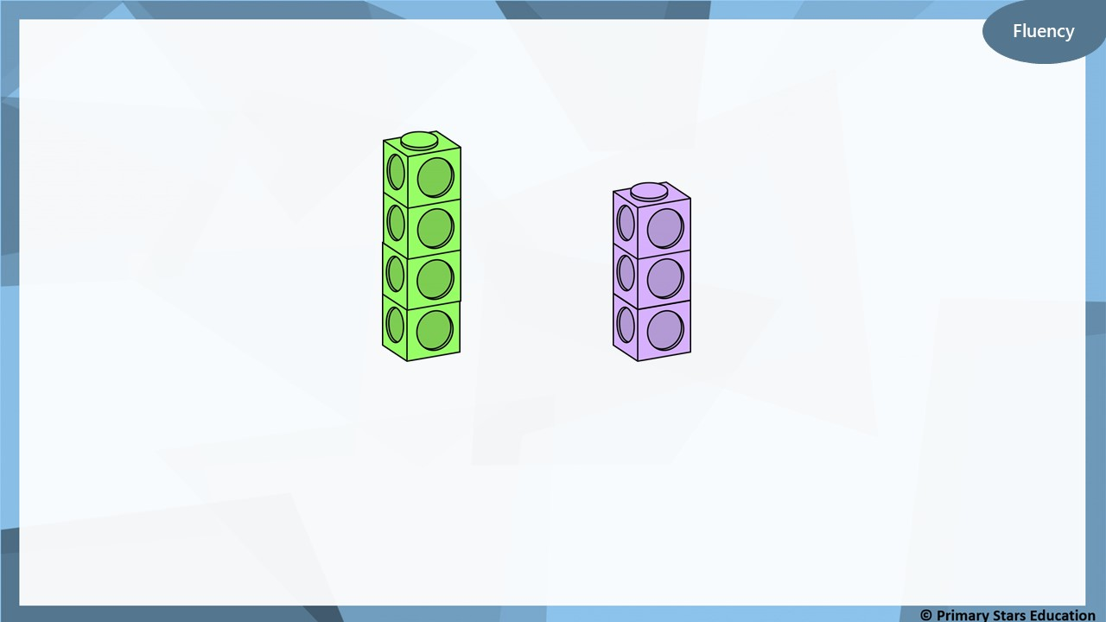
Complete the sentences.
purple
green
The ___________ cubes are shorter than the ____________ cubes.
The ___________ cubes are taller than the ____________ cubes.
green
purple

Slide 20
When stretched out, both strings will be the same length.
A
B
Do you agree with Che? Explain your answer.
No, String A will be longer than string B when stretched.

Slide 21
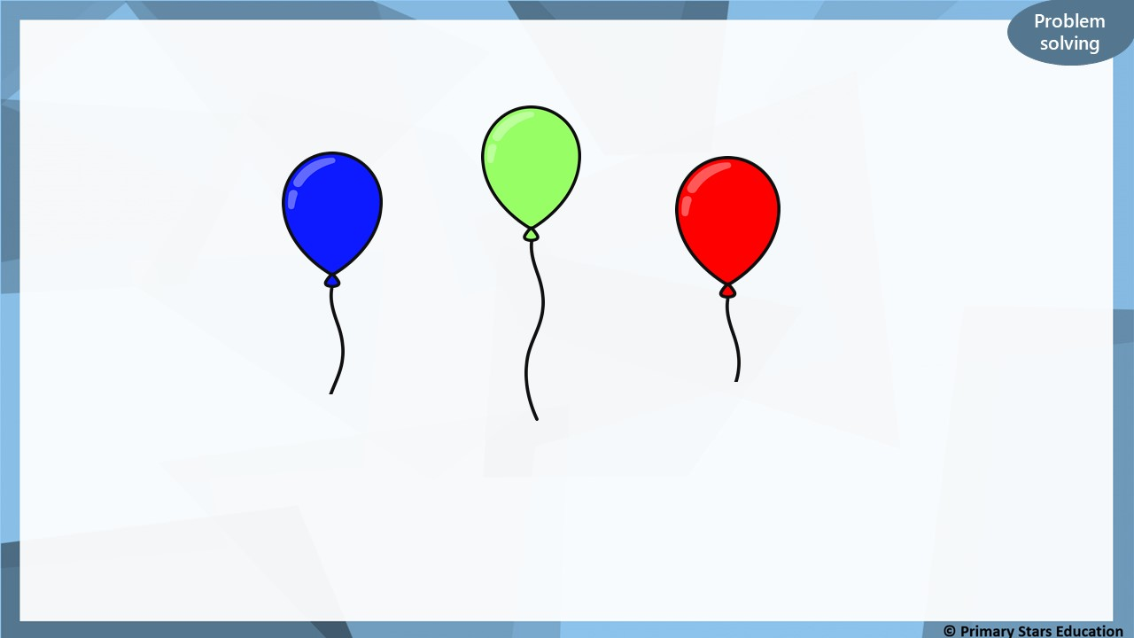
Order the balloons shortest to tallest.
shortest
red
blue
green
tallest

Slide 22
Lesson 3 Wednesday 3.3.21
Step: Compare lengths & heights (3)

Slide 23
Complete the sentences.
longer
The blue frame is _______________ than the green frame.
The green frame is _______________ than the blue frame.
shorter

Slide 24
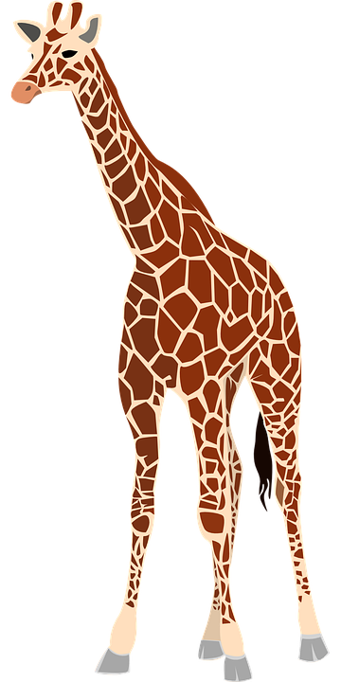
Fluency
Complete the sentences.
taller
The giraffe is _______________ than the tiger.
The tiger is _______________ than the giraffe.
shorter

Slide 25
Complete the sentences.
shorter
The blue pencil is _______________ than the pink pencil.
The pink pencil is _______________ than the blue pencil.
longer

Slide 26
Fluency
Complete the sentences.
taller
The red flower is _______________ than the black flower.
The black flower is _______________ than the red flower.
shorter

Slide 27
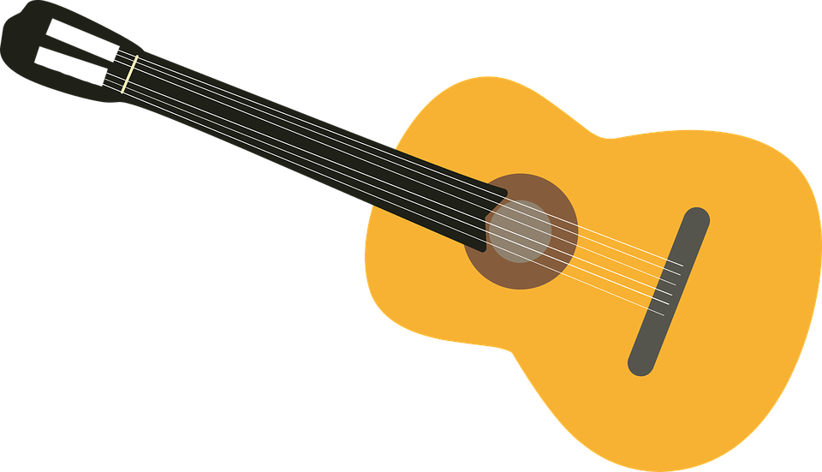
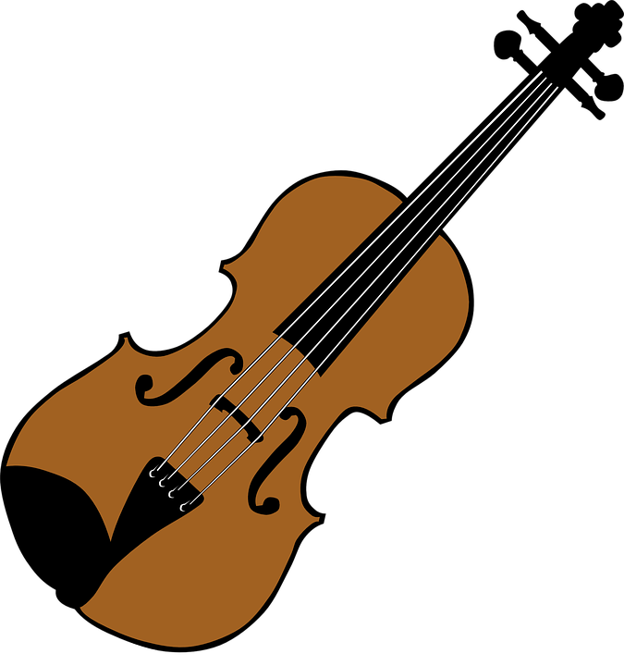
Fluency
Complete the sentences.
longer
The guitar is _______________ than the violin.
The violin is _______________ than the guitar.
shorter

Slide 28
Fluency
Complete the sentences.
red
The ___________ ribbon is the longest. The ___________ ribbon is the shortest.
The green ribbon is _____________ than the blue ribbon.
The red ribbon is _____________ than the green ribbon.
green
shorter
longer

Slide 29
Spot the mistake. Explain your answer.
Reasoning
shortest
longest
The pink and yellow blocks need swapping round as the yellow block is the shortest in length.

Slide 30
My tower is 7 cubes tall.
My tower is 5 cubes tall.
What sentences could you write to describe Jess’ and Dom’s towers?
Examples: Jess’ tower is taller than Dom’s tower. Dom’s tower is shorter than Jess’ tower Jess’ tower is 2 cubes taller than Dom’s tower.

Slide 31
Lesson 4 Thursday 4.3.21
Step: Measure lengths (1) (Practical)

Slide 32
Fluency
Find the following object and measure how many cubes it is in length.
pencil
Can it be measured using something else?

Slide 33
Fluency
Find the following object and measure how many cubes it is in length.
book
Can it be measured using something else?

Slide 34
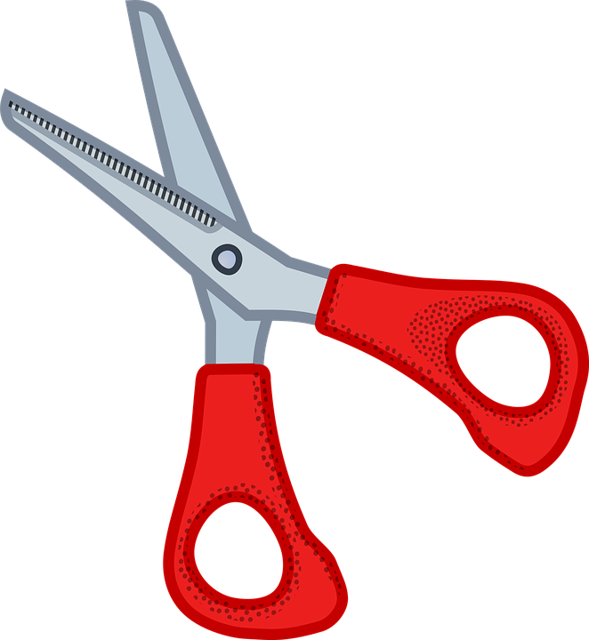
Fluency
Find the following object and measure how many cubes it is in length.
scissors
Can it be measured using something else?

Slide 35
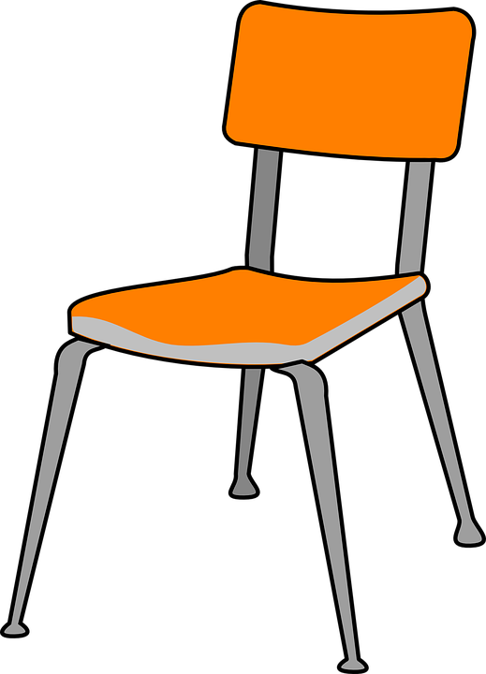
Fluency
Find the following object and measure how many cubes it is in length.
chair
Can it be measured using something else?

Slide 36
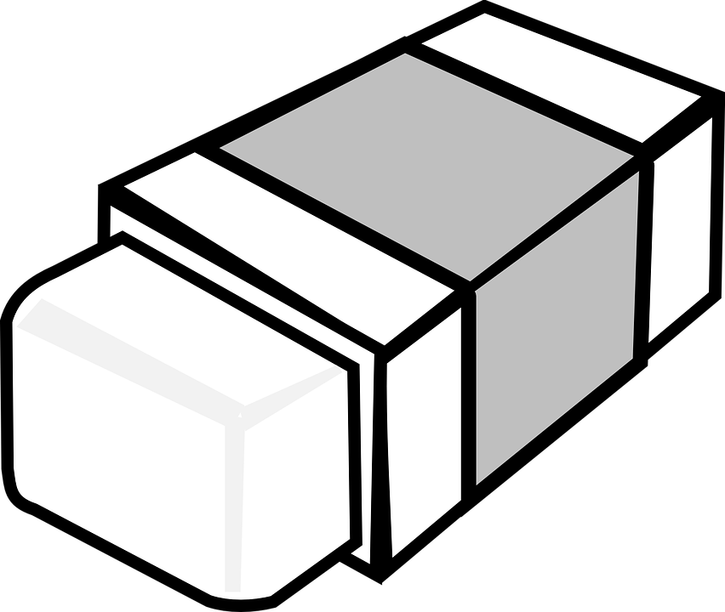
Fluency
Find the following object and measure how many cubes it is in length.
rubber
Can it be measured using something else?

Slide 37
Lesson 5 Friday 5.3.21
Step: Measure lengths (1)

Slide 38
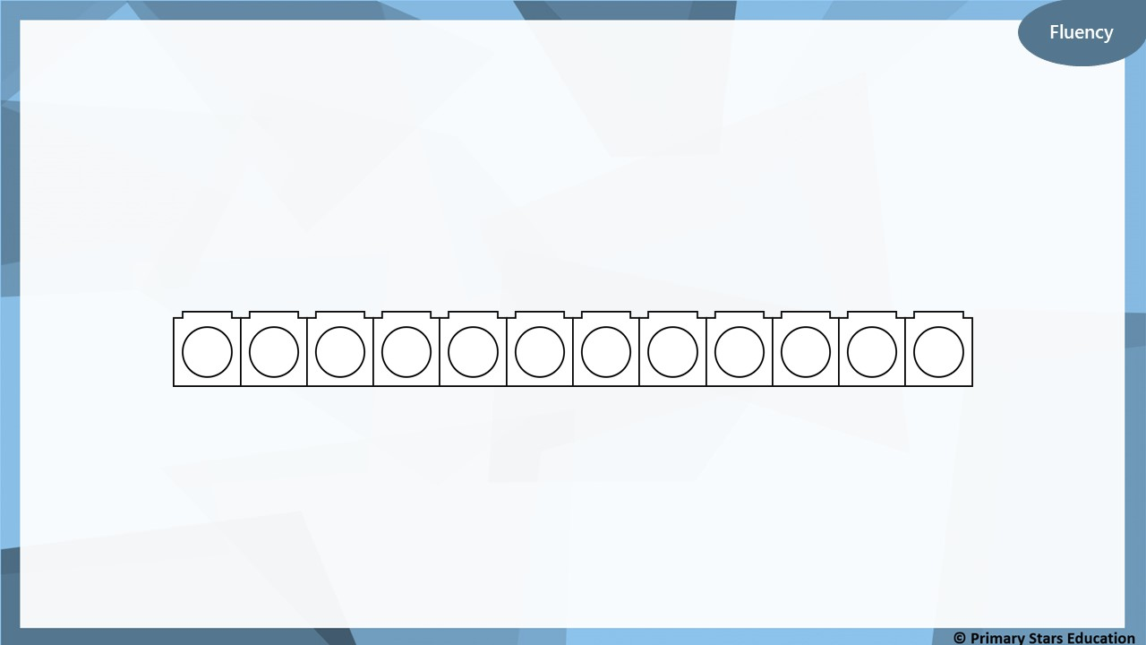
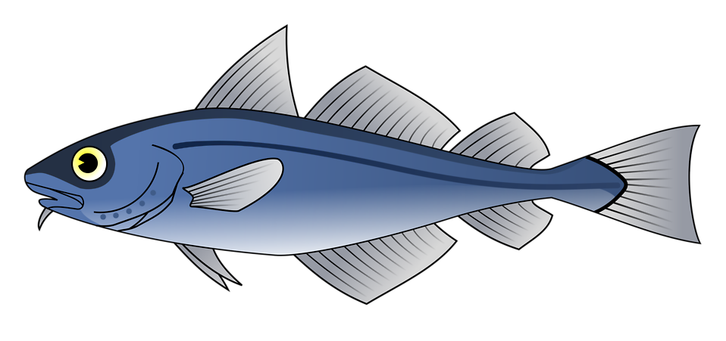
How many cubes long is the fish?
5
The fish is ________ cubes long.

Slide 39
How many cubes long is the pencil?
8
The pencil is ________ cubes long.

Slide 40
How many cubes tall is the lolly?
5
The lolly is ________ cubes high.

Slide 41
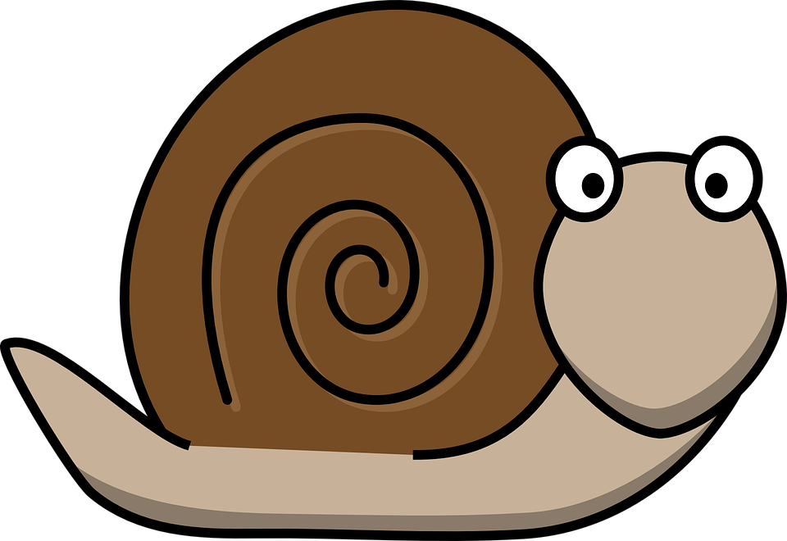
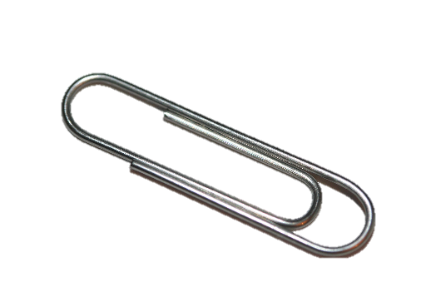
Fluency
What is the length in paper clips?
3
The snail is ________ paper clips long.

Slide 42
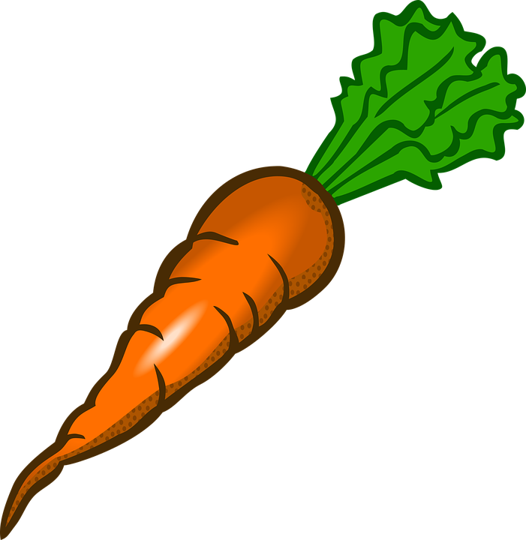
Fluency
What is the length in paper clips?
5
The carrot is ________ paper clips long.

Slide 43
How many hands in height?
2
The book is ________ hands in height.

Slide 44
How many hands in height?
5
The chair is ________ hands in height.

Slide 45
The pencil is 5 cubes in length.
Is Kat correct?
No, the pencil is 6 cubes in length.

Slide 46
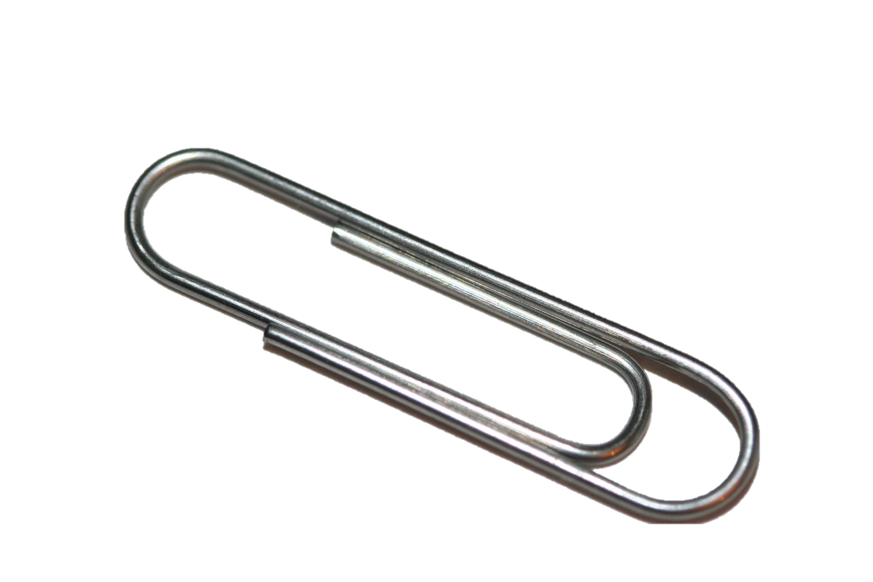
Name an item that would be best measured using:
hands
paper clips

