Slide 1
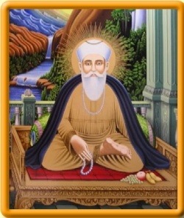
Who is Guru Nanak?
https://www.bbc.co.uk/bitesize/clips/zc34wmn

Slide 2
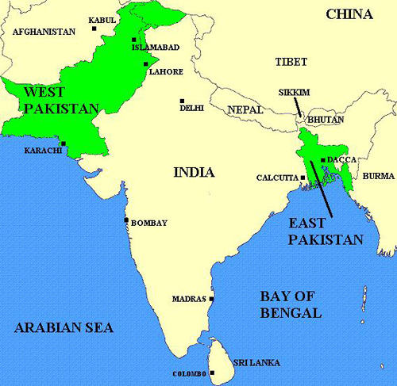
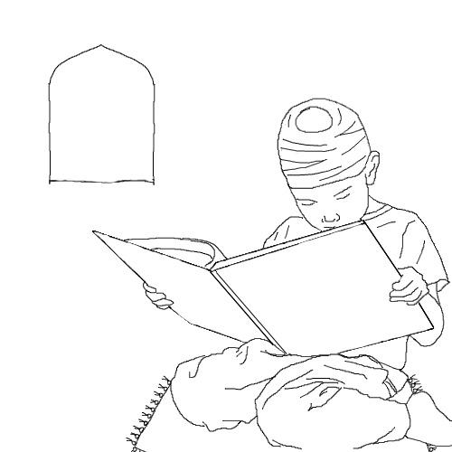
Nanak was born in 1469 in the Punjab.
Even when young he always asked questions and looked for information.
Nanak married Sulkhni and they had two sons, Sri Chand and Lakhmi Das.
He got a job as the manager of the government's grain store. He would share his food and money with the needy.

Slide 3
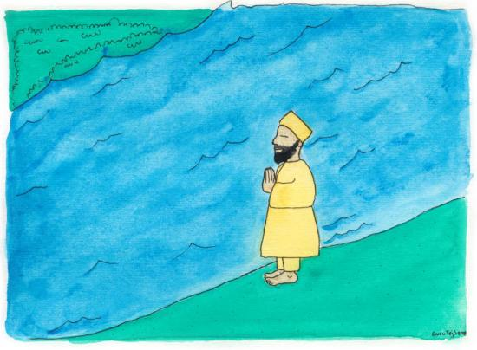
One morning, when he was twenty-eight, he went down to the river to bathe and meditate.
It was said that he was gone for three days. When he came back again, filled with the spirit of God, it was clear to everyone that he had changed.
He said nothing, but he quit his job and gave away all his possessions to the poor.

Slide 4
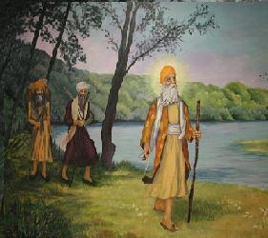
Accompanied by his childhood friend, a Muslim named Mardana he left town.
When, after a few days, he spoke saying "There is no Hindu, no Musalman.”
It was then that Guru Nanak began his missionary work and travels.

Slide 5
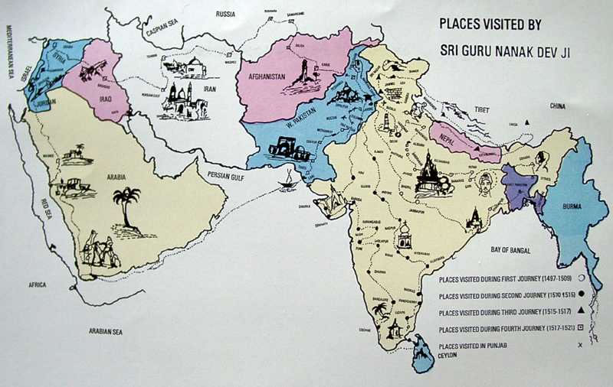
He made four great journeys, travelling to all parts of
India
Arabia and Persia; visiting Mecca and Baghdad.
He spoke to the followers of lots of different religions including Hindus, Buddhists and Muslims.

Slide 6
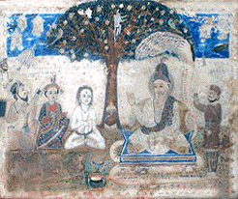
Wherever he went, Guru Nanak spoke out against empty religious rituals, pilgrimages, the caste system and of depending on books to learn the true religion.
He never asked his listeners to follow him. He asked the Muslims to be true Muslims and the Hindus to be true Hindus.

Slide 7
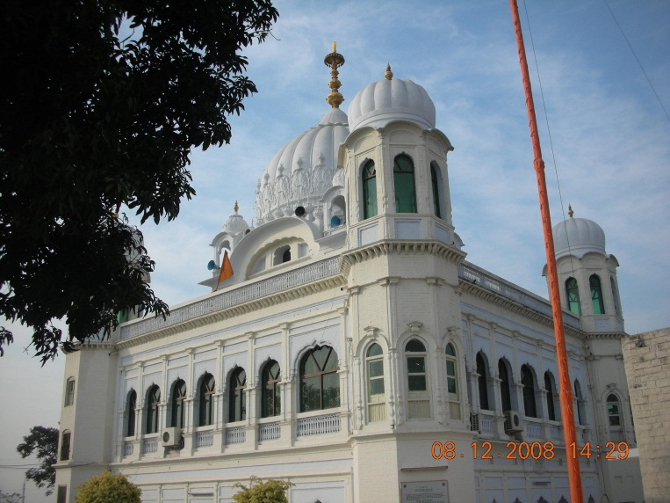
After the last of his great journeys, Guru Nanak he built a town called Kartapur . Followers from all over would gather there and pray and sing together.
During this time, although his followers still remained of the religion to which they were born, they became known as the Guru's disciples, or sikhs.

Slide 8
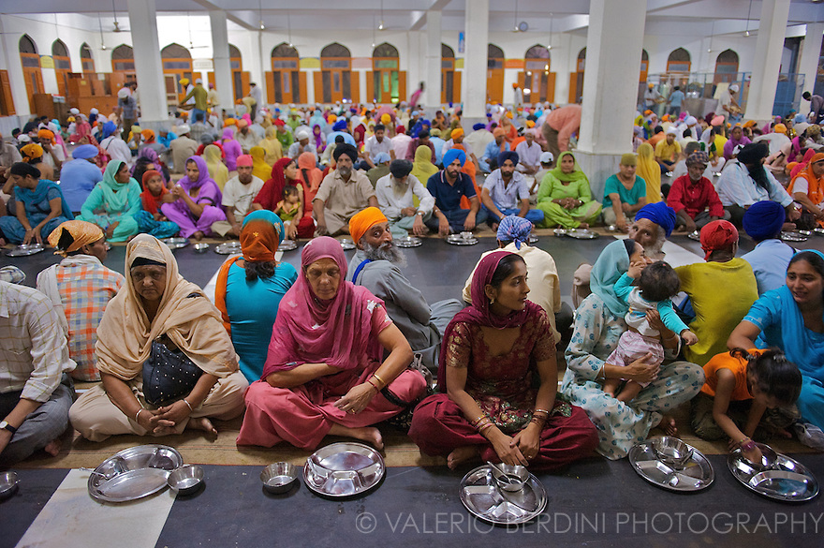
The Guru told his followers that they were not to live apart from the world -- there were to be no priests.
In the evening everyone would cook together in the same kitchen, and ate together – no matter how rich or poor they were.

