Slide 1
Year 2 – Home Learning Maths – Spring 2 – Week 1
Fractions

Slide 2
Day 1 - Fractions
Today, Miss Sidhu will you show how we can find one half of the shape. Listen carefully as she introduces fractions.
https://classroom.thenational.academy/lessons/to-identify-one-half-of-a-shape-60up2c?activity=video&step=1
Don’t worry if you don’t have the items Miss Sidhu asks for, just watch the video and she will explain.

Slide 3
Day 1: Find halves, quarters and thirds of shapes by folding.
Get a piece of paper and fold it carefully in half.
How many halves make a whole?
The paper has been folded into 2 equal parts. We call these ‘halves’.
¹/₂
+
¹/₂
=
1 whole

Slide 4
Day 1: Find halves, quarters and thirds of shapes by folding.
Fold a piece of paper into ¹/₄s, by folding it in ¹/₂ and ¹/₂ again.
How many quarters make a whole?
How many quarters make a half?
The paper has been folded into 4 equal parts which are called ‘quarters’.
¹/₄
+
¹/₄
+
¹/₄
+
¹/₄
=
1 whole
¹/₄
+
¹/₄
=
¹/₂

Slide 5
Day 1: Find halves, quarters and thirds of shapes by folding.
What if we fold a piece of paper in half, but each ‘half’ is not equal?
If you tore the piece of paper along the fold and shared it between 2 people, it wouldn’t be fair.
One person would have a bigger piece than the other.
What if we fold the paper into 3 or 4 unequal parts?
Are these thirds and quarters?
Notes:
Today would be a great day to use a problem-solving investigation – Halving – as the group activity, which you can find on the next slide and in this unit’s IN-DEPTH INVESTIGATION box on Hamilton’s website.
Alternatively children can now go on to do differentiated GROUP ACTIVITIES. You can find Hamilton’s group activities in this unit’s TEACHING AND GROUP ACTIVITIES download.
WT/ARE/GD: Identify whether shapes are correctly divided into halves, quarters or thirds.
ARE/GD: Fold shapes into halves, quarters or thirds.

Slide 6
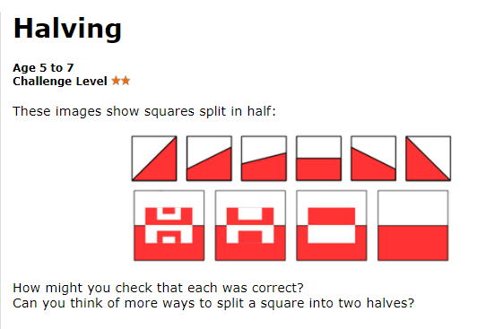
Activities…
1 star – identify ½ or ¼ of different shapes by colouring the correct amount in. If you don’t have the colours then choose a pen and a pencil.
2 star – Work through the investigation, you have a copy of the squares already complete. Could you now try it with ¼?

Slide 7
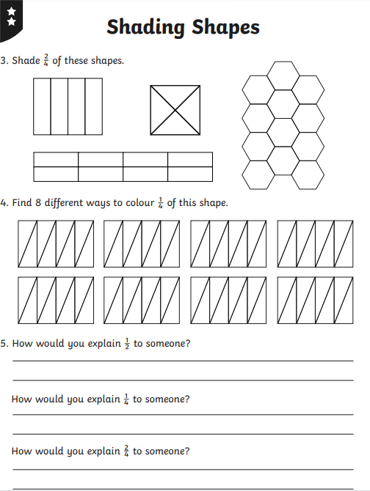
3 star- think carefully about how you would shade 2/4 and ¼ in different ways.
Then complete the questions at the bottom of the page.

Slide 8
Day 2 - fractions
Today, you will be looking at finding ½ of a quantity and number. Before you watch the video, have a go at the quiz to recap what you learnt yesterday.
https://classroom.thenational.academy/lessons/to-find-half-of-a-quantity-6nhpct?activity=intro_quiz&step=1
Then, watch as Miss Sidhu works with you to find ½ of quantities.
https://classroom.thenational.academy/lessons/to-find-half-of-a-quantity-6nhpct?activity=video&step=2&view=1

Slide 9
Day 1: Finding ¹/₂, ¹/₄ and ¹/₃ of amounts by sharing.
Look! I have 10 sweets.
I am feeling generous today and want to give Tom half.
Use 10 cubes to work this out.
How many will he get?

Slide 10
Day 1: Finding ¹/₂, ¹/₄ and ¹/₃ of amounts by sharing.
How did you work it out?
We could share 10 into 2 equal piles.
Or just know that
half of 10 is 5.
¹/₂ of 10 = 5

Slide 11
Now it’s time to decide how confident you are at finding ½ of a quantity.
There are 3 different activities to choose from to practice what you have learnt.
If you choose 3 star, there are 2 activities. Try to have a go at each of them.

Slide 12
Day 3 - fractions
Now we will look at finding ¼ of a quantity. Remember, to find ¼ we must half and then half again.
Before you watch the video, complete the quiz to show what you have learnt so far.
https://classroom.thenational.academy/lessons/to-find-one-quarter-of-a-quantity-6xjkad?activity=intro_quiz&step=1
Now, listen as Miss Sidhu explains how to find ¼ of a quantity.
https://classroom.thenational.academy/lessons/to-find-one-quarter-of-a-quantity-6xjkad?activity=video&step=2&view=1

Slide 13
Day 2: Find ¹/₂ and ¹/₄ of amounts by using number facts and sharing.
I have 16 pens here and we are allowed to keep a quarter.
How many pens is that?
Use 16 cubes to try to work this out.
Notes:
As children try to work out the answer, ask the following questions:
How many groups will we need to share the pens into? (4.)
How many of the groups will we keep? (1, as we are trying to work out ¹/₄, or 1 out of 4 equal groups.)

Slide 14
Day 2: Find ¹/₂ and ¹/₄ of amounts by using number facts and sharing.
What would half of 16 be?
Who can explain what they did?
To find ¹/₄ we just need to halve again, because a ¹/₄ is half of a ¹/₂!
Revisit the paper-folding exercise previously done: fold a piece of paper in half and then in half again then unfolding to reveal the 4 equal sections.

Slide 15
Day 2: Find ¹/₂ and ¹/₄ of amounts by using number facts and sharing.
Now I have 20 pens and we are allowed a ¹/₄. How many pens can we keep?
With your partner, use 20 cubes to try to work this out.

Slide 16
Day 2: Find ¹/₂ and ¹/₄ of amounts by using number facts and sharing.
What is ¹/₂ of 20
To find ¹/₄ we just need to half again.
So, what is
¹/₄ of 20?
Notes:
Children can now go on to do differentiated GROUP ACTIVITIES. You can find Hamilton’s group activities in this unit’s TEACHING AND GROUP ACTIVITIES download.
WT/ARE: Solve stationery fraction problems.
GD: Explore finding ¹/₂s and ¹/₄s of various numbers.
To finish the lesson, or to continue practising halving using number facts at another time, you might like to play the ‘dart board challenge’ at https://www.topmarks.co.uk/Flash.aspx?f=dartboarddoublesandhalves.

Slide 17
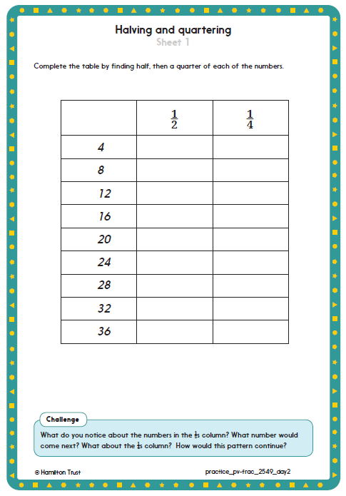
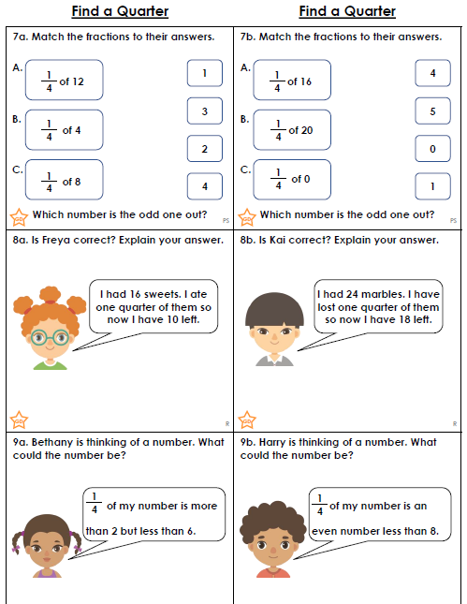

Slide 18
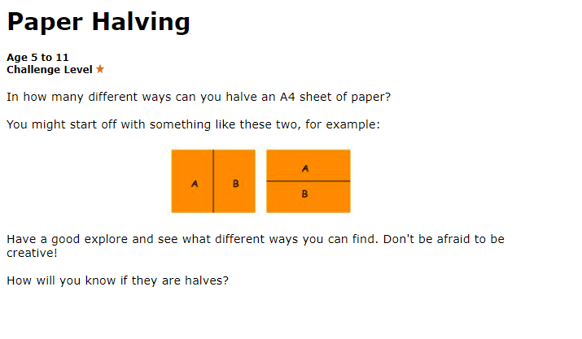
Day 4 – Whole class investigation…
Have a go at the following investigation.
Send in pictures to the school email address or onto our Purple Mash blog.
Tell me about your halves. How do you know this is a half? Can you find some other ways of halving the paper?

Slide 19
Day 5 – Mental Maths
You have been given a mental maths paper to complete. Try to read each question carefully and write your answer in the box. These should be quick questions for you to answer.
Remember that you can use paper to do any working out that you need to.
Once you have completed your paper, ask an adult to help you mark it.
Good luck! ☺

Slide 20
