Slide 1
Year 2 – Home Learning Reading – Spring 2 – Week 1

Slide 2
Day 1 – Reading for pleasure
Today you will listen to the audio book ‘Worst Mission Ever’ read by Gregg Lowe.
While you are listening to the audio book, think carefully about what you like about the story, what could be better and how you would end the story if you were the writer.
https://www.harpercollinschildrensbooks.co.uk/listen-for-free/
Why do you think they are off an adventure?
Who do you think Boris is?
What might happen to make it the ‘worst mission ever’?

Slide 3
Day 2 – Predictions
Today you will be using a video to discuss what ‘prediction’ means.
The girl will give you examples of how you can ‘predict’ what might happen in a story.
https://www.youtube.com/watch?v=Q2840Zr96Gk
Once you have watched the video, have a go at using the text and questions to practice your own predictions.

Slide 4
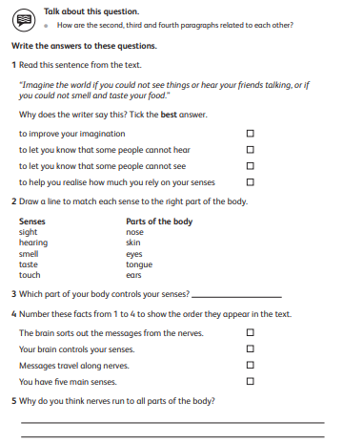
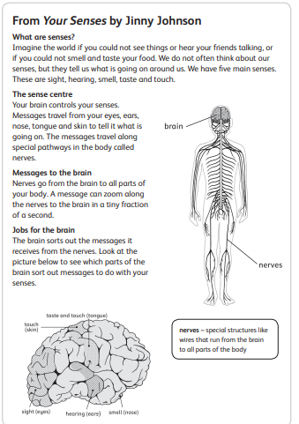
Day 3 - Comprehension
A non-fiction text gives you information about a specific topic or thing. Today you will be given a comprehension text about senses.
Read the text carefully with an adult or older sibling.
Once you have read the text, think carefully about the answers to the questions.

Slide 5
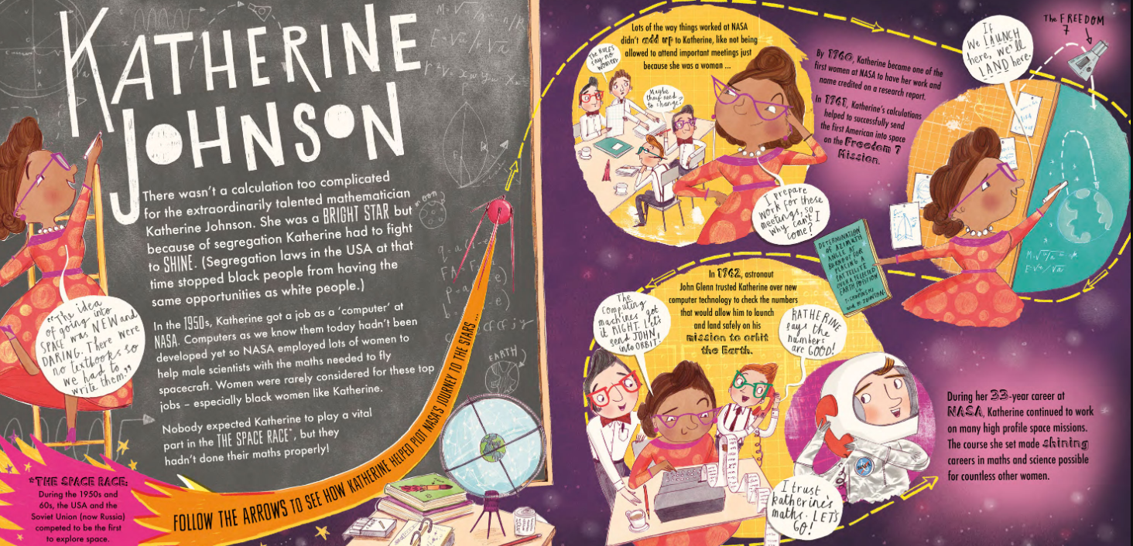
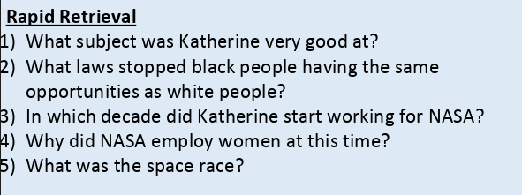
Day 4 - Retrieval
Today’s session will look at locating information from a text to answer questions. If you can, get an adult or an older sister or brother to help you read the text and the questions.
Our focus today is on wonderful women and specifically, NASA star Katherine Johnson.
Read the text carefully and answer the retrieval questions in full sentences.

Slide 6
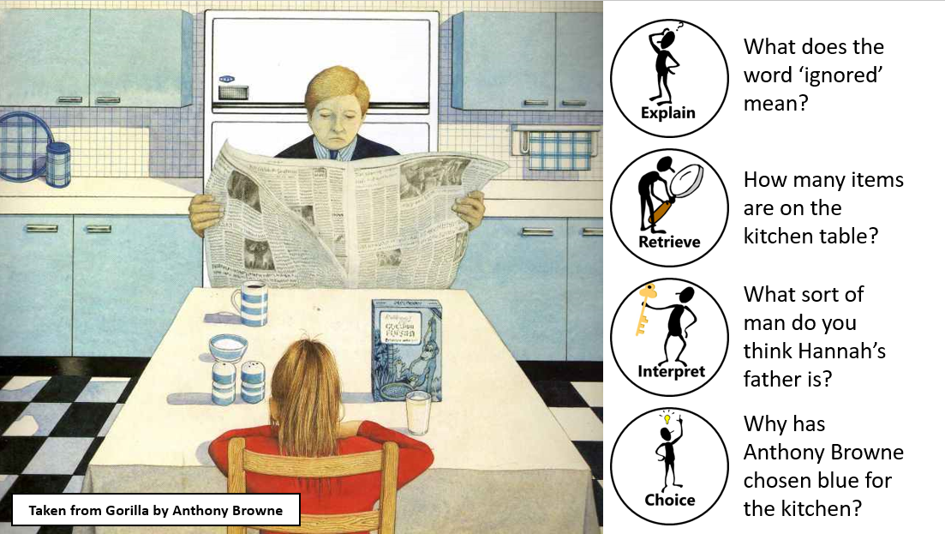
Day 5 - Reading with ERIC - Pictures

