Slide 1
Picture Reflections
Be intrigued by mystery

Slide 2
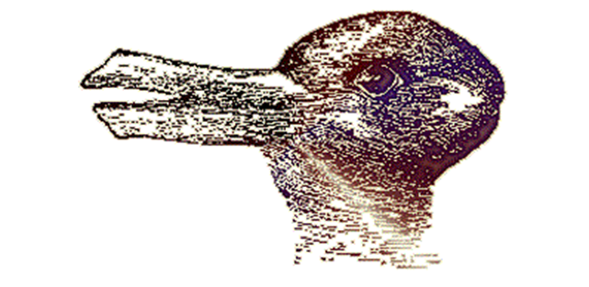

Slide 3
What do you see in the picture?
Can you make a prediction about what we are going to be talking about?
What questions do you have about this picture?
Come up with three questions.

Slide 4
Two pictures In one – optical illusions
Jesus often used parables to teach about God and His kingdom. In many ways these are like optical illusions. The stories can be seen as having two meanings – an earthly meaning and a spiritual meaning. There is also a mystery around parables too – not everyone understands them and it can take quite a bit of thinking to understand them fully.
What is an Optical Illusion?
There is often a mystery around optical illusions. With optical illusions you can often see two pictures in one and you need to really try hard to see the full picture.
Can you see a rabbit, a duck or both?

Slide 5
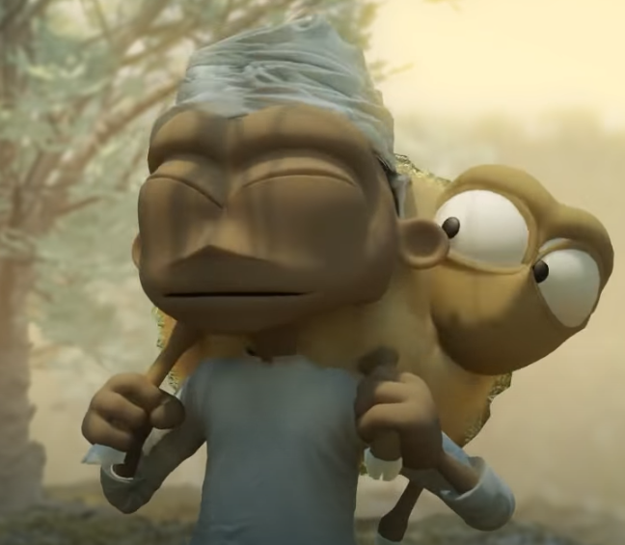
A story with a hidden meaning, A parable of the growing seeds (https://www.youtube.com/watch?v=tyWZeOlaRo4)
Then Jesus told them this story: “Suppose one of you has 100 sheep, but he loses 1 of them. Then he will leave the other 99 sheep alone and go out and look for the lost sheep. The man will keep on searching for the lost sheep until he finds it. And when he finds it, the man is very happy. He puts it on his shoulders and goes home. He calls to his friends and neighbours and says, ‘Be happy with me because I found my lost sheep!’ In the same way, I tell you there is much joy in heaven when 1 sinner changes his heart. There is more joy for that 1 sinner than there is for 99 good people who don’t need to change.

Slide 6
Intrigue and mysteries
What do you think this story means?
What do you think we can learn from this story?
What is your one key emotional response word?

Slide 7
Reflection PARABLES AND HIDDEN MEANINGS
People often asked Jesus questions about faith, God and the Kingdom of God – he used the ordinary things in life to explain these mysteries.
In this parable Jesus compares God’s love for all people to that of a farmer who puts his own life at risk to save a sheep.
Jesus taught that God loves all people, whatever their background and despite what they do or say. This was hard for some people to understand because they thought they were better than others and that God loved only them.

Slide 8
Mysteries and intrigues
When you think about the world, about God, about faith, about the universe – what questions do you have?
Take some time to share your questions and ideas.

Slide 9
British Values
Individual Liberty
We promote the freedom of choice and the right to respectfully express views and beliefs in a safe environment. With this comes a responsibility to make good choices that impact ourselves and others in a positive way.
This Photo by Unknown Author is licensed under CC BY-SA

