Slide 2
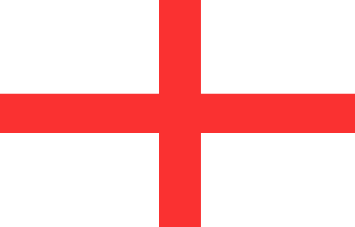
Geography
The United Kingdom of Great Britain and Northern Ireland (also referred to as the UK) is made up of four countries:
Scotland
Northern Ireland
England
Wales

Slide 3
Geography
The flag of the UK combines the crosses of three patron saints:
St Andrew: Scotland
St Patrick: Northern Ireland
St George: England
United Kingdom

Slide 4
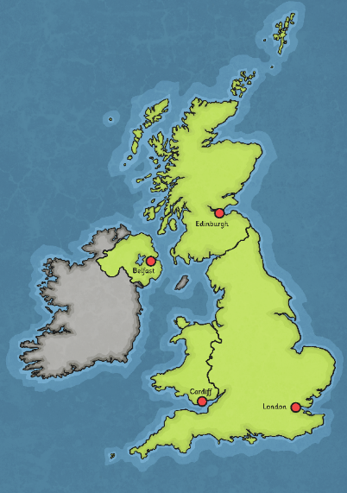
Geography
The capital city of the United Kingdom is London. In addition, Scotland, Wales and Northern Ireland each have their own capitals (the capital city of England is also London).
The capital city of Scotland is Edinburgh.
The capital city of Northern Ireland is Belfast.
The capital city of Wales is Cardiff.
The capital city of England is London.

Slide 5
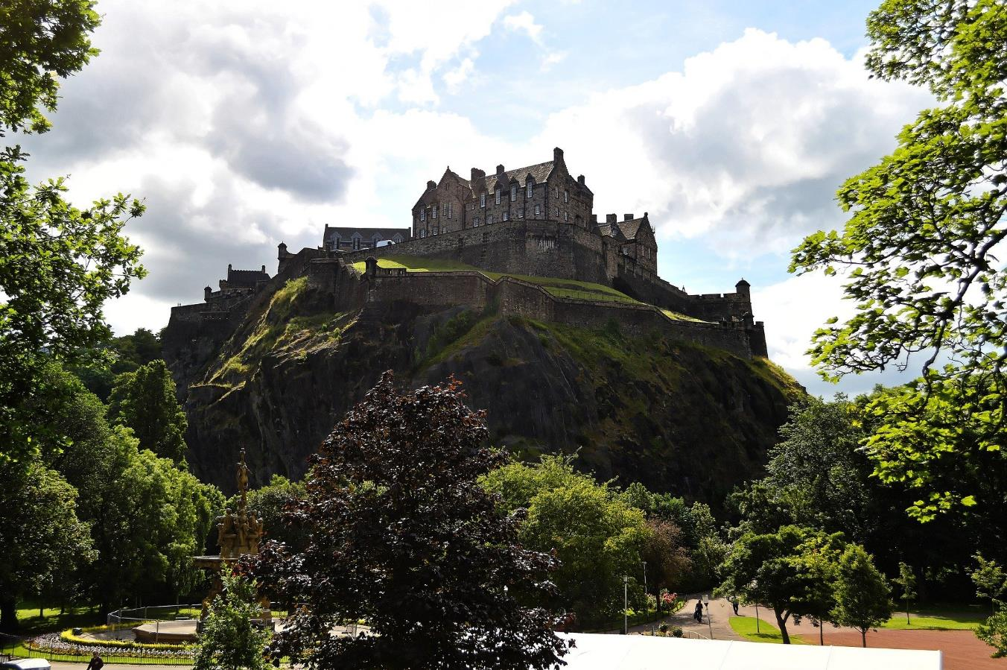
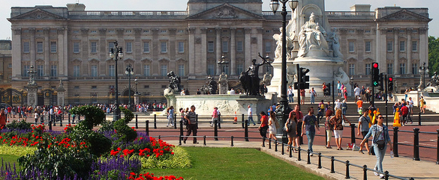
Edinburgh Castle, Scotland

Slide 6
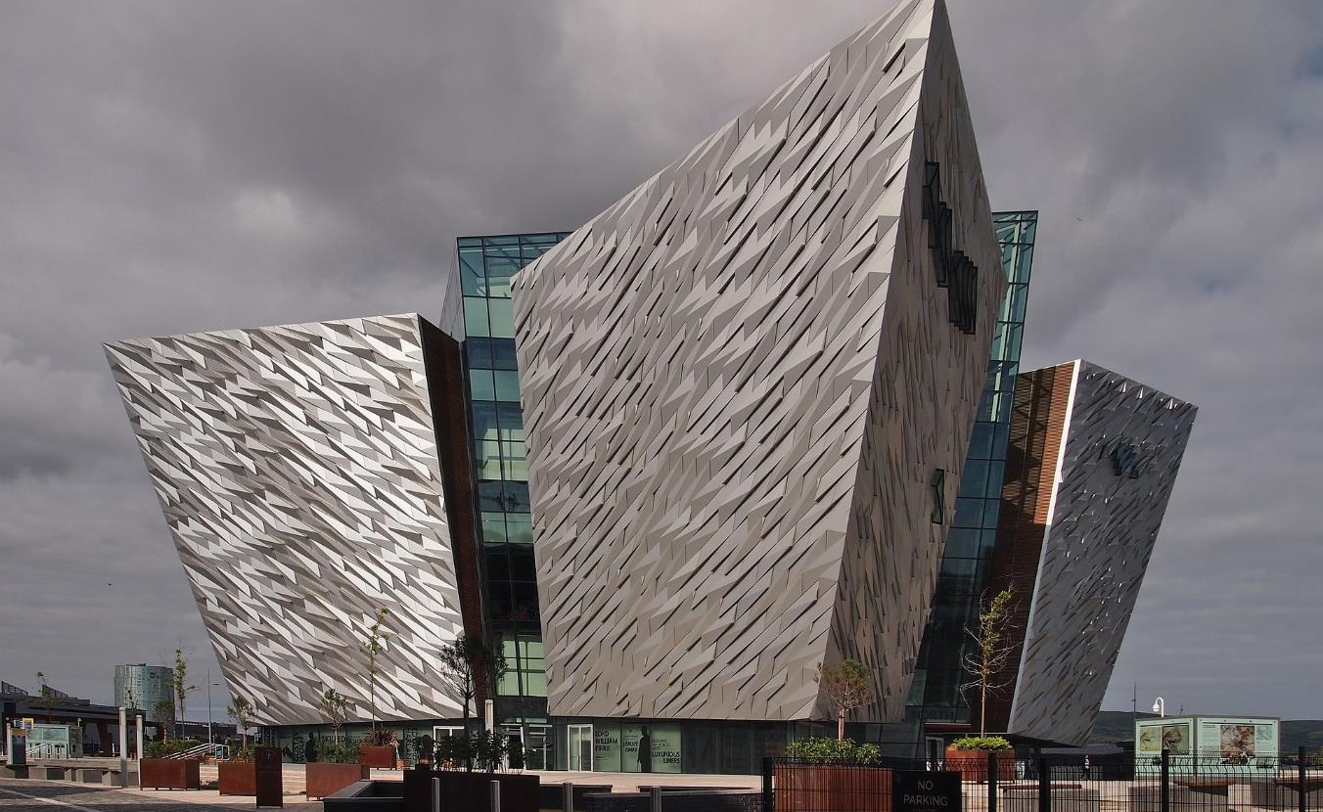
Titanic Museum, Northern Ireland

Slide 7
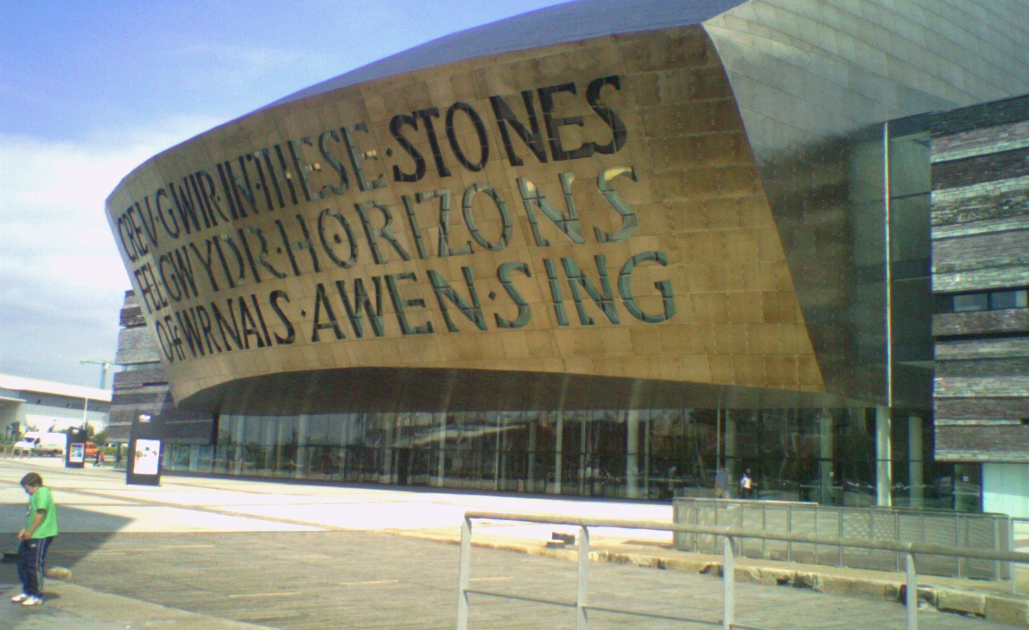
Wales Millennium Centre, Wales

Slide 8
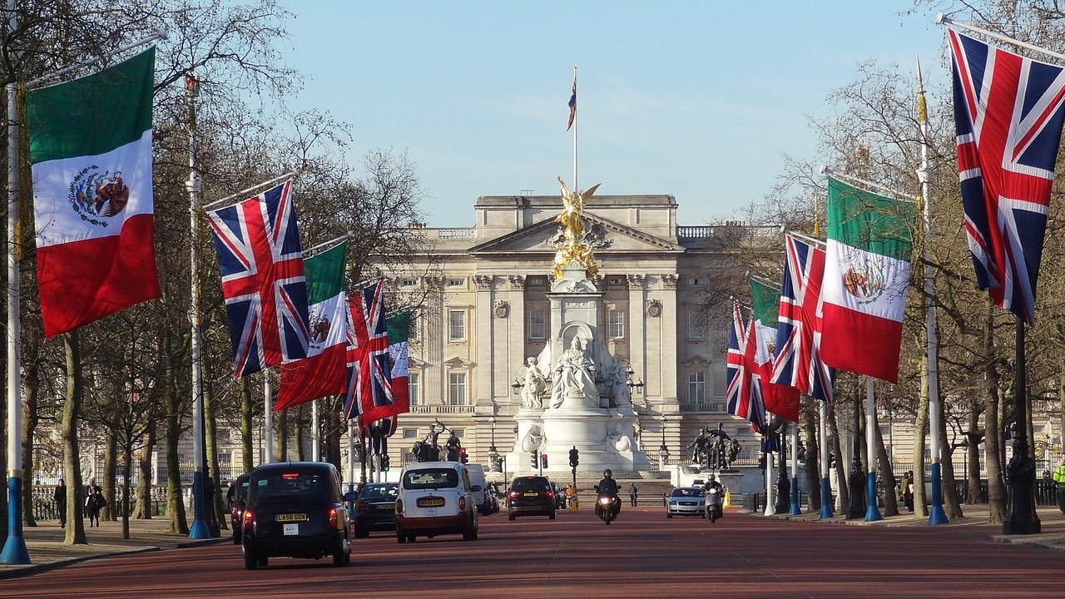
Buckingham Palace, England

Slide 9
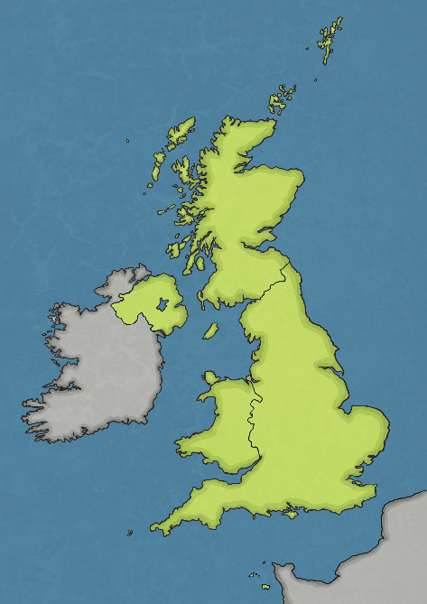
Surrounding Waters
Atlantic Ocean – The entire Atlantic Ocean covers one-fifth of the planet.
North Sea – The North Sea can be stormy and foggy, making it dangerous to cross.
Atlantic Ocean
The Channel – The Channel separates England and France. People have swum this route.
North Sea
Irish Sea
Celtic Sea – The Celtic Sea is located off the south coast of Ireland.
Celtic Sea
The
Channel
Irish Sea – The Irish Sea separates Ireland and Great Britain. Great Britain is made up of England, Scotland and Wales.
The Channel, the North Sea, the Celtic Sea and the Irish Sea are all part of the Atlantic Ocean.

Slide 10
Culture
Name of Country:
United Kingdom of Great Britain and Northern Ireland
Population:
68 million
Official Language:
English
Major religions:
Christianity
Islam
Hinduism
Sikhism
Judaism
Buddhism

Slide 11
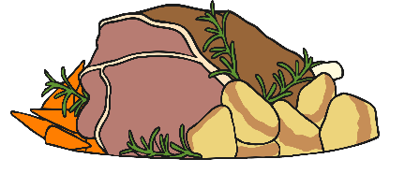
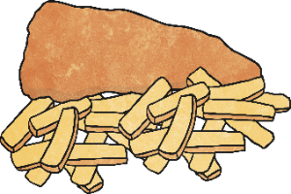
Food
Traditional British food is often based around simple, local ingredients. However, the UK’s rich cultural heritage has influenced food to create a wide range of dishes and flavours. Some common British dishes include:
roast beef and yorkshire pudding
chicken tikka masala
fish and chips
full English breakfast

Slide 12
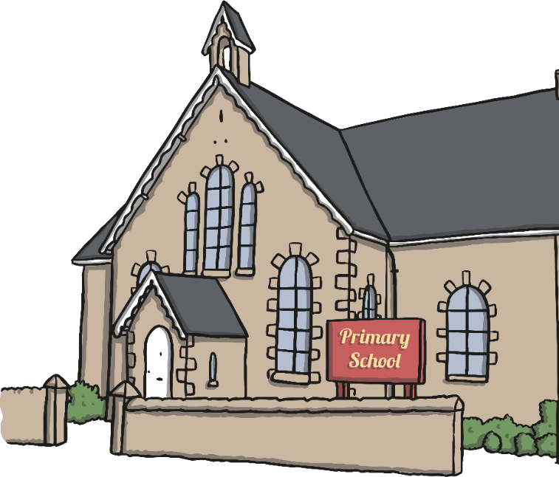
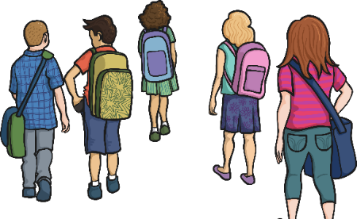
School
Each of the countries in the UK have their own school systems.
Education usually begins at the age of four or five.
There are three main stages of education:
primary;
secondary;
tertiary (including college, sixth-form and university).
State schools are free to attend, whereas private schools are paid for.

