Slide 1
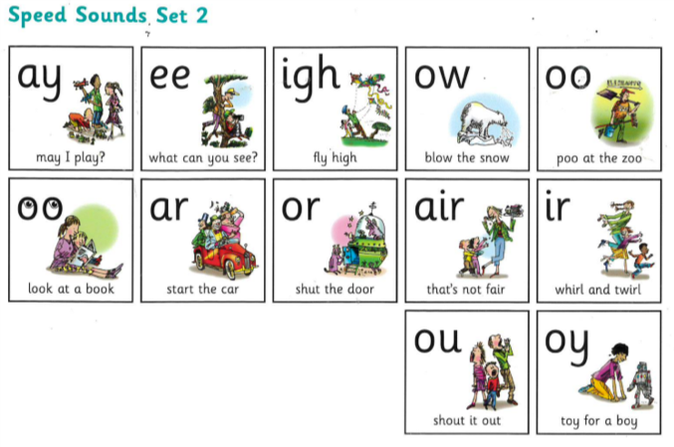
Recap Set 2 sounds
Say each diagraph below that you can remember!

Slide 2
Recap ‘oy’
Read these green words :
toy boy
joy enjoy

Slide 3
Read and underline the ‘oy’ sounds in these sentences
I can jump for joy.
The boy plays with his toys.

Slide 4
Can you write a sentence using the ‘oy’ sound?
_____________________________________________
_____________________________________________

