Slide 1
Year 2 – Home Learning Maths – Spring 2 – Week 2
Fractions

Slide 2
Day 1 – ¾
Today, you will practice finding 3/4 . You have learnt how to find ¼ of a shape or an amount. Remember you will have 4 groups. The top number (numerator) tells you how many of those groups you need to count up.
e.g. ¾ of 20 = 15

Slide 3
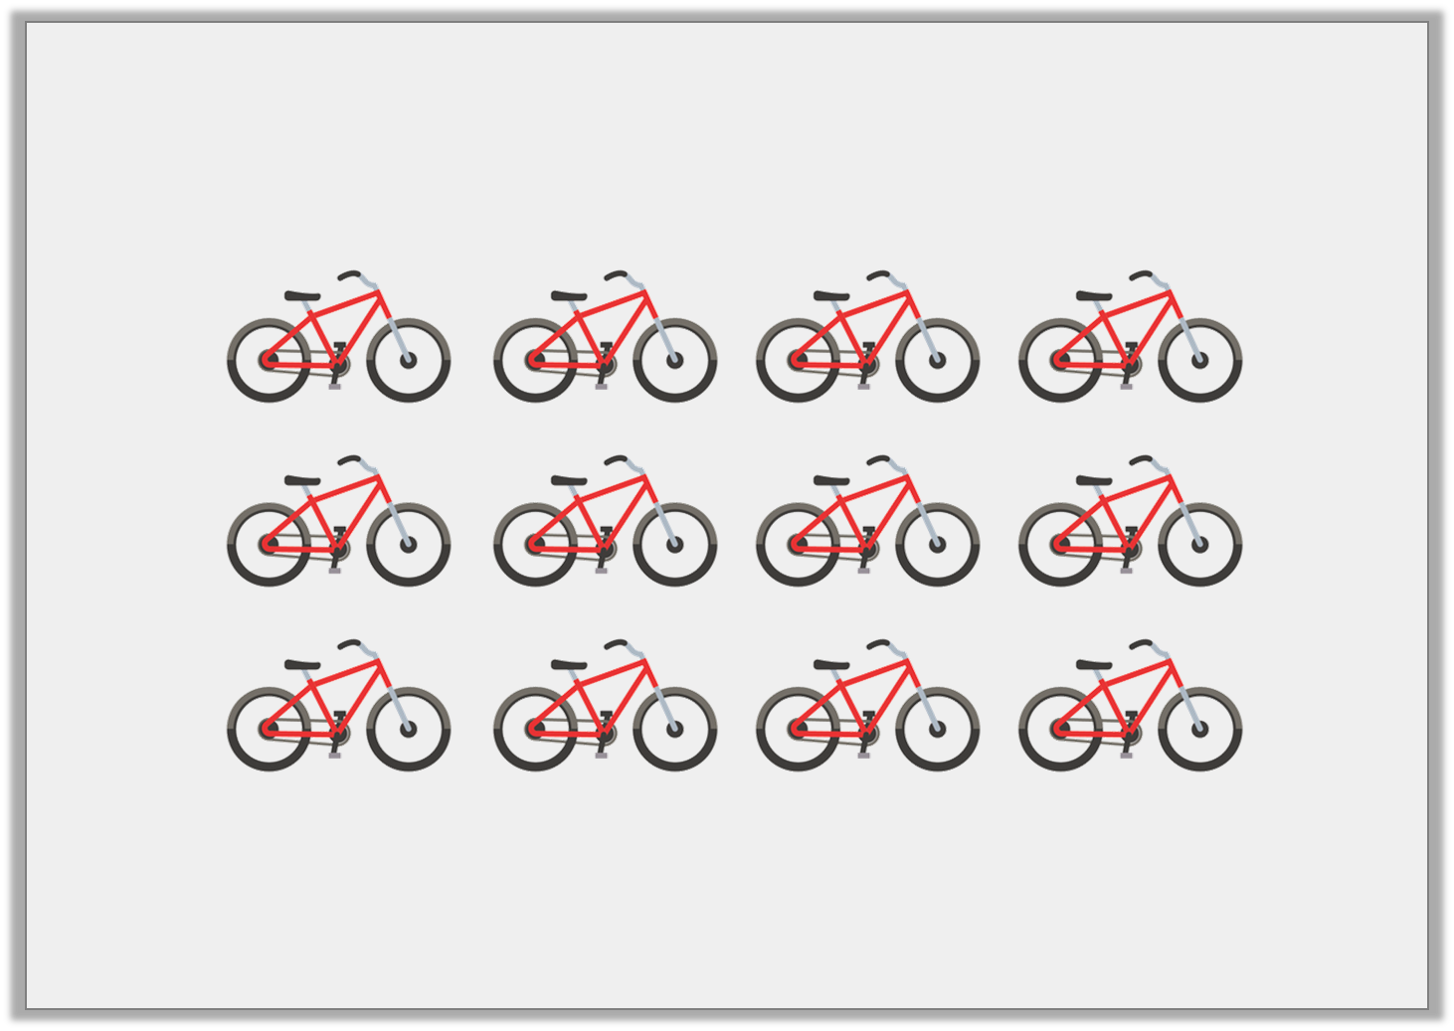
Varied Fluency 1
Circle three quarters of the bikes.
© Classroom Secrets Limited 2019

Slide 4
Varied Fluency 1
Circle three quarters of the bikes.
© Classroom Secrets Limited 2019

Slide 5
Varied Fluency 2
Shade the shape to show of 20.
3
4
© Classroom Secrets Limited 2019

Slide 6
Varied Fluency 2
Shade the shape to show of 20.
3
4
© Classroom Secrets Limited 2019

Slide 7
Varied Fluency 3
Complete the statements.
16
1 | of 16 is ____
4
16
2 | of 16 is ____
4
16
3 | of 16 is ____
4
© Classroom Secrets Limited 2019

Slide 8
Varied Fluency 3
Complete the statements.
16
●   
1 | of 16 is ____
4
4
16
●    | ●   
2 | of 16 is ____
4
8
16
●    | ●    | ●   
3 | of 16 is ____
4
12
© Classroom Secrets Limited 2019

Slide 9
Day 2 – word problems
Now that you have practiced finding ¼, ½ and ¾ of shapes and amounts – you must put your knowledge to the test.
You have been given a set of word problems. There are 3 different versions, you must think carefully about which level is best for you based on how you’ve got on with the fractions unit.

Slide 10
Day 3 – Purple Mash
You have been set 3 2Do’s on Purple Mash to test your fractions knowledge.
Try your best to work through them, remember to save your work before you exit.

Slide 11
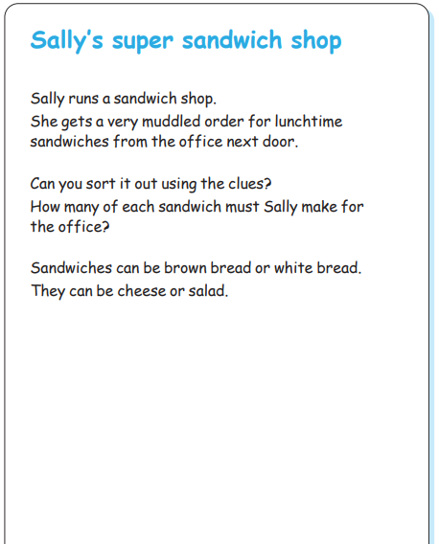
Day 4 – logic problem…
Have a go at the following logic problem.
Send in pictures to the school email address or onto our Purple Mash blog.

Slide 12
Day 5 – Mental Maths
You have been given a mental maths paper to complete. Try to read each question carefully and write your answer in the box. These should be quick questions for you to answer.
Remember that you can use paper to do any working out that you need to.
Once you have completed your paper, ask an adult to help you mark it.
Good luck! ☺

Slide 13
