Slide 1
Why did Guy Fawkes want to blow up the houses of Parliament?
Lesson 1 of 3
History
Miss Emms

Slide 2
Star Words
When did it happen?
Catholics and Protestants
The story of the Gunpowder Plot
End of Lesson Quiz

Slide 3
In this lesson, you will need:
Paper
Pencil
Brain
📓
✎
🧠

Slide 4
Star Words
⭐
⭐
King James
Guy Fawkes
⭐
The Gunpowder Plot
⭐
Catholics
⭐
religion
⭐
⭐
Protestants
⭐

Slide 5
When did it happen?

Slide 6
Timeline
The Gunpowder Plot
My granny was born
Today
Miss Emms was born

Slide 7
1605
Over 400 years ago

Slide 8
Pause the video to complete your task
When did Guy Fawkes try to blow up the houses of Parliament?
Resume once you’re finished

Slide 9
Catholics and Protestants

Slide 10
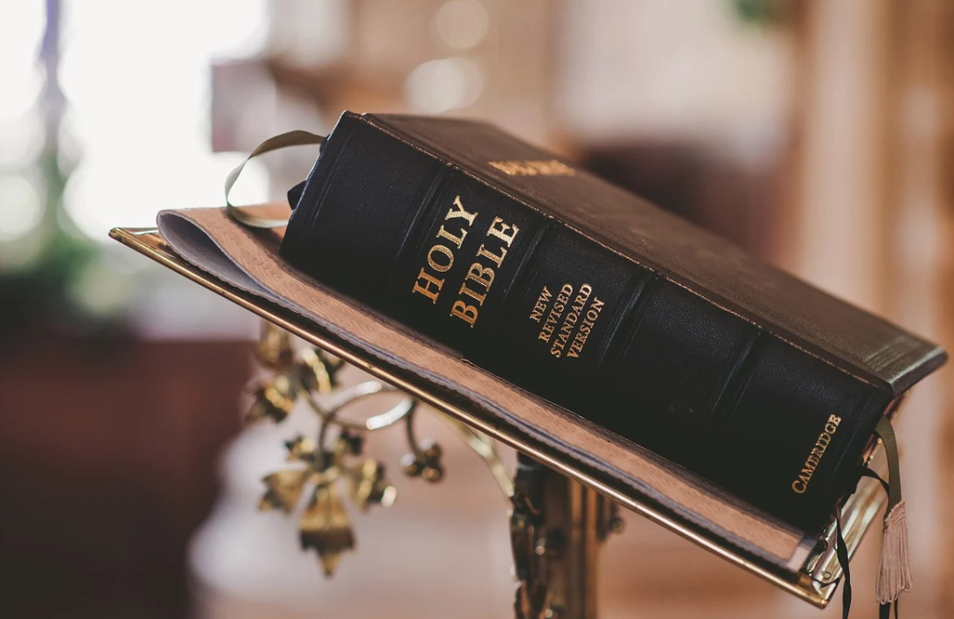
Religion
Credit: Pixabay

Slide 11
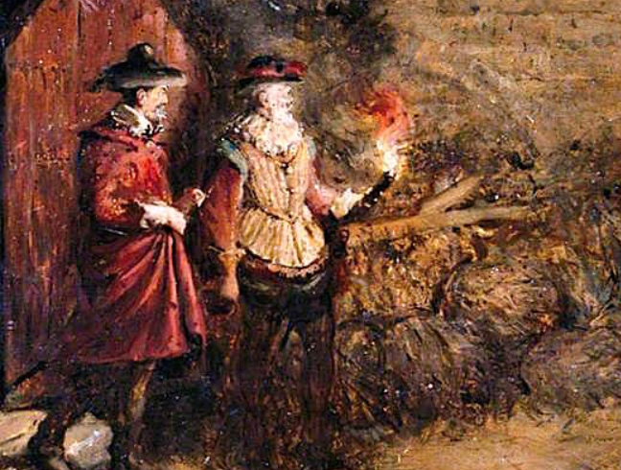
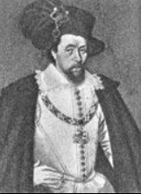
1605
Catholics
Protestants
Guy Fawkes
King James I
Credit: Guy Fawkes, Charles Gogin, Wikimedia Commons
Credit: King James I, Unknown Author, Wikimedia Commons

Slide 12
Catholics
Protestants
Catholics and Protestants shared lots of the same Christian beliefs.
They also disagreed on a number of things.

Slide 13
Catholics
Protestants
Guy Fawkes was a Catholic.
He and other Catholics were angry at laws that the King had made.
Protestants were in charge of the country.
King James I was a protestant.

Slide 14
Pause the video to complete your task
Catholic
Protestant
King James I was a ____________.
Guy Fawkes was a _____________.
The ____________ were in charge.
Resume once you’re finished

Slide 15
The story of the Gunpowder plot

Slide 16
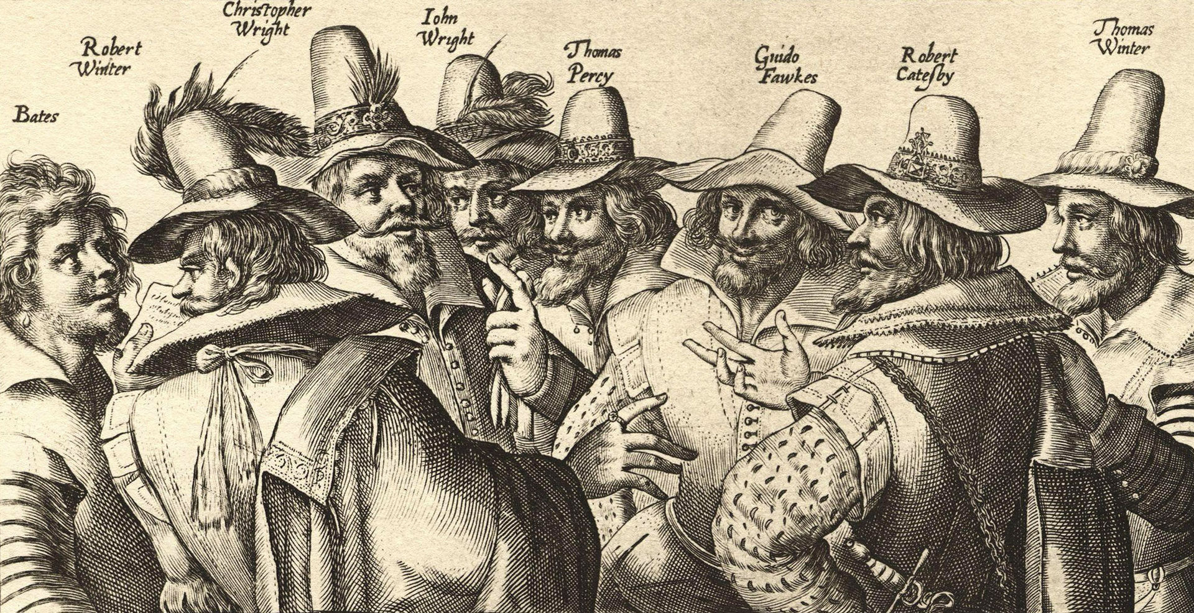
The conspirators
Credit: Gunpowder plot conspirators, Crispijn van de Passe the Elder, Wikimedia Commons

Slide 17
Mapping the story

Slide 18
Draw a table like this
1 | 2 | 3
4 | 5 | 6

Slide 19
Pause the video to complete your task
Why did Guy Fawkes want to blow up the houses of Parliament?
Tell your screen
Resume once you’re finished

Slide 20
End of lesson quiz

Slide 21
⭐
⭐
⭐
⭐
Great job today!
⭐
⭐
⭐

