Slide 1
To solve problems using repeated patterns
Maths
Miss Sidhu

Slide 2
Welcome to today’s lesson!
This lesson is about ‘Multiplication and Division’.
You will need:
paper and pencil
There are times when you will have to pause the video to have a go at some of the activities yourself.
Let’s get started!

Slide 3
Be prepared….here comes the lesson!
Agenda for the lesson
Here is the outline for this lesson. We are going to look at:
key vocabulary
finding ‘equal groups’ using 2-D shapes with equal numbers of sides
connecting repeated addition and 2-D shapes
investigating combinations of shapes
an independent task and answers
a final quiz to see what we learnt

Slide 4
Star Words!

Slide 5
To solve problems using repeated patterns
Brain teaser!
You may want to use 12 objects.

Slide 6
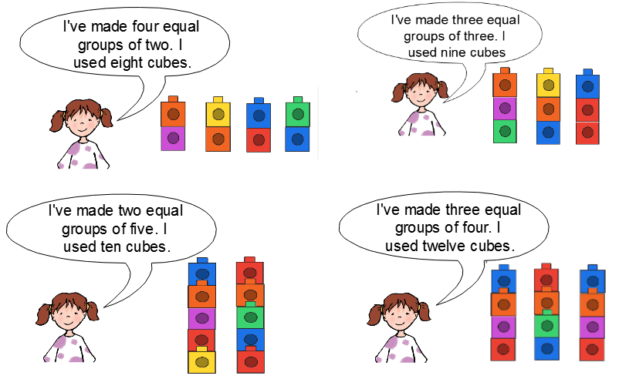
To solve problems using repeated patterns
Brain teaser!

Slide 7
To solve problems using repeated patterns

Slide 8
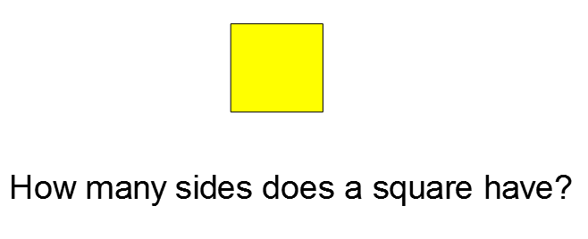
To solve problems using repeated patterns

Slide 9
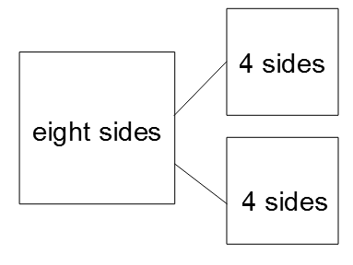
To solve problems using repeated patterns

Slide 10
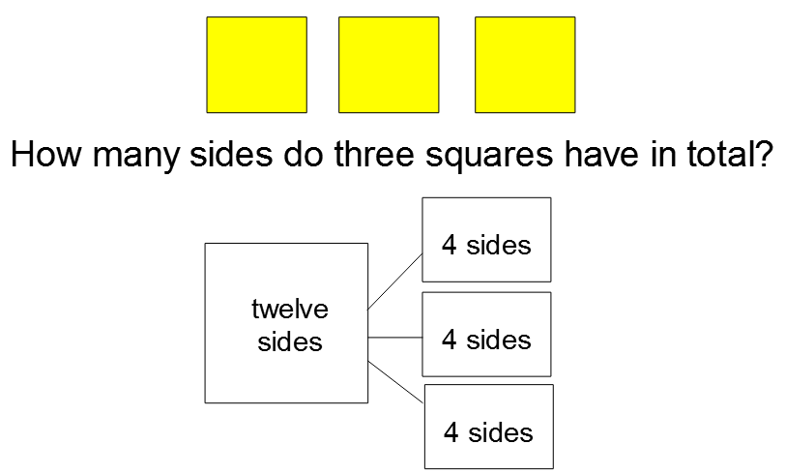
To solve problems using repeated patterns

Slide 11
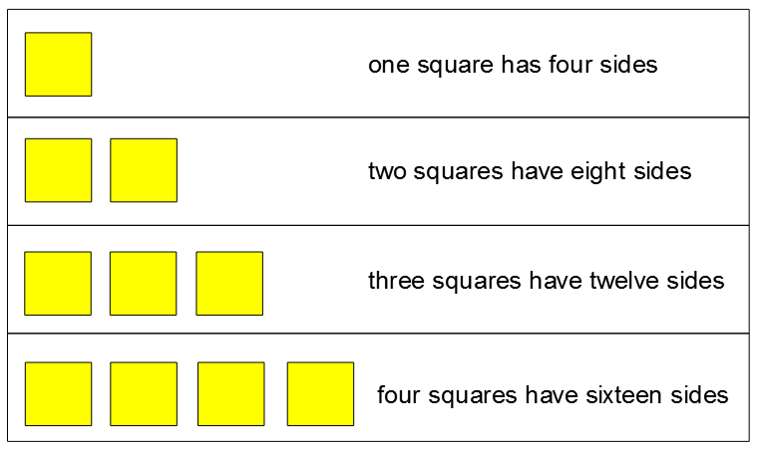
To solve problems using repeated patterns
It’s repeated addition!

Slide 12
To solve problems using repeated patterns

Slide 13
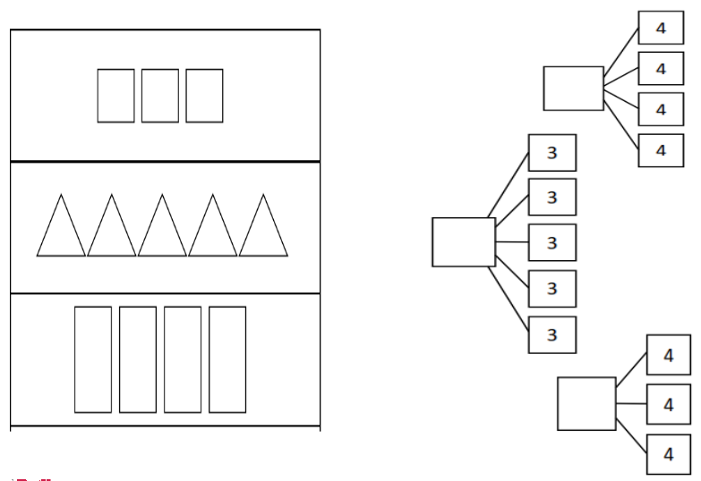
To solve problems using repeated patterns

Slide 14
To solve problems using repeated patterns
16
15
12

Slide 15
To solve problems using repeated patterns
Code One
(12)

Slide 16
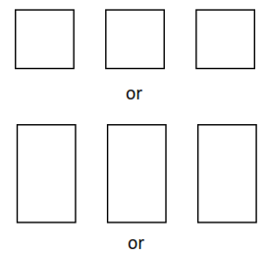
To solve problems using repeated patterns
Code One (12)

Slide 17
Independent Task 1
Code Two
(24)

Slide 18
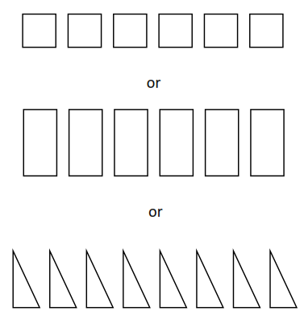
Independent Task 1 Answers
Code Two (24)

Slide 19
Challenge
Code Three
(15)
Clue: the shapes have 15 sides in total.
All the shapes are the same.

Slide 20
Challenge answers
Code Three (15)

Slide 21
Well done for all of your hard detective work! Hope you’ve had fun cracking the codes.
Don’t forgot to complete your end of lesson quiz.

