Slide 1
To explore arrays- part one
Maths
Miss Charlton, Mrs Bramble and Miss Sidhu

Slide 2
Welcome to today’s lesson!
This is lesson eight for the topic of ‘Multiplication and Division.’
You will need:
paper and pencil
There are times when you will have to pause the video to have a go at some of the activities yourself.
Let’s get started!

Slide 3
Be prepared….here comes the lesson!
Agenda for the lesson
Here is the outline for this lesson. We are going to look at:
key vocabulary
begin to learn what an array is
explore different arrays
an independent task and answers

Slide 4
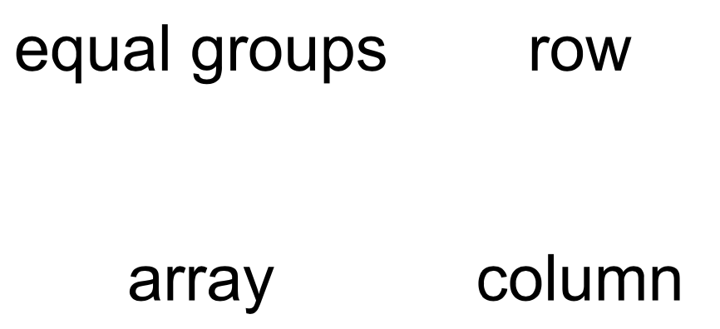
Star Words!

Slide 5
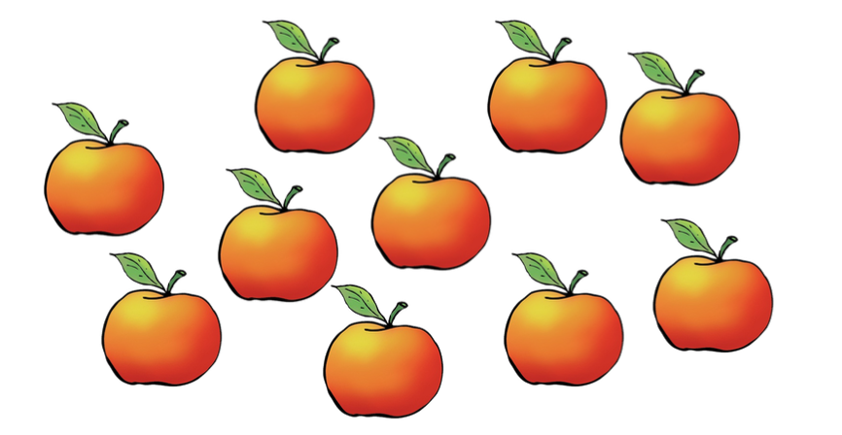

Slide 7
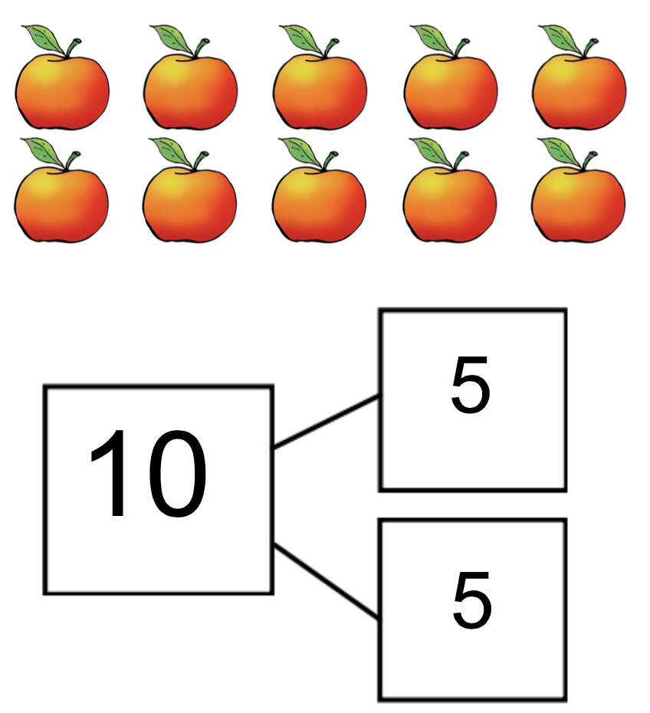

Slide 8
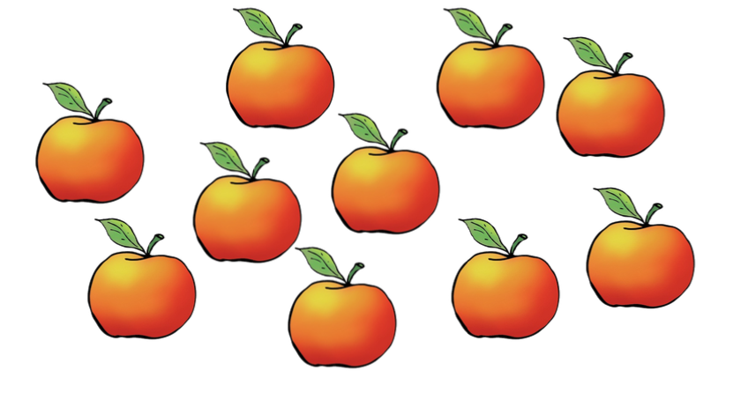

Slide 9
An array:
5 rows of 2.

Slide 11
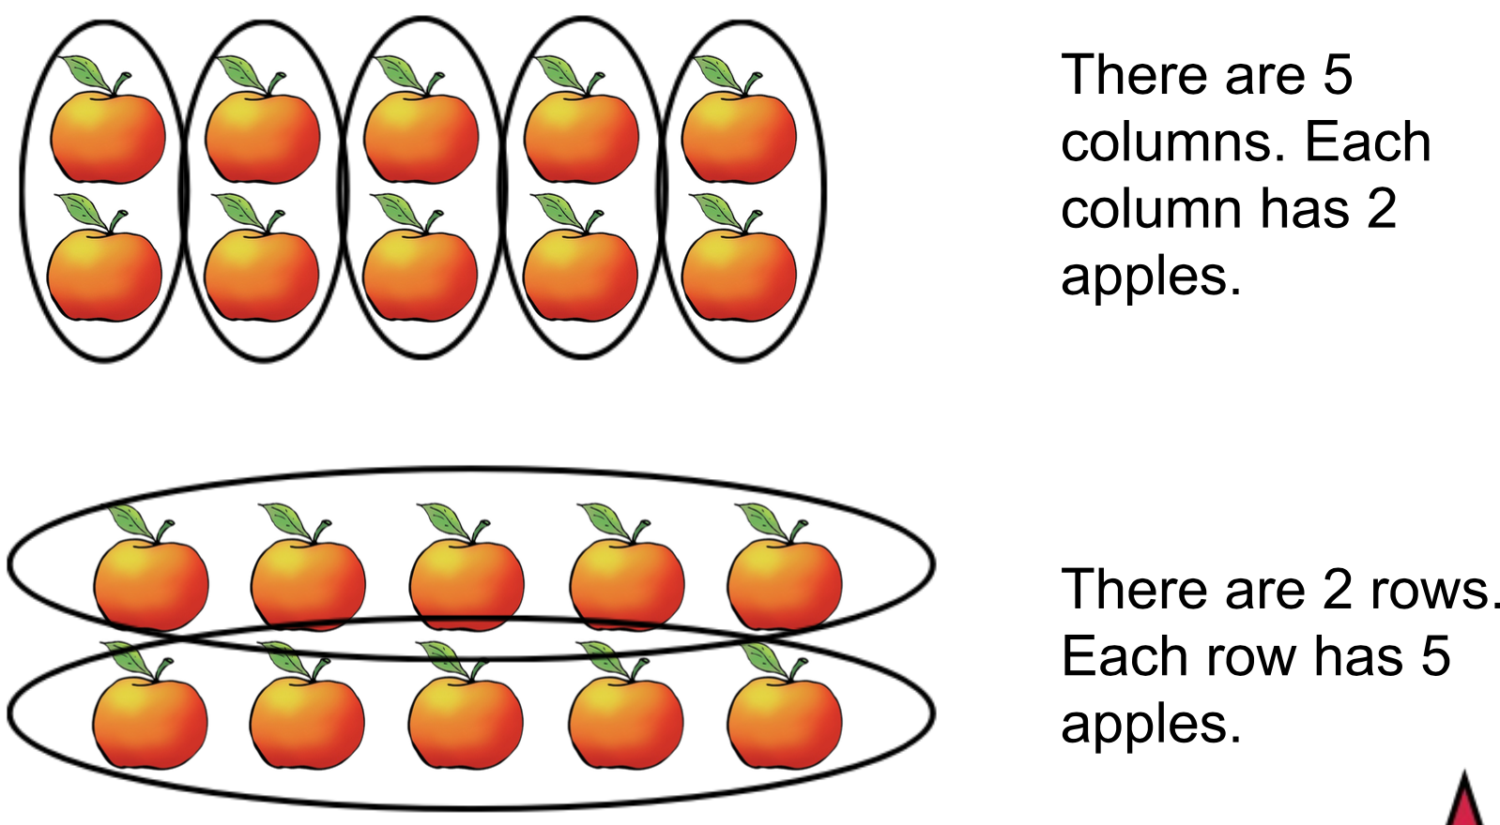

Slide 12
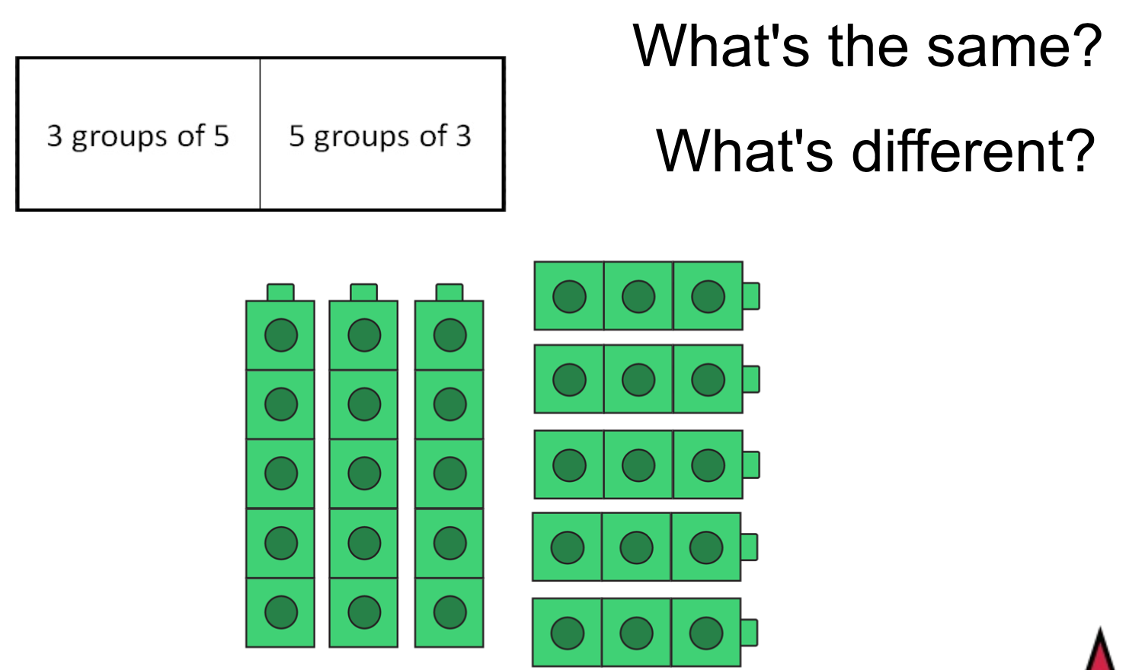

Slide 13
Independent Task
Challenge: what other arrays can you create?
Draw and then label them...

Slide 14
Answers

Slide 15
Answers

Slide 16
Hope you’ve had fun!
Well done for the learning today, you were fantastic mathematicians.
Bye!

