Slide 1
To develop understanding of halves and quarters of quantities
Maths
Miss Sidhu

Slide 2
Welcome to today’s lesson!
This is lesson ten for the topic of ‘Multiplication and Division’.
You will need:
paper and pencil
some objects
There are times when you will have to pause the video to have a go at some of the activities yourself.
Let’s get started!

Slide 3
Be prepared….here comes the lesson!
Agenda for the lesson
Here is the outline for this lesson. We are going to look at:
key vocabulary
exploring halves and quarters
understanding halves and quarters of quantities
an independent task and answers
a final quiz to see what we learnt

Slide 4
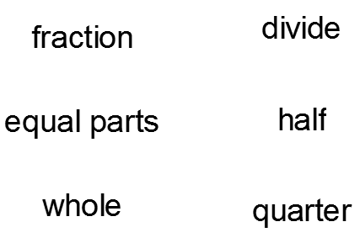
Star Words!

Slide 5
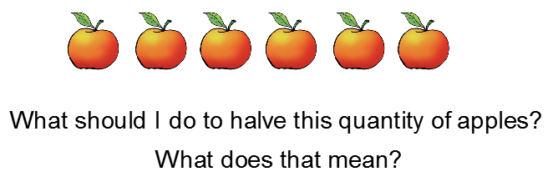
LO: To develop understanding of halves and quarters of quantities

Slide 6
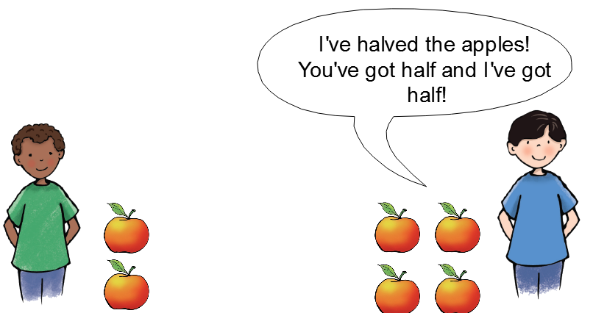
LO: To develop understanding of halves and quarters of quantities

Slide 7
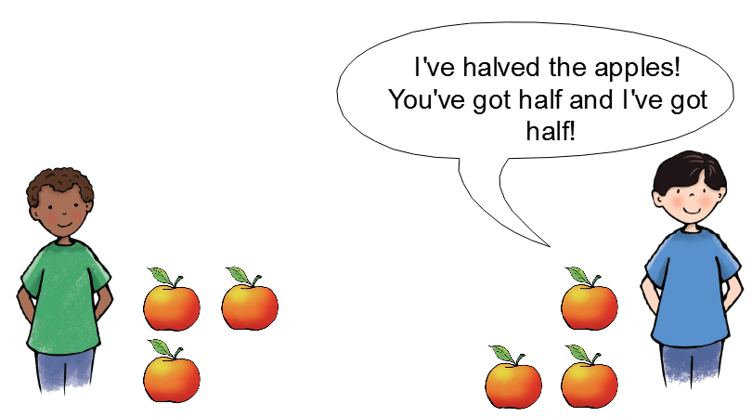
LO: To develop understanding of halves and quarters of quantities

Slide 8
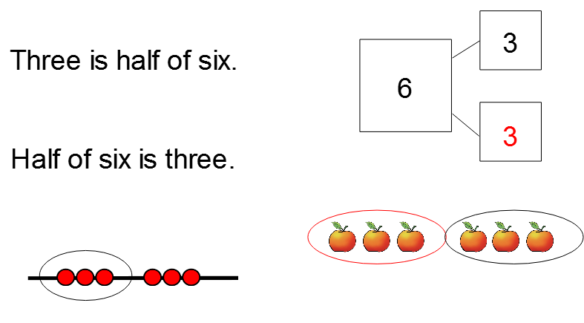
LO: To develop understanding of halves and quarters of quantities

Slide 9
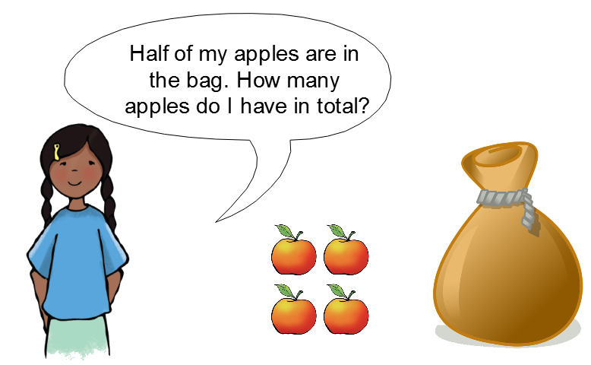
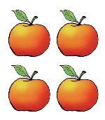
LO: To develop understanding of halves and quarters of quantities

Slide 10
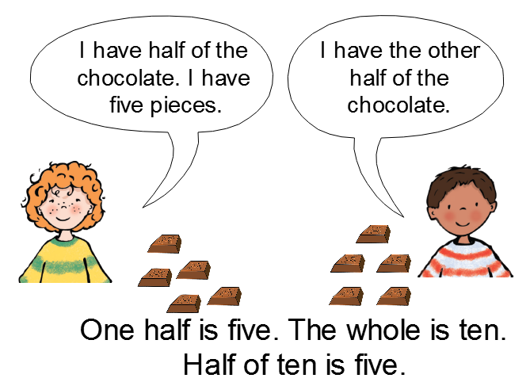
LO: To develop understanding of halves and quarters of quantities
True

Slide 11
LO: To develop understanding of halves and quarters of quantities

Slide 12
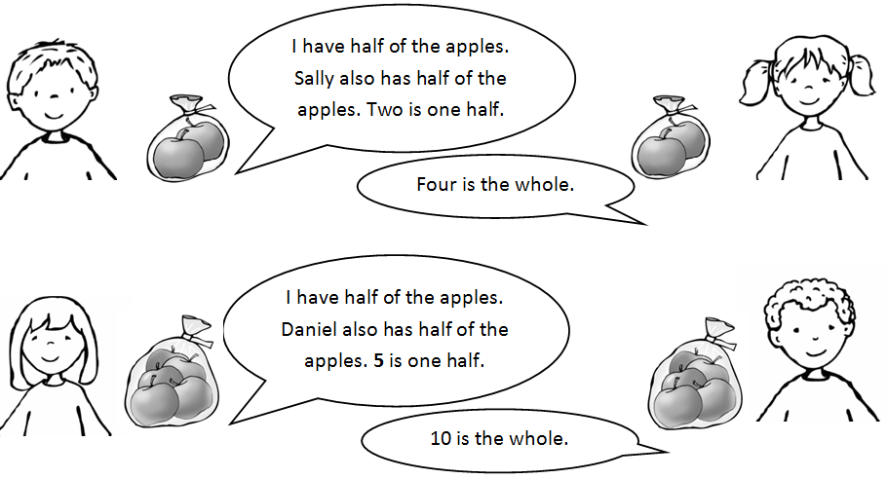
LO: To develop understanding of halves and quarters of quantities

Slide 13
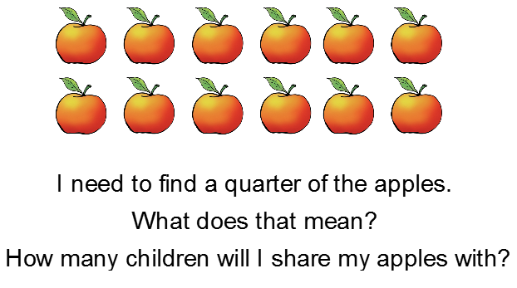
LO: To develop understanding of halves and quarters of quantities

Slide 14
LO: To develop understanding of halves and quarters of quantities

Slide 15
LO: To develop understanding of halves and quarters of quantities

Slide 16
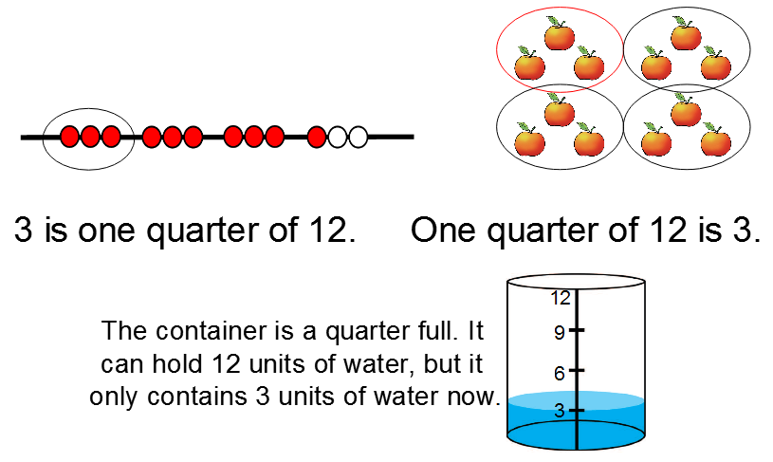
LO: To develop understanding of halves and quarters of quantities

Slide 17
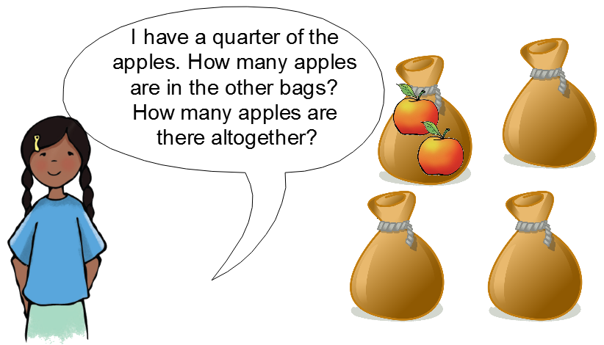
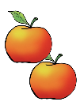
LO: To develop understanding of halves and quarters of quantities

Slide 18
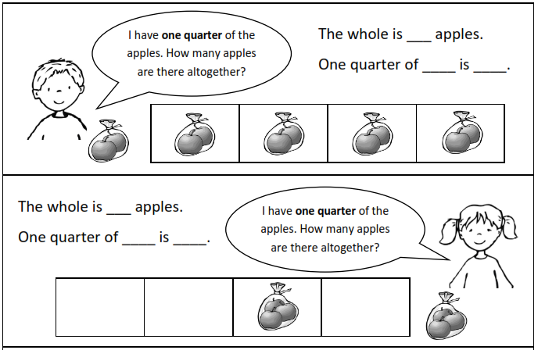
Independent Task

Slide 19
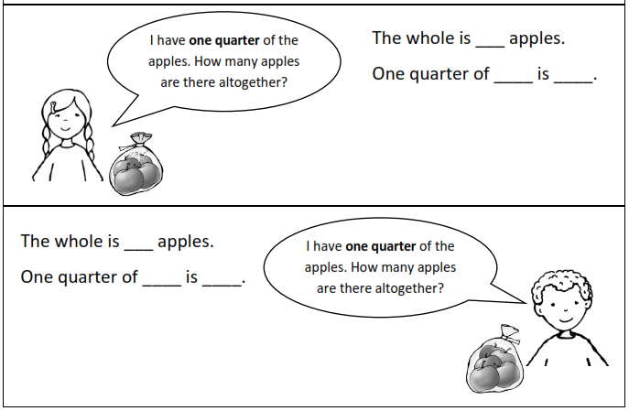
Challenge

Slide 20
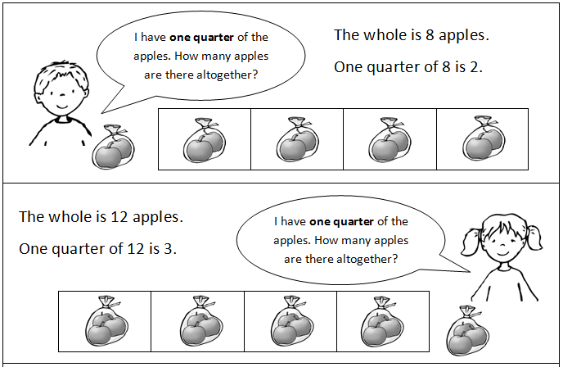
Answers

Slide 21
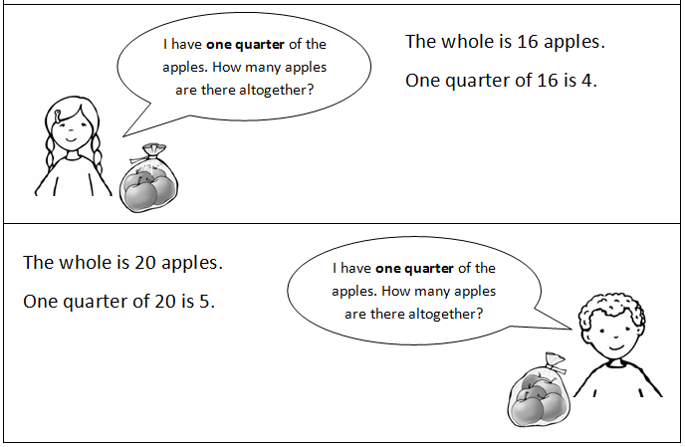
Challenge answers

Slide 22
Hope you’ve had fun finding the half and quarter quantities.
Now complete your end of lesson quiz!
Have a good day!

